Slide 1
CENTRE FOR ATMOSPHERIC RESEARCH, NASRDA:
Data & Research Resources
Babatunde Rabiu
Director & Chief Executive
Center for Atmospheric Research CAR,
National Space Research & Development Agency NASRDA,
Federal Ministry of Science &Technology, Anyigba, Nigeria.
Email: tunderabiu@carnasrda.com

Slide 2
outline
About CAR
Research Projects
Our Observational facilities
Space Research Laboratories
Research Output
2019 Targets

Slide 3

NASRDA AND ITS CENTRES
CENTRE FOR ATMOSPHERIC RESEARCH (CAR), ANYIGBA
GEOAPPS PLUS LTD,
ABUJA
CENTRE FOR GEODESY AND GEODYNAMICS (CGG),
TORO
CENTRE FOR SATELLITE TECHNOLOGY DEVELOPMENT (CSTD), ABUJA
CENTRE FOR BASIC SPACE SCIENCE (CBSS), NSUKKA
NATIONAL CENTRE
FOR REMOTE SENSING (NCRS), JOS
CENTRE FOR SPACE TRANSPORTATION AND PROPULSION (CSTP), EPE
CENTRE FOR SPACE SCIENCE AND TECHNOLOGY EDUCATION (CSSTE), ILE-IFE

Slide 4
Center for Atmospheric Research

Slide 5
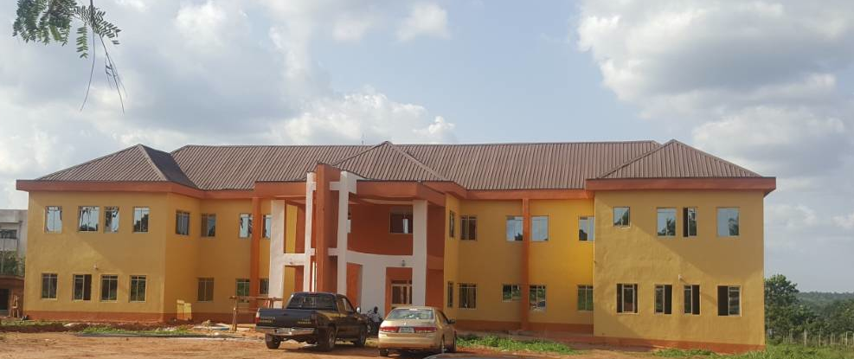
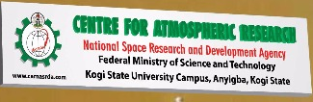
Centre for Atmospheric Research
• Established in January 2013
• Located at Anyigba, Kogi State, Nigeria
Office building and Engineering workshops commissioned on 23rd April 2018
14/09/2017
www.carnasrda.com
5

Slide 6
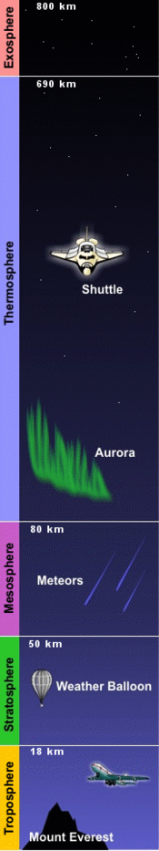
Center for Atmospheric Research
  A world class research and development center of NASRDA committed to research and capacity building in the atmospheric and related sciences
  dedicated to understanding the atmosphere—the air around us—and the interconnected processes that make up the Earth system, from the ocean floor through the ionosphere to the Sun's core
  provides research facilities and services for the atmospheric and Earth sciences community

Slide 7
Mission Statement
To understand the behavior of the entire spectrum of the Earth’s atmosphere and related physical, biological, and social systems;
To promote capacity development in relevant atmospheric sciences as a way of facilitating international competitiveness in research being conducted by atmospheric scientists; and
To disseminate atmospheric data and products to users towards socio-economic development of the Nation

Slide 8
Mandates
The Center for Atmospheric Research is to provide sound education, research and knowledge in
Lower atmosphere
Upper Atmosphere (Ionospheric/Magnetospheric physics),
Atmospheric chemistry and environmental science
Geomagnetism,
Environmental research
tropospheric and trans-ionospheric radio propagation research
Solar physics, Solar Terrestrial Interactions, Space Weather
Human space technology Initiative
Space debris

Slide 9
Focus Areas
Lower atmosphere: micrometeorology, BDL
Upper Atmosphere: Ionosphere/magnetosphere
Solar Terrestrial Physics: Solar physics, Solar Terrestrial Interactions and Space Weather (Sun and heliosphere)
Atmospheric chemistry & environmental research
Space Research Initiative: Human space technology Initiative – medical geography, Magneto-biology, space experiments as it affect agric, medicine, vaccine development etc, space debris

Slide 10
CAR is envisioned to operate in 3 modes
Observations
Research
Training/
capacity building/
outreach
dissemination of atmospheric data and products to users towards socio-economic development of the Nation

Slide 11
Research Projects of CAR
Space Weather Observation Network over Nigeria- SWONON
  Space Weather Observation Network over Africa- SWONOA
Tropospheric Data Acquisition Network – TRODAN
Atmospheric Chemistry and Environment Research – ACER
Microgravity and Human Space Technology - MHST
Atmospheric Research Software and Instrumentation Development - ARSID

Slide 12
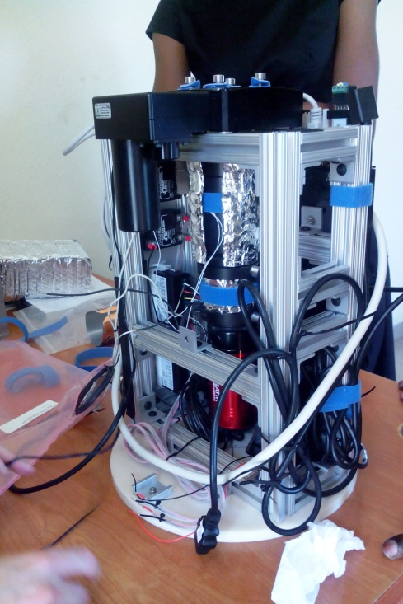
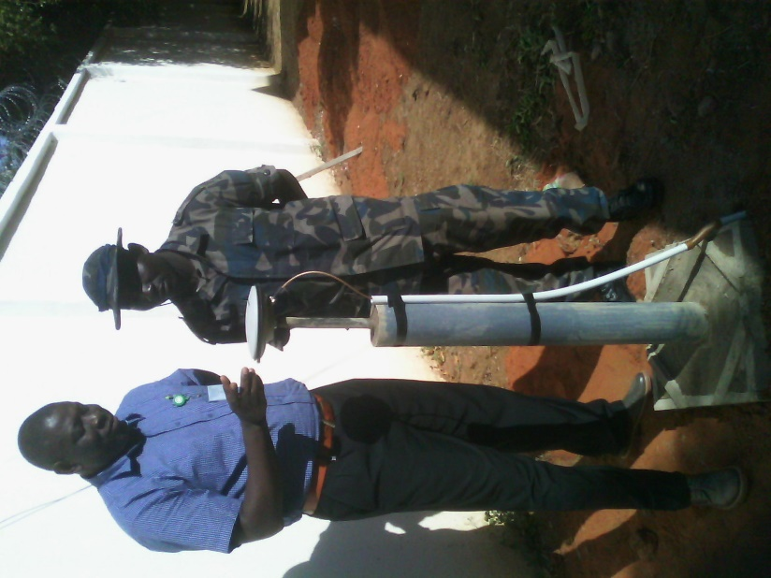
Space Weather Observation Network over Nigeria- SWONON
1
Monitoring space environment including satellite altitudes
Maintenance of existing stations
Networking of existing stations
1 Station per state
Data generation
Secondary products
Magnetometer
GPS SW monitor
Digisonde
FPI
All Sky Optical imager
Equipment
5-8 November 2013; Sokoto

Slide 13
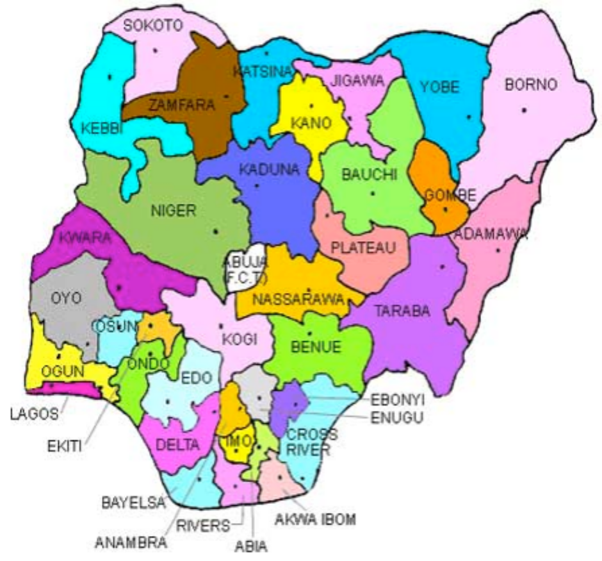
Space Weather Observation Network over Nigeria- SWONON
to monitor and nowcast space weather over Nigeria
To develop in-country expertise for implementation, operations, processing and analyses of space weather processes.
  Network of ground-based space observatories (facilities include magnetometers, digisondes, Ionospheric GNSS monitors, optical imagers)
Space Weather Observation Network over Africa- SWONOA

Slide 14
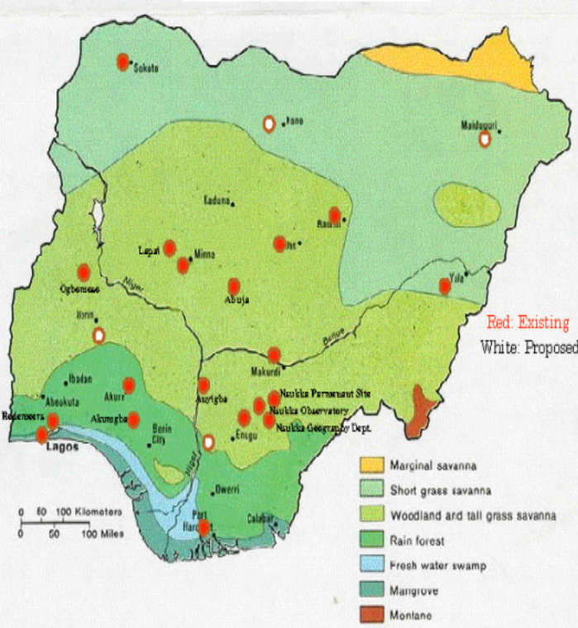
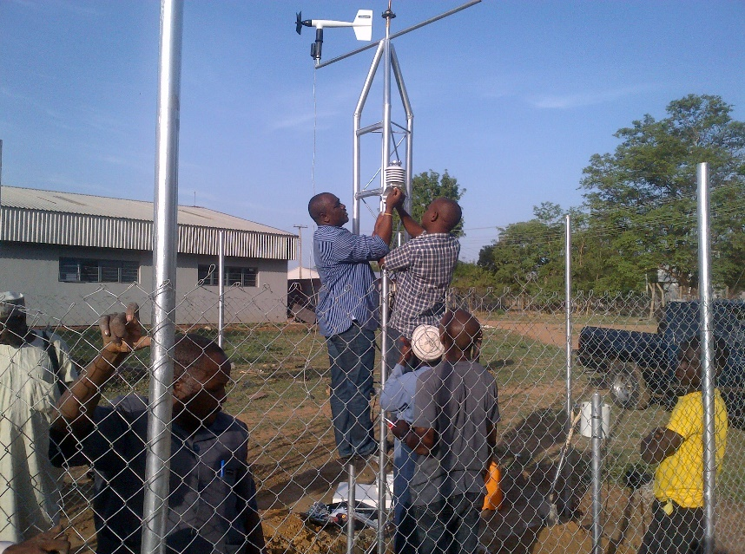
Tropospheric Data Acquisition Network TRODAN
22
From Earth surface to altitudes of about 30 km
Atmospheric parameters
Maintenance of existing 19 stations
Installation of new facilities
Research
Secondary products
Weather stations
Rain radar
Atmospheric sounders
15th to 17th May, 2013; Bauchi

Slide 15

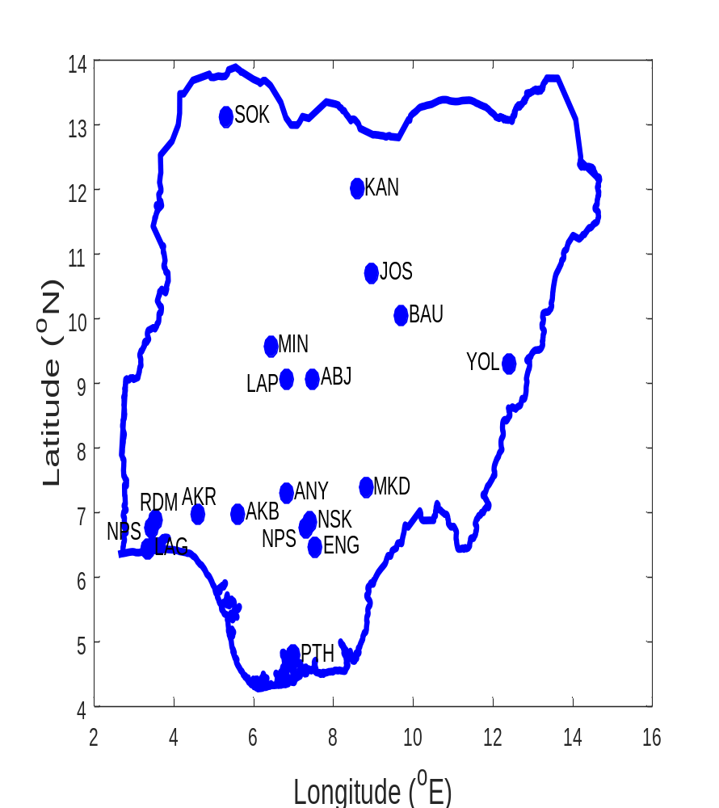
Stations Installation Dates and & Codes
UNN ... July 2007 NSK
UNIABUJA ...July2007 ABJ
UNILAG ...October 2007 LAG
UNIAGRIC MAKURDI ...October 2008 (2015) MAK
UNIJOS ...March 2008 JOS
FUT, MINNA ...February 2008 MIN
RSUST, PH ... February 2008 PHT
AAU, AKUNGBA... July 2008 AKB
CBSS PERM SITE ...July 2008 NPS
UTHMAN DAN FODIYO UNIV, SOKOTO ...May 2008 SOK
FUT, YOLA ...November 2009 YOL
FUT, AKURE ...May 2010 AKR
IBB UNIV, LAPAI ... May 2010 LAP
CAR AYINGBA ... July 2010 AYB
Redeemer’s Univ. 2010 RDM
ESUT. 2012 ENU
LAUTECH 2012 OGM
ATBU, BAUCHI April 2013 BAU
BUK, Kano May 2017 KAN
Geographical location of the stations on Nigeria Map

Slide 16
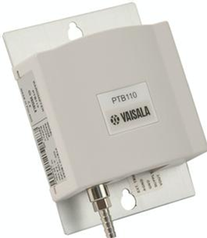
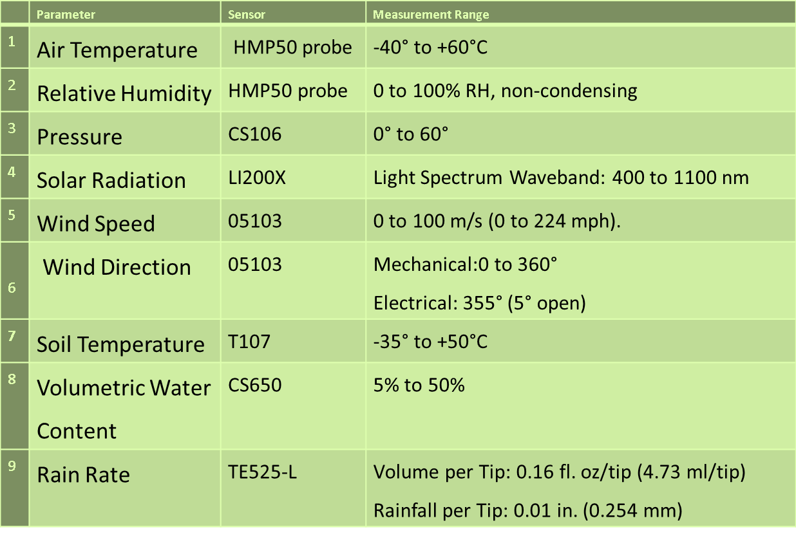

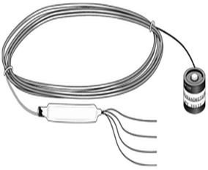
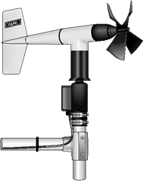
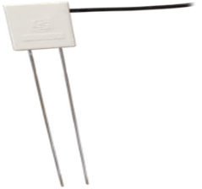
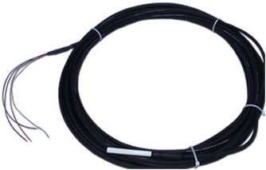
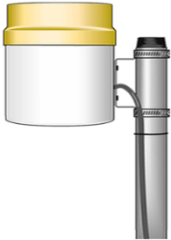
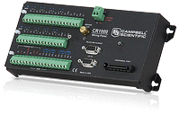
TRODAN Instrumentation and Sensors
HMP50 probe
CS106
LI200X
05103
Upgraded to include sensors for COx, NOx, O₃
CS650
T107
TE525-L
CR1000
14/09/2017
16
Notes:
NECOP Instrumentation
Each station is built up with Campbell Scientific instrument sensors, solar power system for uninterruptible power supply, measurement and control system and the data logging system.

Slide 17
8 new stations installed at
SERl, Abuja
SEERL, UNIBEN
Bowen University, Iwo
ABSU Uturu
ASWeRL, UNIOSUN, Osogbo
CARL, CAR, Anyigba
Rufus Giwa Poly, Owo
MCIU, Delta State
Atmospheric parameters & green house gases

Slide 18
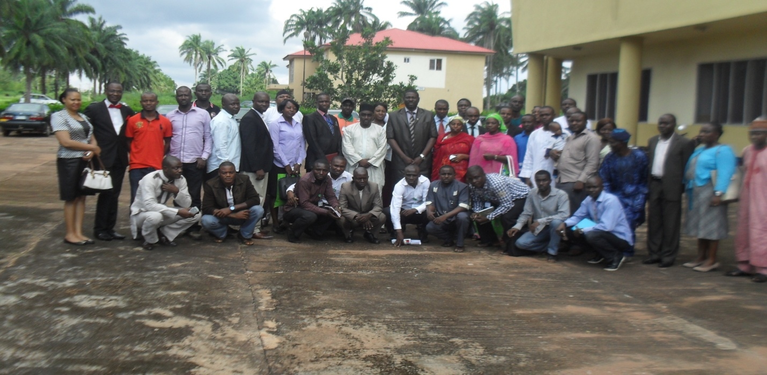
Microgravity &Human Space Technology - MHST
3
Acquisition of facilities for Microgravity experiments in the Laboratory
Training/Workshops
Food security
Vaccine/drugs development

Slide 19
Atmospheric Chemistry & Environment Research
– ACER
4
Environmental samples analysis for radioactivity
      Kogi & Delta States
Environmental gases monitoring
      Instruments from NCAR, USA
      Staff training on instrumentation in the USA
Atmospheric and water pollution studies
Air Quality Measurements
      Air Quality Research Lab @ UNILORIN
      Aerosol, O₃ etc….
Just acquired an Ozone monitor

Slide 20
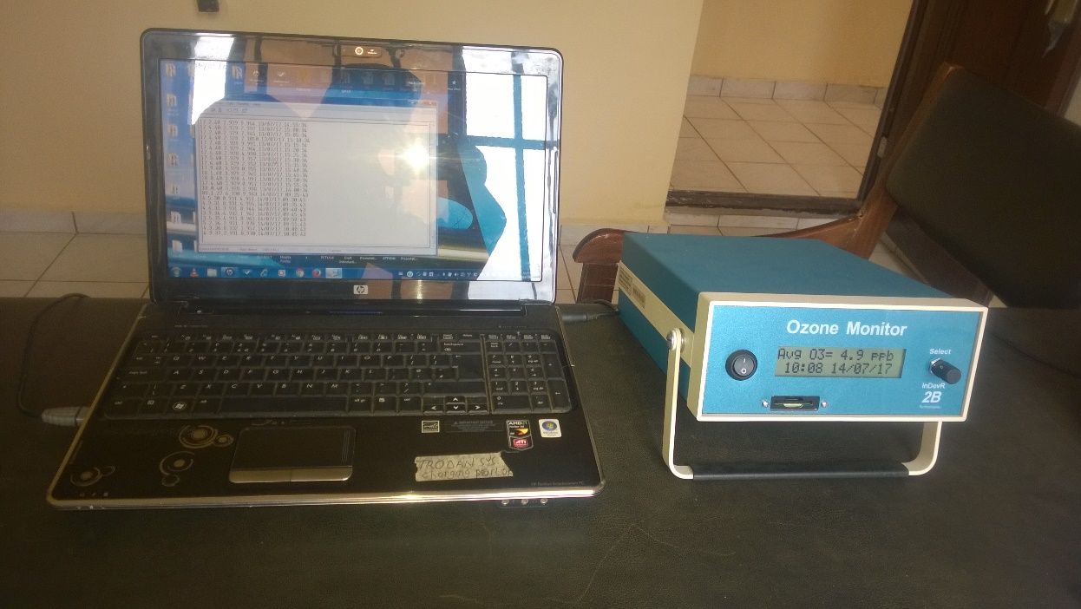
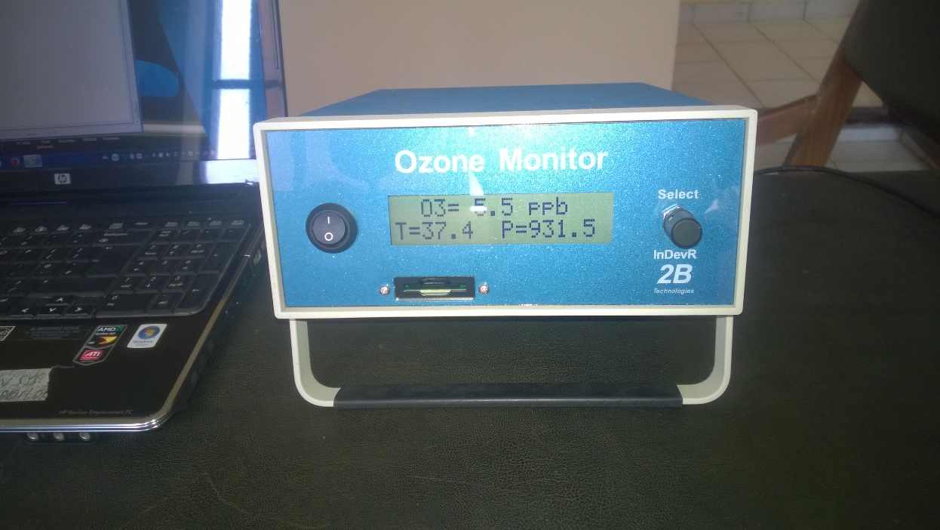
Just acquired an Ozone monitor
Ozone measurement at CAR

Slide 21
Atmospheric Research Software & Instrumentation Development - ARSID
5
Development of software for atmospheric research
Instrumentation
Real-time maps of atmospheric parameters over Nigeria
Real-time maps of environmental gases over Nigeria
Now-cast of space weather over Nigeria
6 locally developed
- magnetometers
- Automatic weather stations
- Air Quality monitors
awaiting deployment

Slide 22
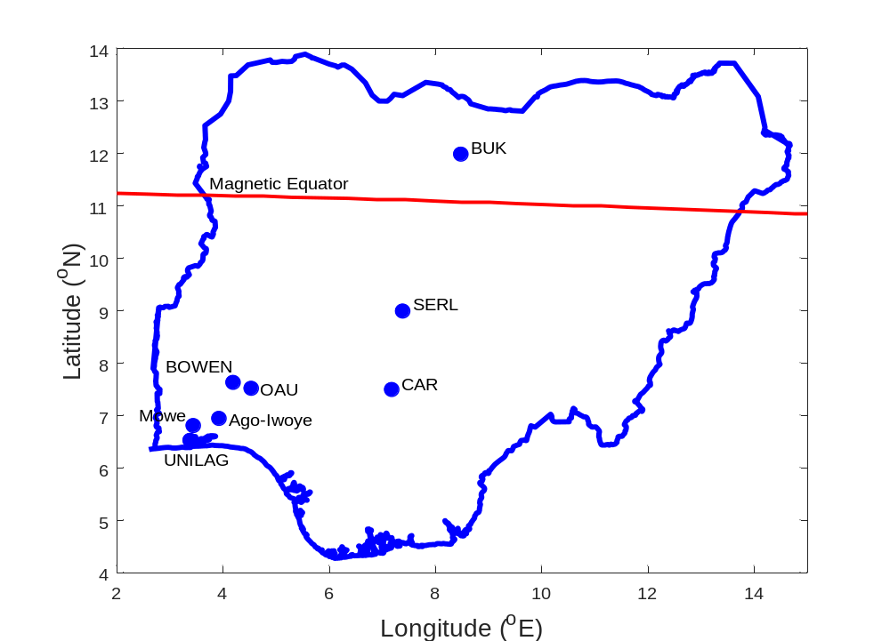
newly deployed 8 magnetometers to monitor space weather & Earth’s movement
Sensor
Indoor electronics

Slide 23
CAR: atmospheric & space weather monitoring facilities
27 weather stations under the TRODAN project
4 GPS stations for Space Weather monitoring
1 lightning monitor facility,
I all-sky Optical Imager,
4 magnetometers (1 AMBER, 3 MAGDAS)
8 magnetometers (SWONON)
I scintillation monitor,
1 Fabry Perot Interferometer,
I SOFIE, and
1 Ozone monitor.

Slide 24
TRODAN Instrumentation and Sensors
6 units locally developed Upgraded to include sensors for COx, NOx, O₃
24
Notes:
NECOP Instrumentation
Each station is built up with Campbell Scientific instrument sensors, solar power system for uninterruptible power supply, measurement and control system and the data logging system.

Slide 25
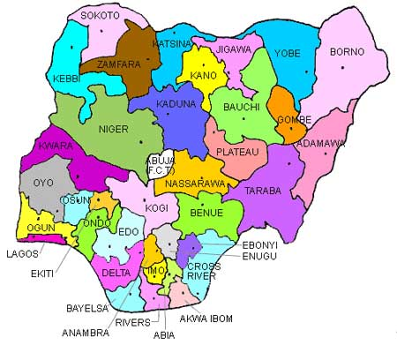
Experimental set up – our Vision
a permanent array of Space & atmospheric probing instruments :
Atmospheric sensors (AWS, Thunderstorm & Lightening monitors, Air Quality Monitoring Equipment etc)
GNSS stations
Magnetometers
etc
collocated at 72 observation points
2 in each state & FCT

Slide 26
Experimental set up
Extra equipment would be located at some specific locations:
    Optical Imager
    FPI
    Ionosonde
    Any other specialized probe

Slide 27
CAR Space Research Laboratories SRL: Functions
Shall host assorted world-class scientific equipment for monitoring space and earth environments
data from the equipment shall be collected, stored and made available for research purpose
shall serve as training hub for space science, technology & applications
Research laboratory for investigations relevant to our mandate
super observation points
host extra equipment

Slide 28
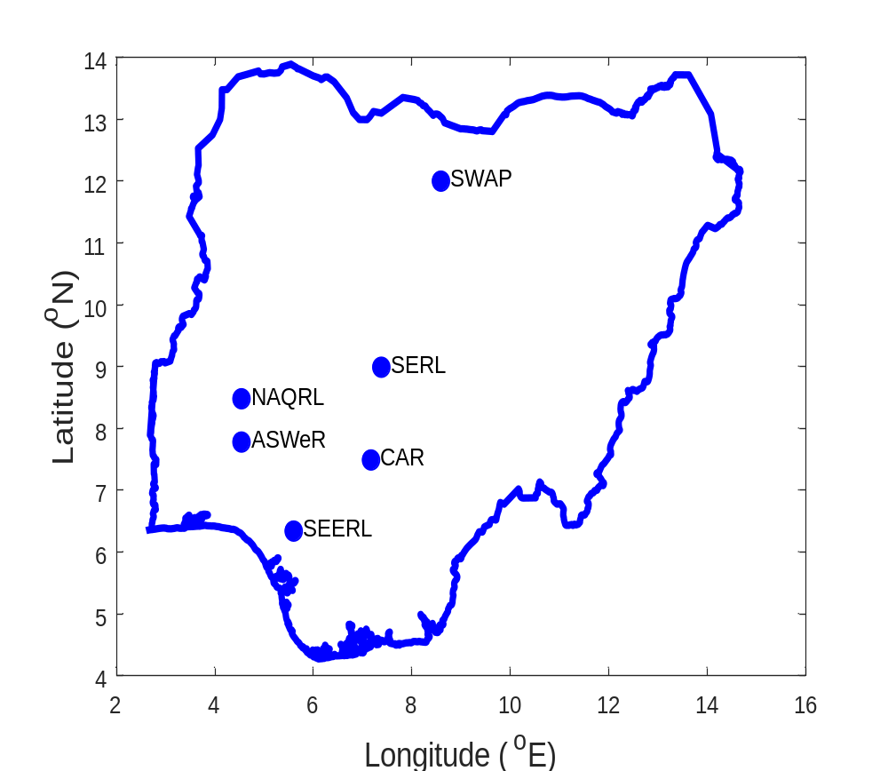
CAR Space Research Laboratories
Space Weather and Atmospheric Physics Laboratory, Kano
National Air Quality Research Laboratory, Ilorin
Space Environment Research Laboratory, Abuja
Atmospheric & Space Weather Research Laboratory, Osogbo
Center for Atmospheric Research, Anyigba
Space Earth Environmental Research Laboratory, Benin

Slide 29
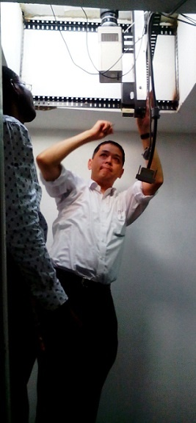
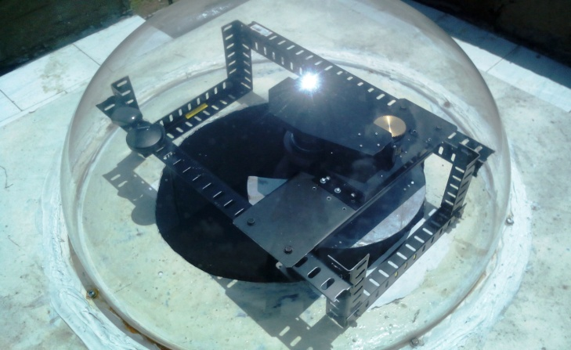
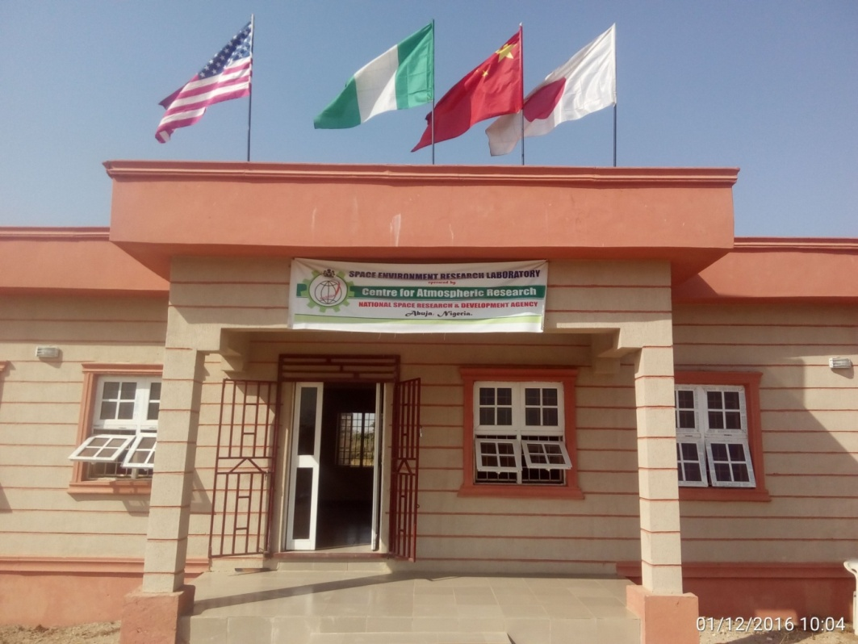
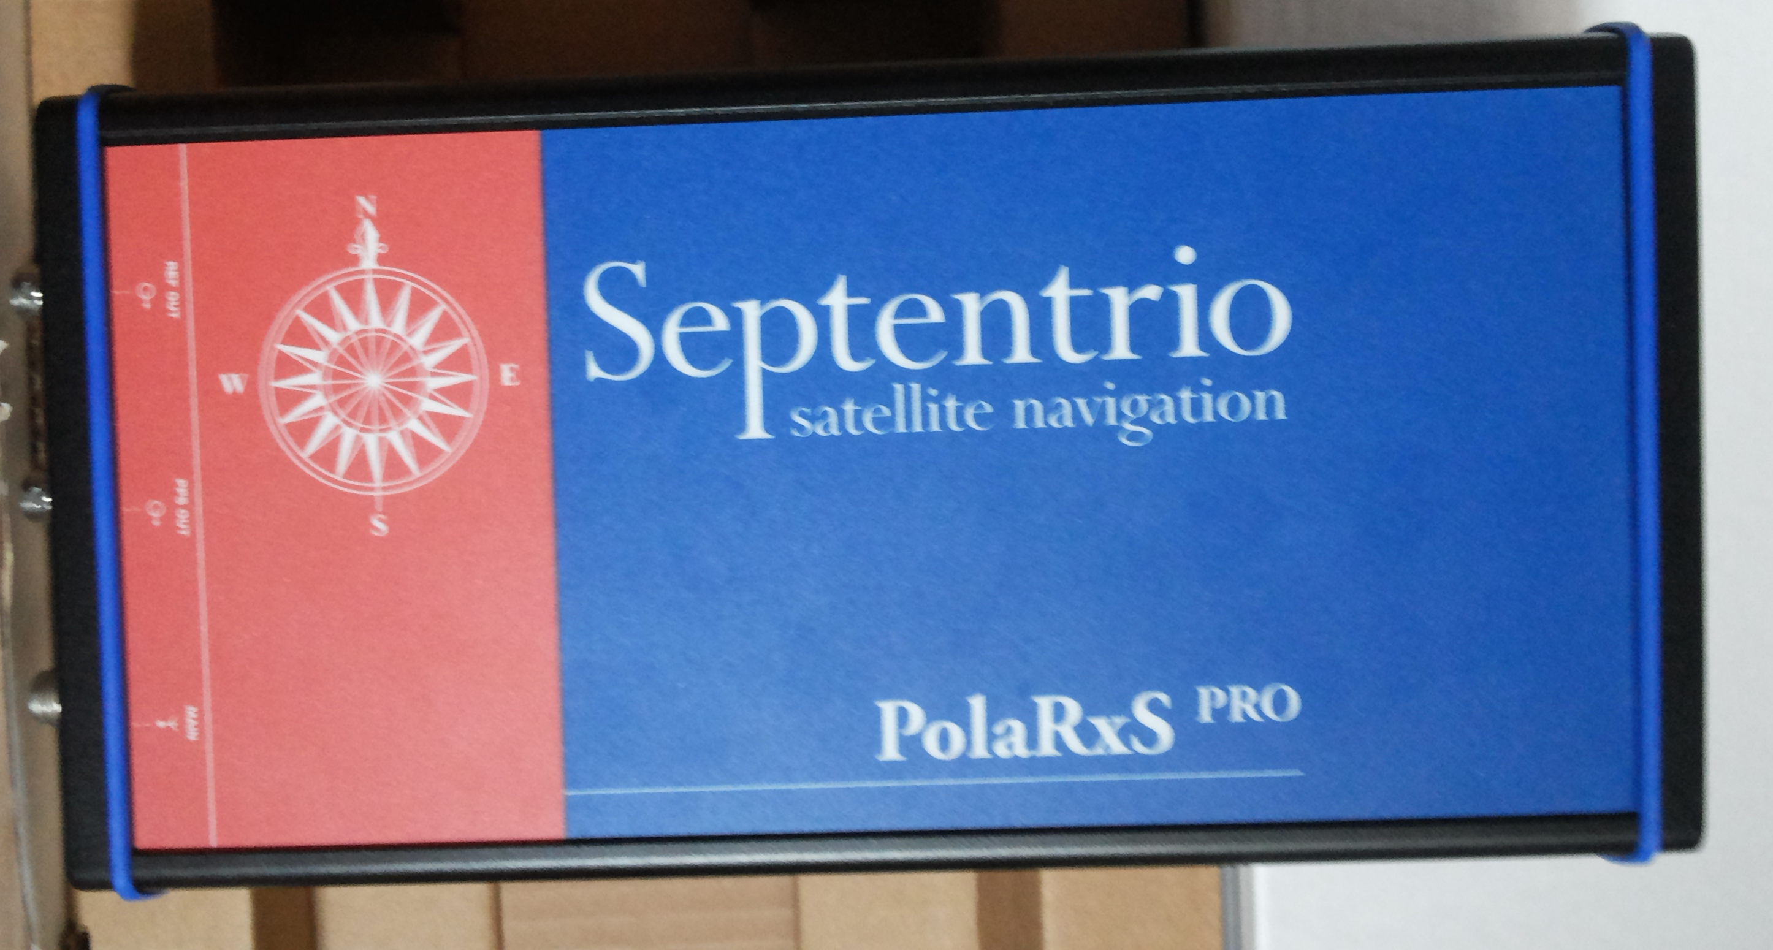
Space Environment Research Lab, Abuja
June 2015.
Optical Imager, FPI, Magnetometers (2), GNSS Space Weather Monitor

Slide 30
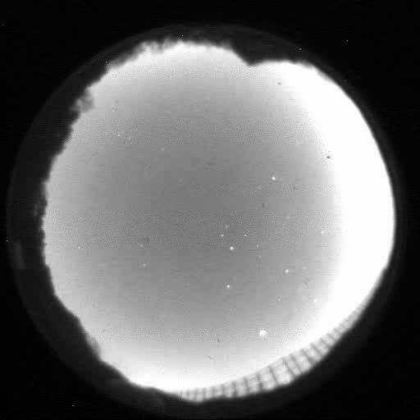
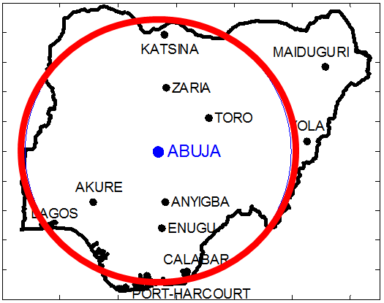
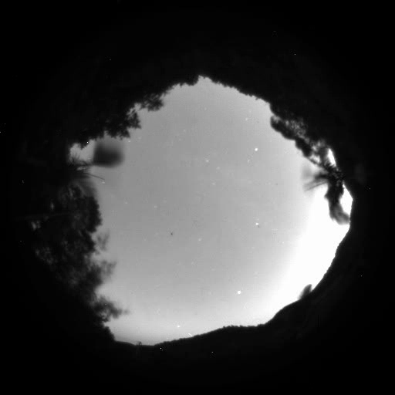
captures the space environment up to 500 km over a radial distance of up to 500 km and gives information about travelling ionospheric disturbances, gravity waves and plasma bubbles among other ionospheric phenomena
Some data
Space Research Laboratories
Space Research Laboratories
Space Research Laboratories
Abuja, Nigeria
June 21, 2015

Slide 31
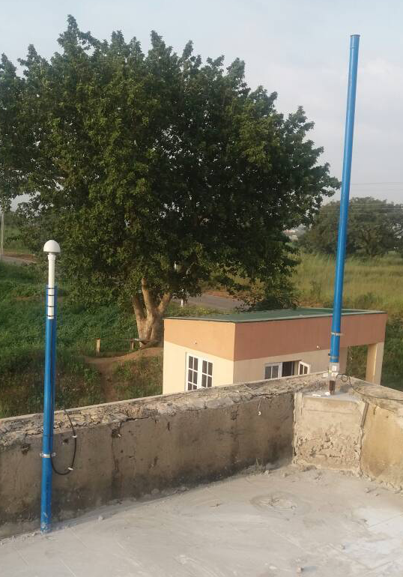
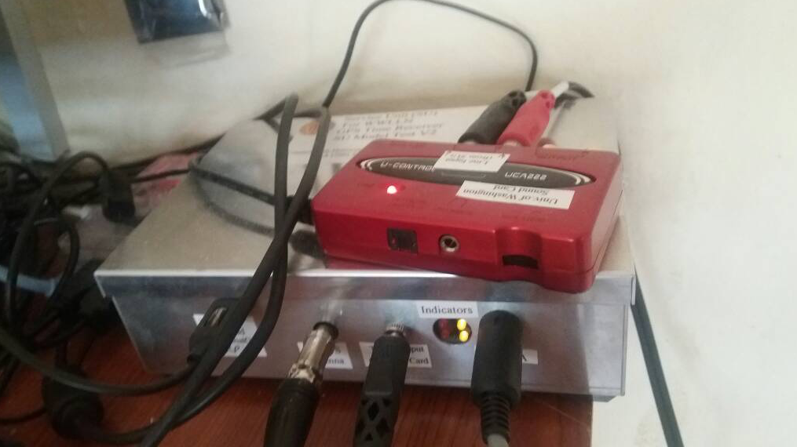
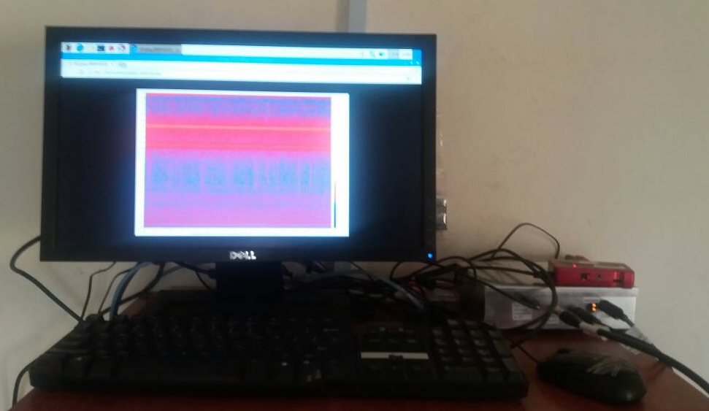
World-Wide Lightning Location Network WWLLN
a project in collaboration with University of Washington, USA.
Installed 18th October 2017 and currently undergoing observation
a lightning monitoring facility
Location: Anyigba
31

Slide 32

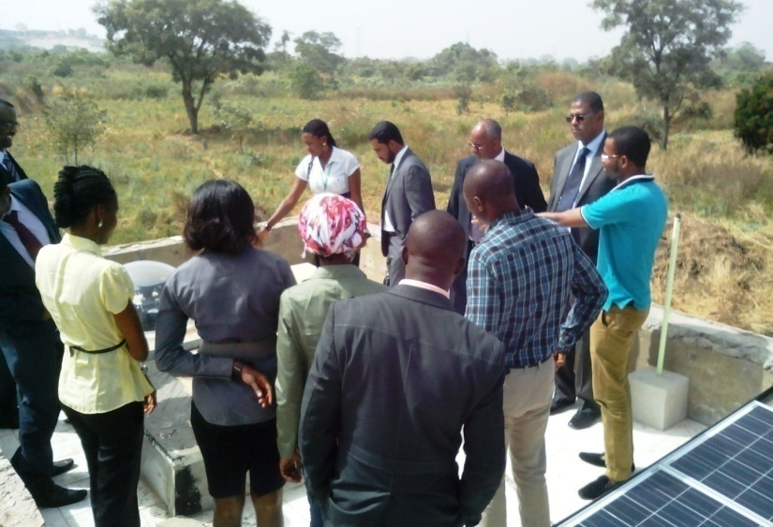
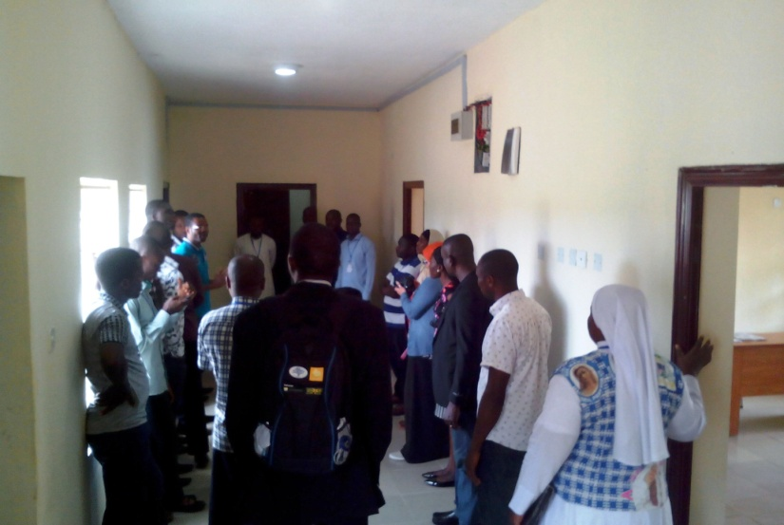
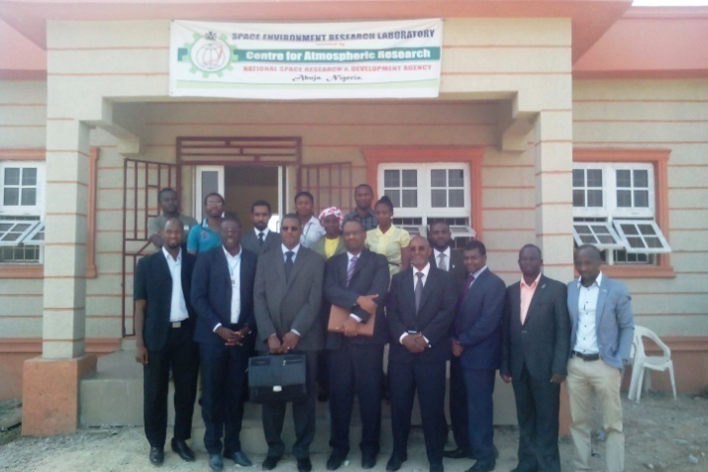
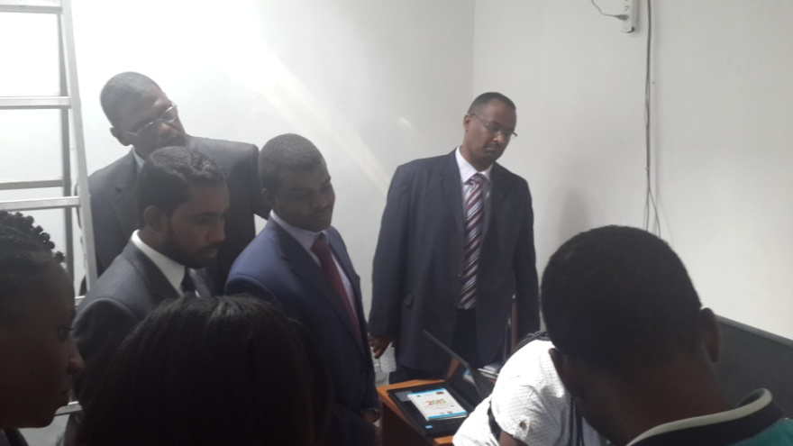
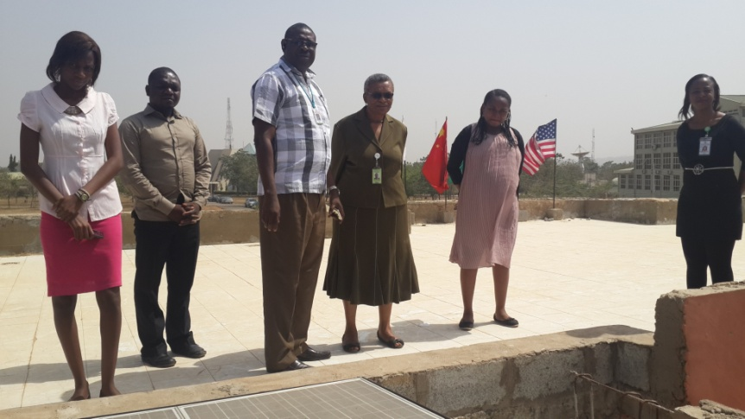
Activities
Over 4000 visitors; over 100 institutions ; up to 10 Countries
ISELLI, September 2015
Sudan, December 2015
Vice Chancellor, Federal University Lafia, January 2016

Slide 33
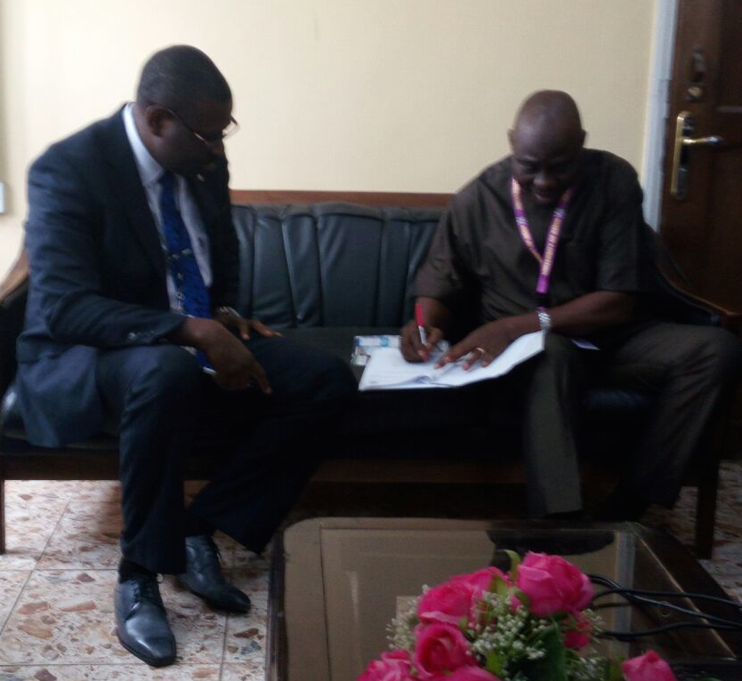
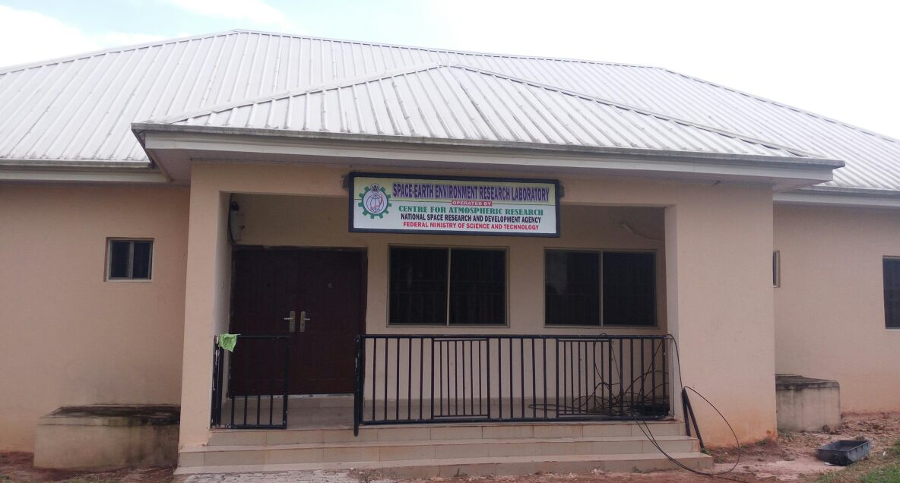
Space-Earth Environment Research Lab. SEERL
Located at the University of Benin
Uniben provided
Building for SEERL,
all furniture
ACs
Cleaning & security services
Wifi
Activity began on 1st September 2016

Slide 34
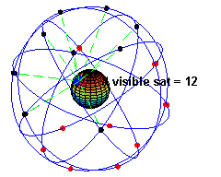
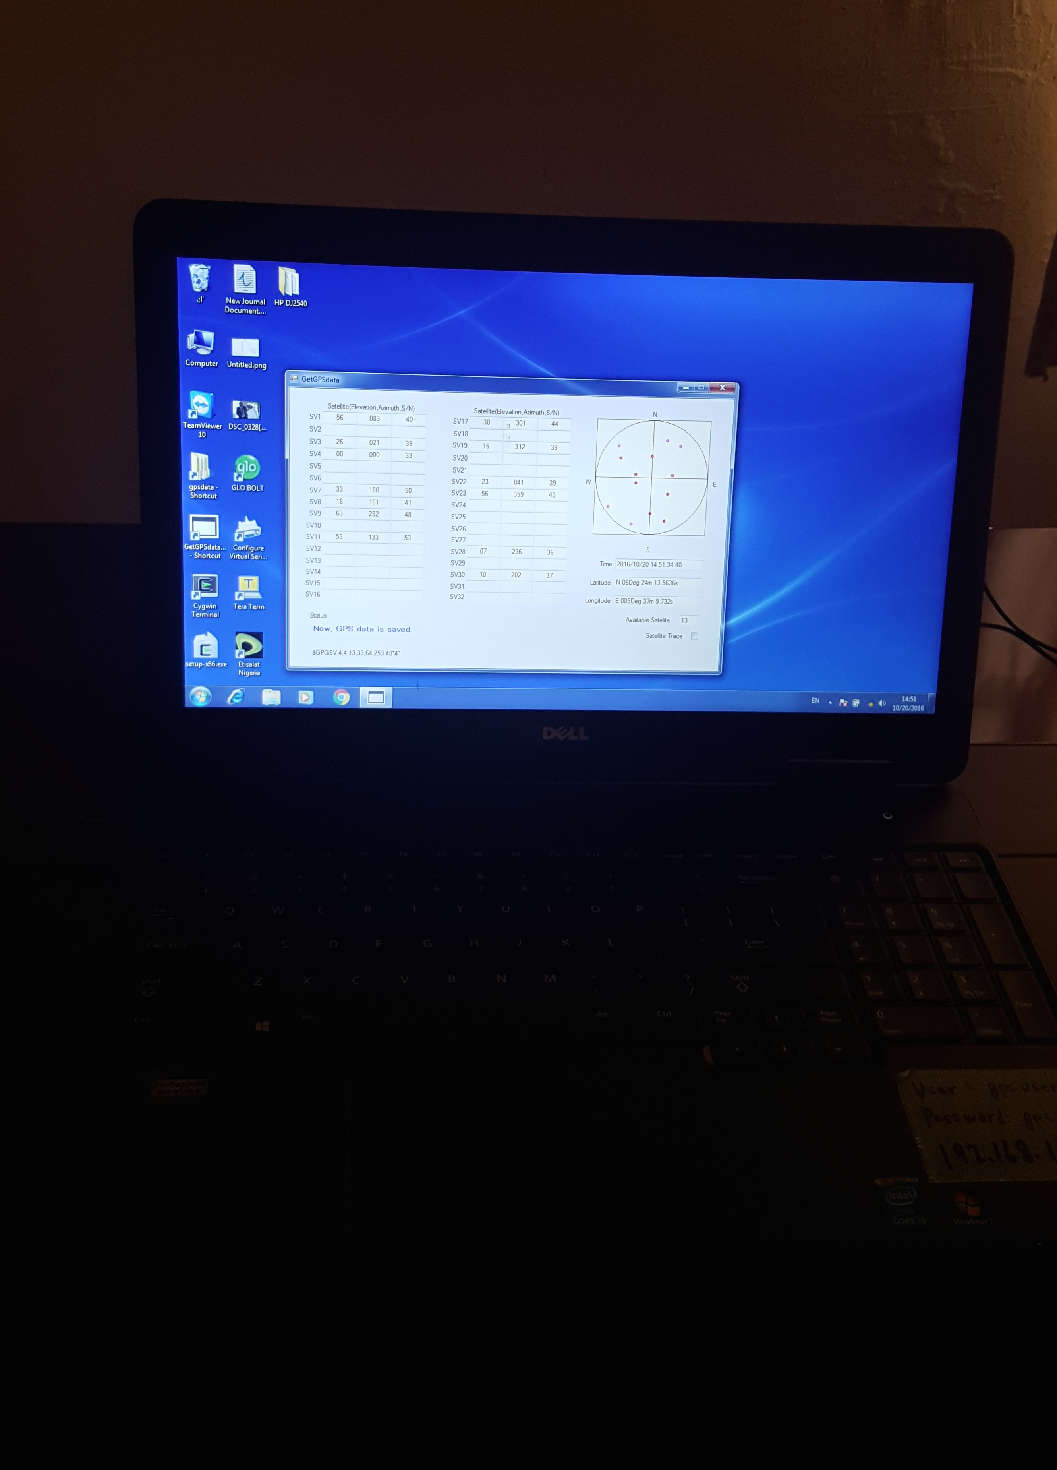
Space-Earth Environment Research Lab. SEERL
Located at the University of Benin
Mounted antenna
Activity began on 1st September 2016
- 1st equipment Scintillation monitor
- installed in SEERL
20 October 2016

Slide 35
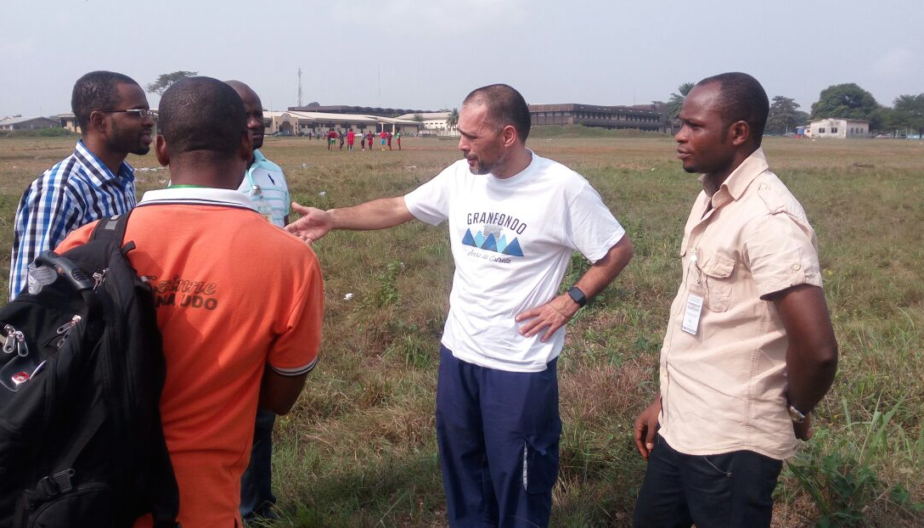
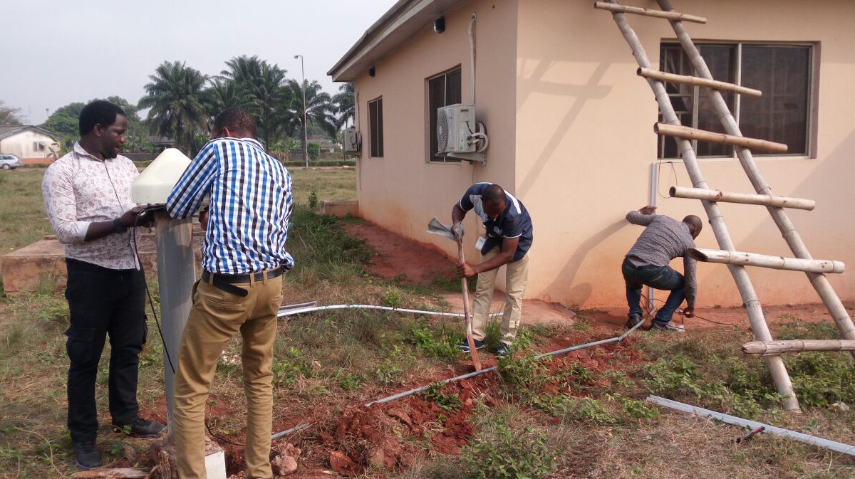
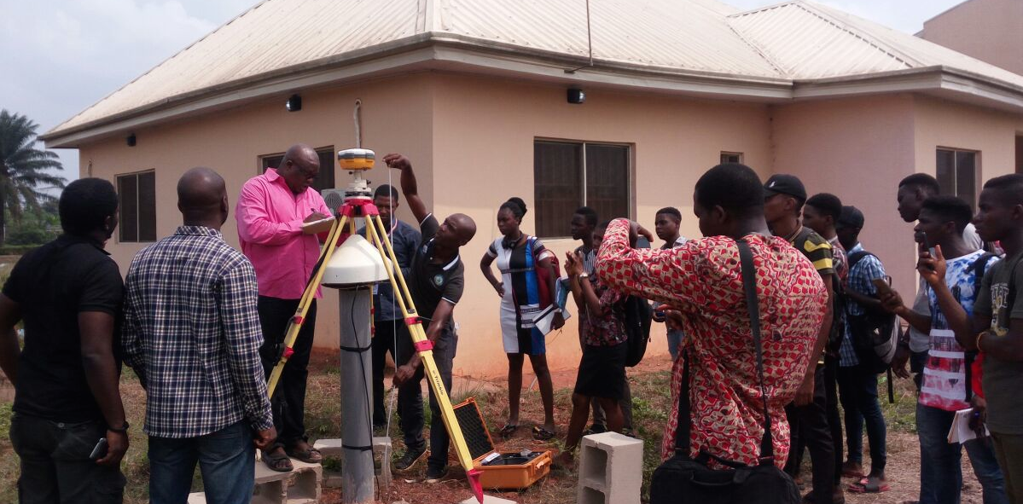
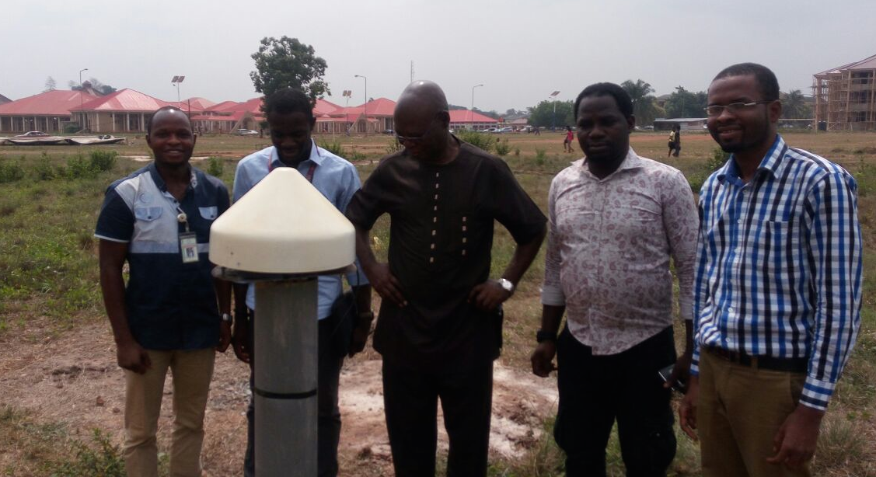
GNSS – COR Station

Slide 36
1st International School on Equatorial & Low Latitude Ionosphere, Nigeria, 14 – 19 sept 2015, ISELLI -1

Slide 37
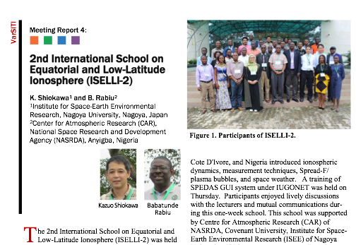
Most Recent School in Nigeria
60 participants
10 countries
1-week long activities
10-16 Sept 2017
CU, Ota, near Lagos
37

Slide 38
University Support Programme:
Joint Research Programme with African Universities
Joint research programme with postgraduate research students (MSc & PhD).
Promote the lab’s research visibility in projects that are useful and applicable for sustainable development
Position advertised at www.carnasrda.com
ALL Nigerian and African Universities are welcome
Successful applicants will spend time (typically 1-3 months) in the lab working on projects under the supervision of the lab scientists.

Slide 39
The Inter-University Corporation for Atmospheric Research IUCAR
conceived to be a conglomeration of researchers & institutions with interest in atmospheric and space sciences
Setting up a one-stop database for all researchers and institutions with relevance in atmospheric sciences
provide a meeting platform for all researchers in fields of relevance to atmospheric sciences in Nigeria
foster effective partnership among researchers of similar scientific interest
promote international competitive research among members
promote professionalism and instill sound academic culture in members
establish a formidable team capable of forming alliance with international teams with the aim of pursuing long-term scientific programs
and work with CAR and other national entities to promote research, observational programs, training and formulation of policies of relevance to atmospheric sciences in Nigeria.
http://carnasrda.com/iucar/

Slide 40
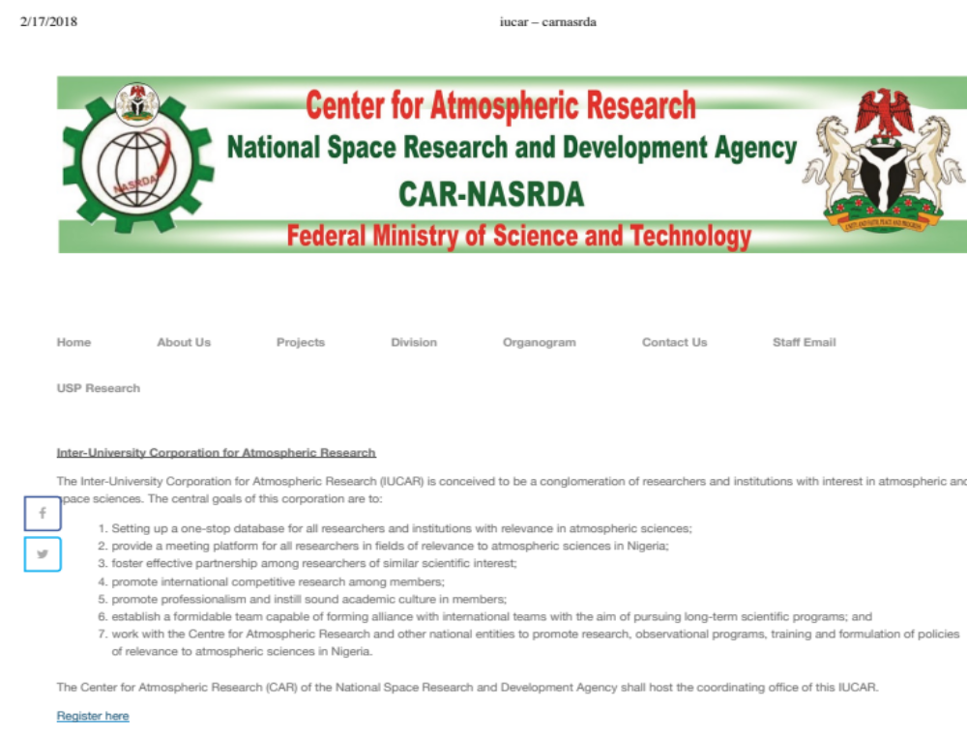
http://carnasrda.com/iucar/
over 100 scientists have registered so far

Slide 41
Research Output

Slide 42
CAR: present research activities
quality of the air around us
the annexation of solar energy,
strengthening the accuracy of prediction of atmospheric and allied parameters for socio-economic purpose
safety of space environment over us and the improvement of the earth-satellite radio-communication systems which include tele-communication and all manners of space-dependent systems
Precisely, on 6th January 2018, we started the first daily nowcasting and forcasting of the space weather condition in Sub-Sahara Africa.
We continue to maintain our ways by engaging in field observations, promoting research and capacity building

Slide 43
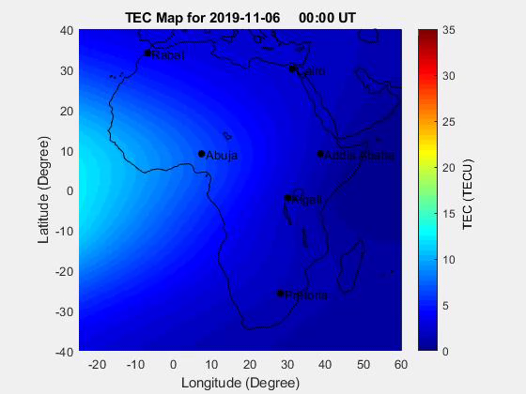
The African GNSS TEC (AfriTEC) Model, version 1.0
a model of the ionospheric GNSS TEC over the entire African region
used to obtain the ionospheric GNSS TEC at all locations over the African continent.
The model is developed by the method of artificial neural networks.
http://carnasrda.com/tec_models/
Lead Scientist: Dr Daniel Okoh, CAR-NASRDA

Slide 44
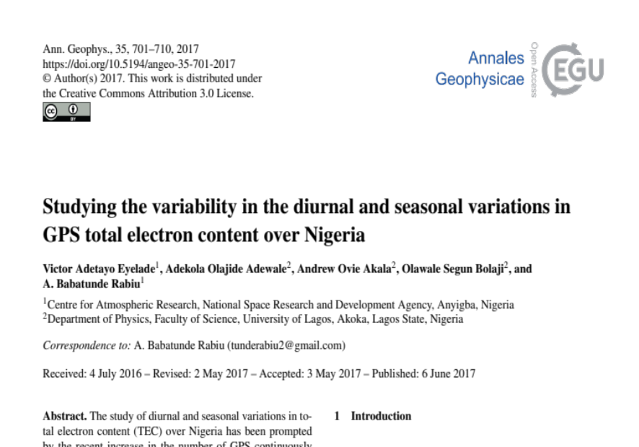



Several Publications ... for examples

Slide 45

GNSS Research
31/08/2017
www.carnasrda.com

Slide 46



^{Plasma bubbles over} ^{Nigeria} ^{using Optical} ^{imager data}
Percentage Occurrence of Plasma Bubbles as observed on the Airglow and GNSS data for the period from June 2015 to January 2017.
Okoh et al, JGR, 2017

Slide 47


All Sky Imager Research
First airglow observations of plasma bubbles on the African continent
31/08/2017
www.carnasrda.com

Slide 48
ARSID: Indigenous development of atmospheric monitoring facilities
our team of engineers at CAR had successfully worked with our local collaborators to develop:
    hybrid of weather stations & air quality monitors,
    magnetometers.
unmanned aerial vehicle UAV with sensors capable of monitoring the altitudinal profile profiles of atmospheric parameters including some GHGs from the ground level to pre-defined altitude of about 300 metres.
telemetry component
compare well with imported products.
......... saving huge capital flight

Slide 49














Our collaborators
others
MoU with several Nigerian Universities

Slide 50
CAR Offers
Staff Exchange
Research grants
Co-supervision of graduate programs
Industrial Training Placement
Joint hosting of meetings
Data exchange/sharing
Equipment hosting
CAR has attained the status of a world-class R & D CoE in atmospheric research.

Slide 51
2019 Targets
January: General Staff Retreat
Topical Training workshops:
        Python programming language
Continuation of
        USP
        Instrumentation development
Deployment of observational facilities
Prof. E. E. Balogun National Symposium on Atmospheric Research
Research work on various topics of relevance to our mandates
Biennial International Colloquium on Equatorial & Low Latitude Ionosphere, Nigeria, Sept 2019
African Space Weather Workshop
linkage programs with our various collaborators

Slide 52
Annual report
Details of our activities &
Biannual annual reports freely available for
            2013-2014
            2015-2016
            @
            www.carnasrda.com
            2017-2018 in press...

Slide 53
Conclusion
Data for free
Research support

Slide 54
Thanks
Email: carnarsda@yahoo.com; carnarsda@gmail.com

