Slide 1

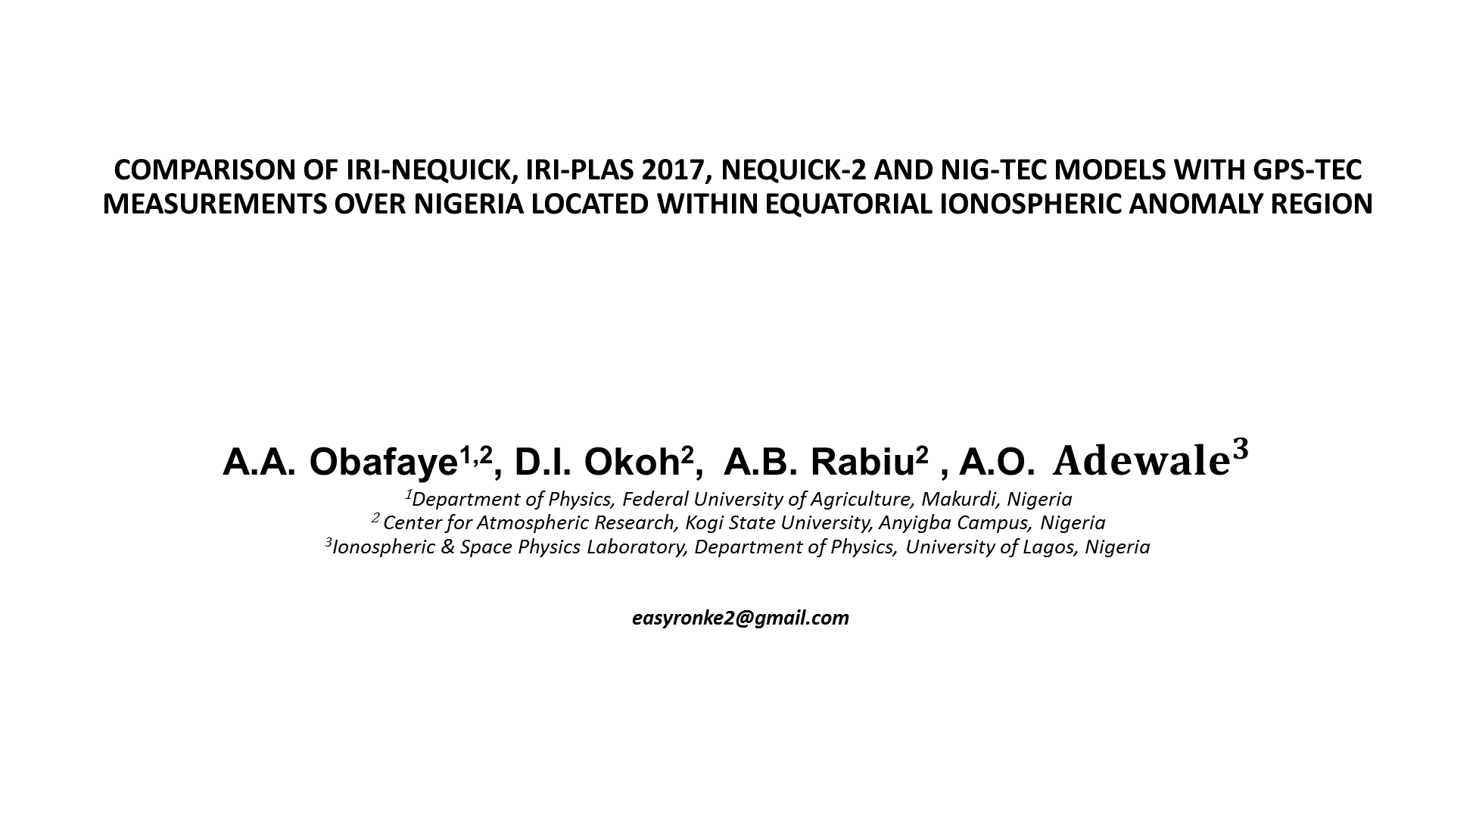
COMPARISON OF IRI-NEQUICK, IRI-PLAS 2017, NEQUICK-2 AND NIG-TEC MODELS WITH GPS-TEC MEASUREMENTS OVER NIGERIA LOCATED WITHIN EQUATORIAL IONOSPHERIC ANOMALY REGION
A.A. Obafaye^{1,2}, D.I. Okoh², A.B. Rabiu² , A.O. ${Adewale}^{3}$
¹Department of Physics, Federal University of Agriculture, Makurdi, Nigeria
² Center for Atmospheric Research, Kogi State University, Anyigba Campus, Nigeria
³Ionospheric & Space Physics Laboratory, Department of Physics, University of Lagos, Nigeria easyronke2@gmail.com

Slide 2
Outline
Introduction
Equatorial Ionosphere
Ionospheric models
Methodology
Results
Conclusion

Slide 3
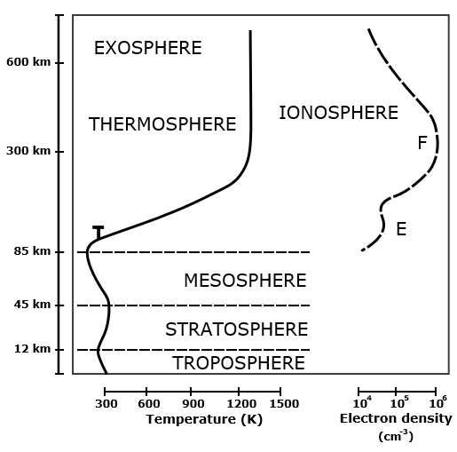
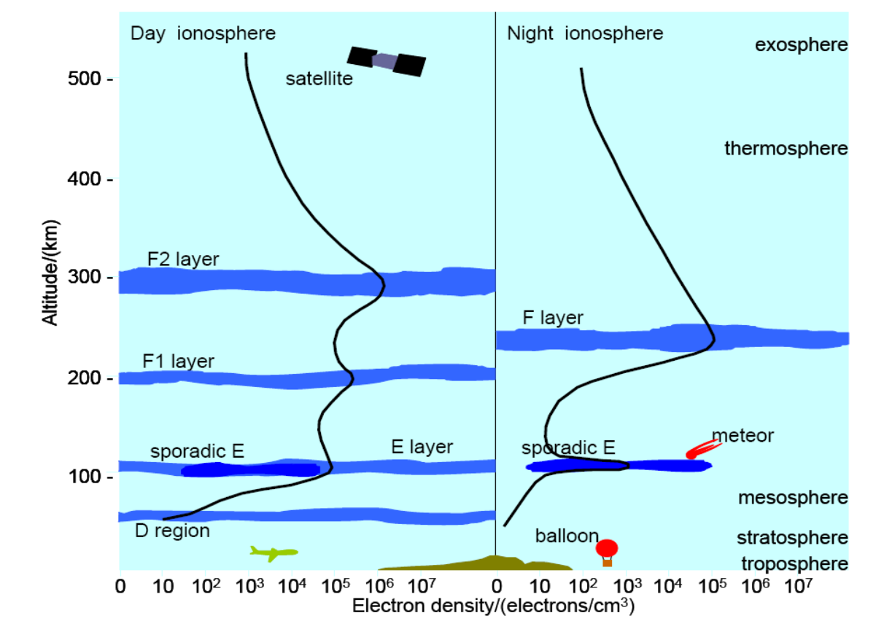
THE IONOSPHERE

Slide 4
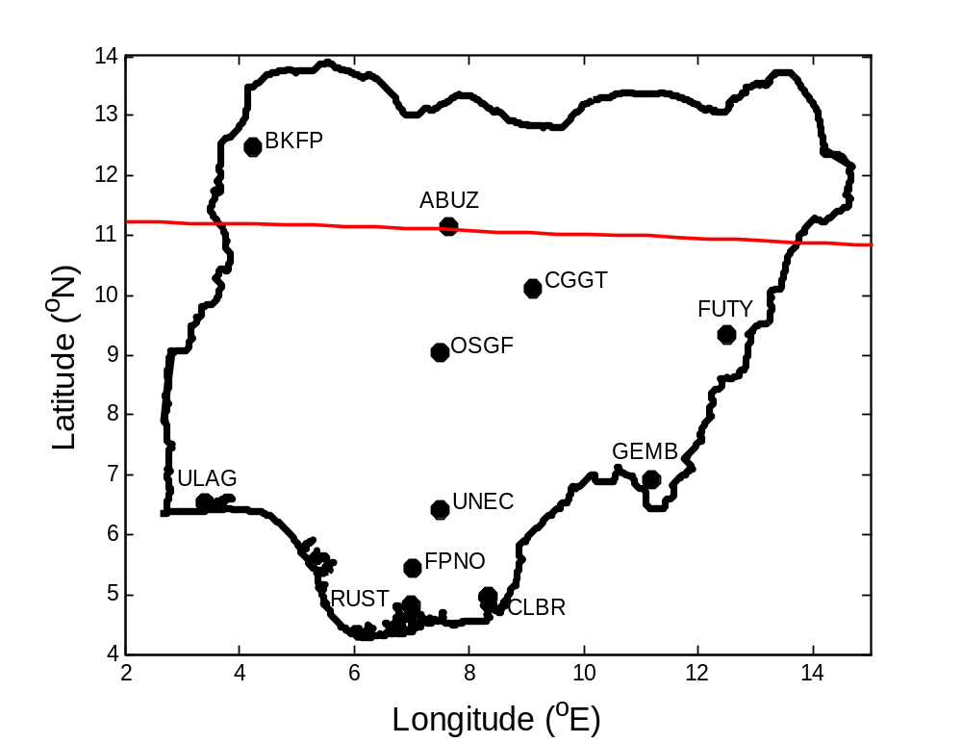
Region of Study
Fig. 2 Geographical locations of stations on the NIGNET.

Slide 5
Sources of Data
The raw GPS data was obtained in the Receiver Independent Exchange (RINEX) format. The uncorrected Slant Total Electron Content (STEC) obtained from the GPS satellite is then converted to Vertical Total Electron Content (VTEC) using the GPS-TEC analysis application software, developed by Gopi Seemala of the Institute for Scientific Research, Boston College, USA.
2. Daily TEC Values was obtained from IRI-2016 model (NeQuick model) by developing an appropriate MATLAB script. The IRI-2016 is an upgraded version of the IRI-2007 model
3. NeQuick-2 is the latest version of NeQuick (Leitinger et al., 2009; Radicella. 2010). NeQuick data was generated from the NeQuick source code package which used some input parameters to generate daily vertical total electron content(VTEC) in TEC units (TECU).
4. IRI-Plas 2017 (Arikan et al., 2017) is the newly developed model of IRI extended to the plasmasphere altitude.

Slide 6
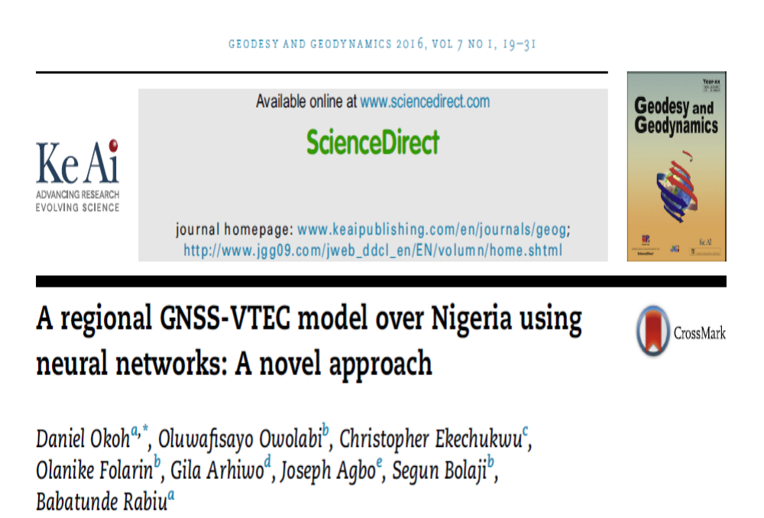
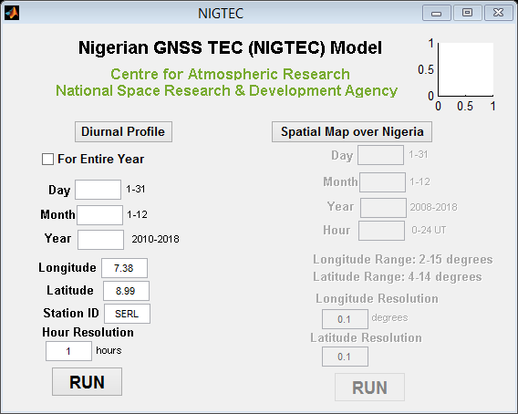
NIG-TEC
The NIGTEC model can be used to obtain the ionospheric GNSS TEC at all locations over Nigeria. The program generated the diurnal profiles for all the days in a year.

Slide 7
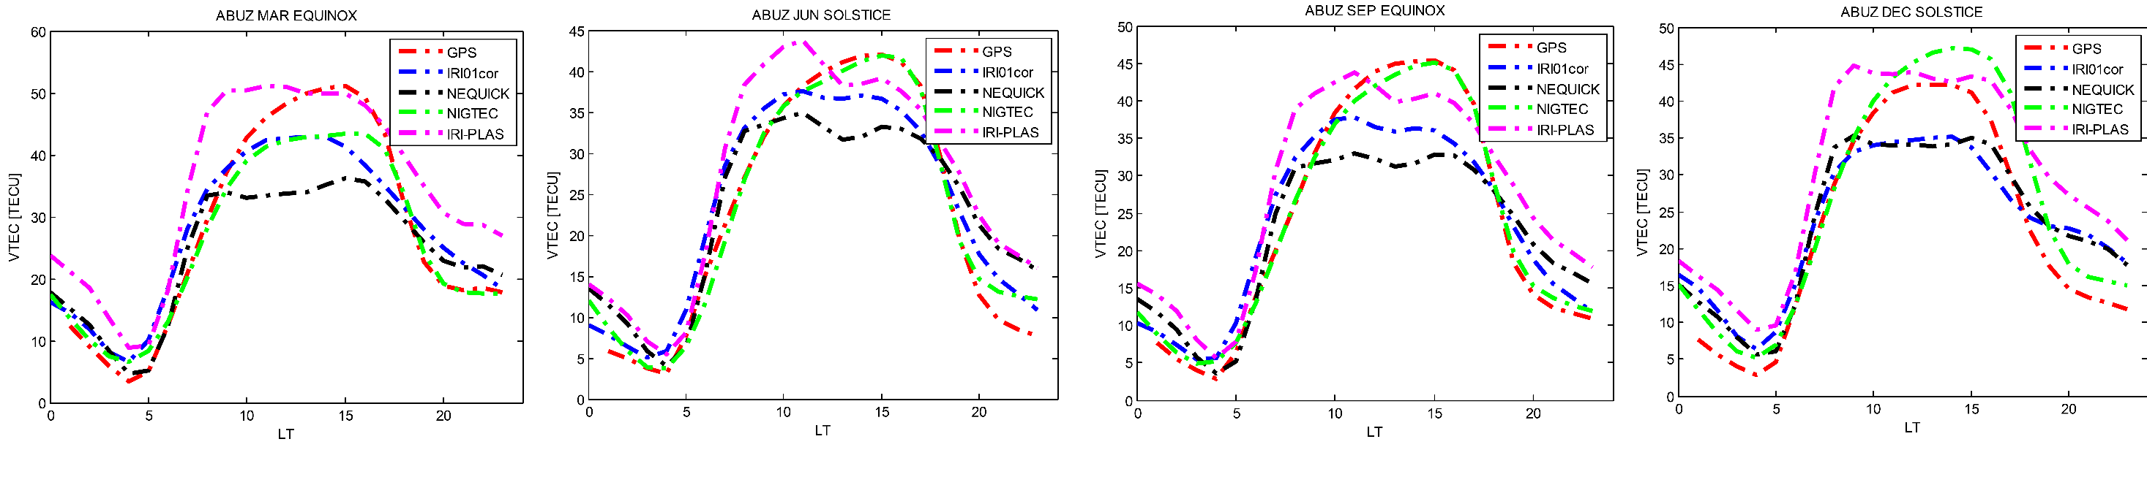
RESULTS
Fig. 3 Diurnal variations of observed mean values of TEC at ABUZ along with the IRI, NeQuick, IRI-Plas and NIGTEC predicted values.

Slide 8
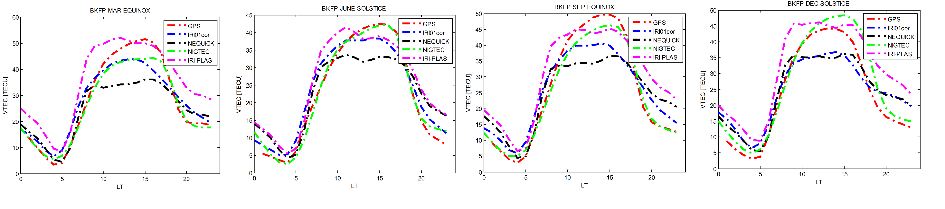
Fig. 4 Diurnal variations of observed mean values of TEC at BKFP along with the IRI, NeQuick, IRIPlas and NIGTEC predicted values.

Slide 9
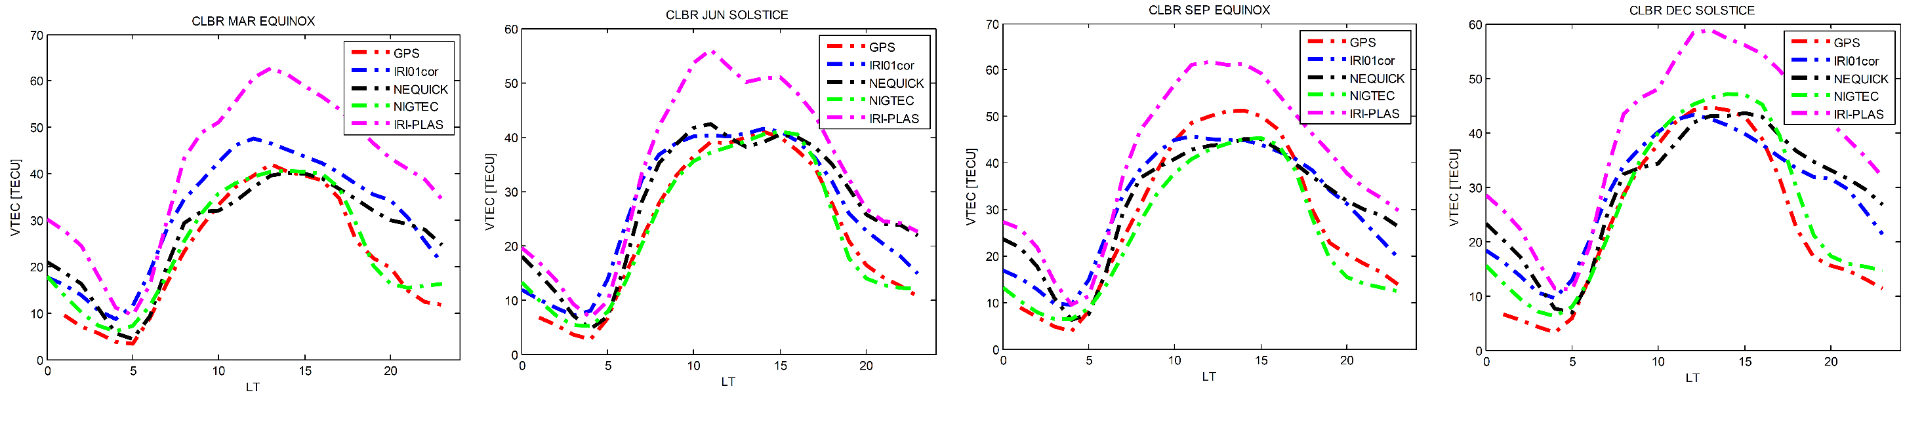
Fig. 5 Diurnal variations of observed mean values of TEC at CLBR along with the IRI, NeQuick, IRIPlas and NIGTEC predicted values.

Slide 10
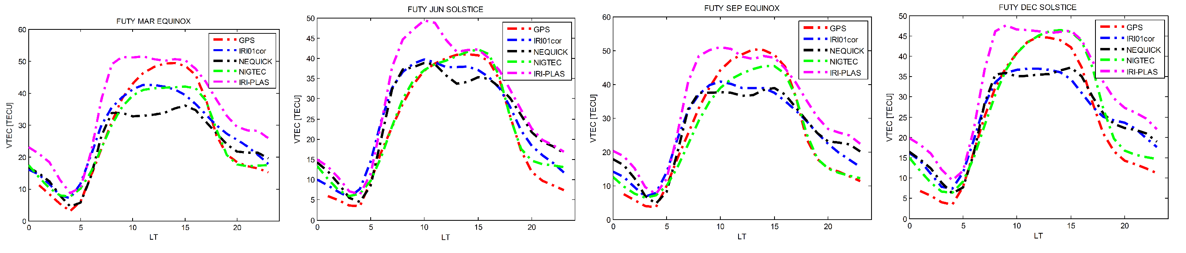
Fig. 6 Diurnal variations of observed mean values of TEC at FUTY along with the IRI, NeQuick, IRIPlas and NIGTEC predicted values.

Slide 11
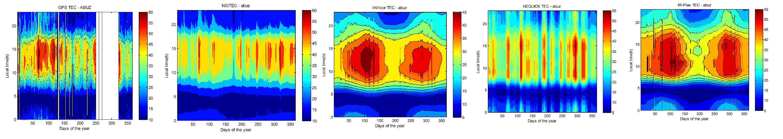
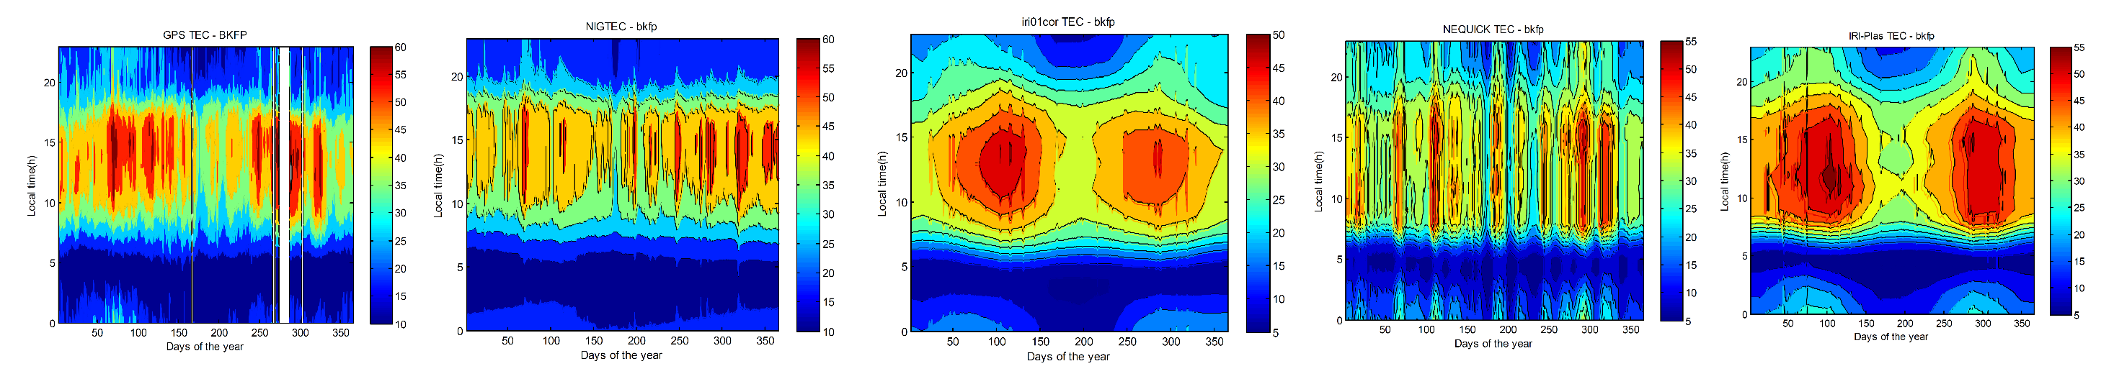
GPS-TEC NIGTEC IRI NEQUICK IRI-PLAS
Fig 7. Contour plots of observed VTEC and predicted VTEC for ABUZ &BKFP

Slide 12
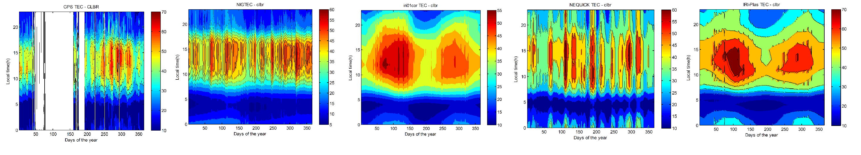
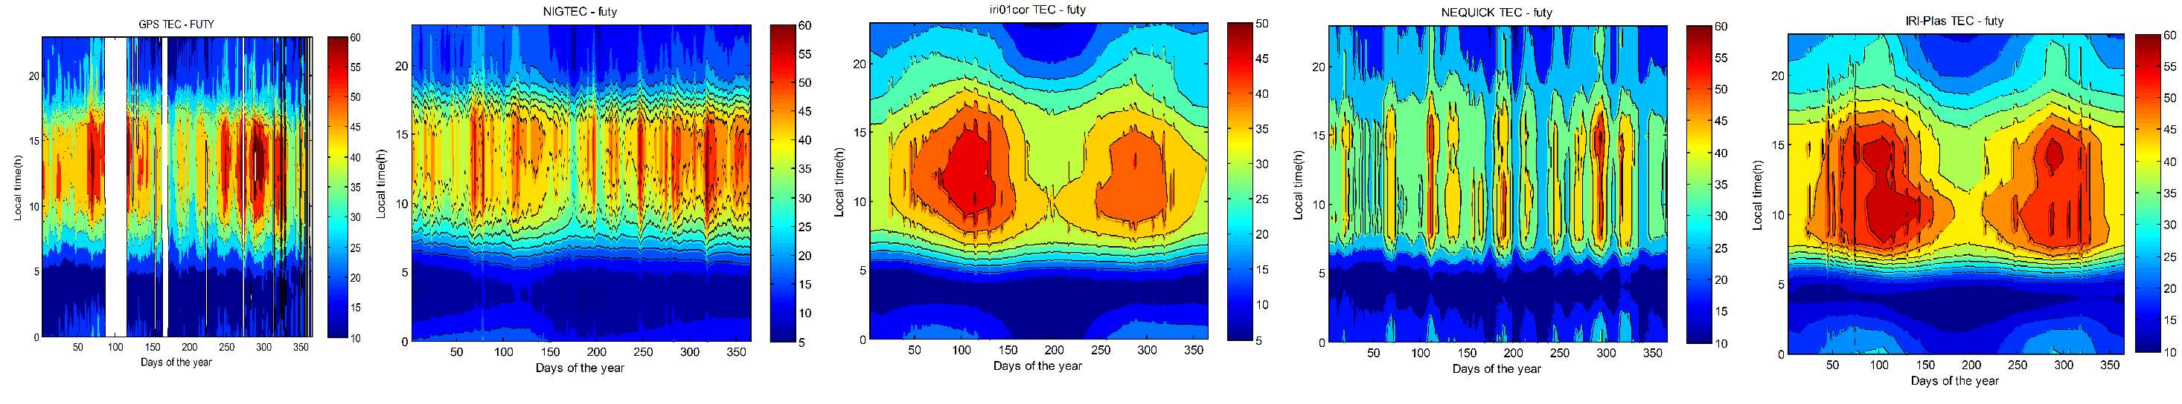
GPS-TEC NIGTEC IRI NEQUICK IRI-PLAS
Fig 8. Contour plots of observed VTEC and predicted VTEC for CLBR & FUTY

Slide 13
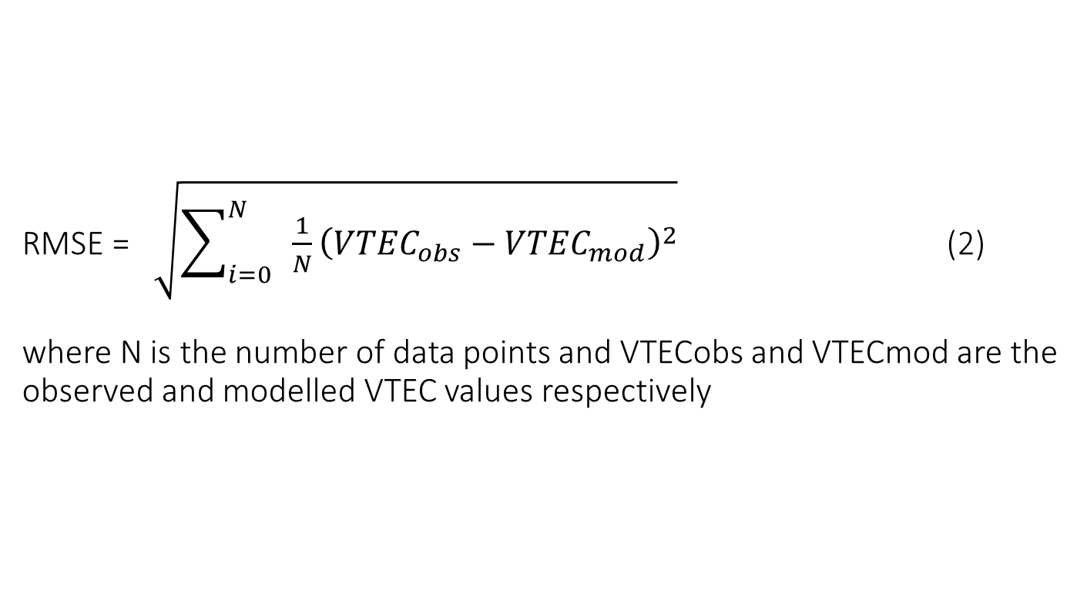
RMSE = $\sqrt{\sum_{i=0}^{N}{ \frac{1}{N}}{\left({VTEC}_{obs}−{VTEC}_{mod}\right)}^{2}}$ (2) where N is the number of data points and VTECobs and VTECmod are the observed and modelled VTEC values respectively
Root Mean Square Error

Slide 14
RMSE
STATION CODE | SEASON OF THE YEAR | RMSE
 |  | IRI | NEQUICK | NIGTEC | IRI-PLAS
ABUZ | DECEMBER SOLSTICE MARCH EQUINOX JUNE SOLSTICE SEPTEMBER EQUINOX | 5.765 5.401 4.053 5.390 | 5.398 8.227 6.191 7.250 | 4.575 3.697 2.096 1.134 | 8.321 8.566 6.344 6.538
BKFP | DECEMBER SOLSTICE MARCH EQUINOX JUNE SOLSTICE SEPTEMBER EQUINOX | 5.883 5.265 3.767 5.879 | 5.631 8.207 7.318 7.061 | 4.175 3.411 2.010 2.409 | 8.653 8.721 5.996 7.815
CLBR | DECEMBER SOLSTICE MARCH EQUINOX JUNE SOLSTICE SEPTEMBER EQUINOX | 8.229 9.262 5.130 6.775 | 9.920 7.246 6.411 8.028 | 3.825 2.734 1.928 4.177 | 17.110 19.268 11.115 13.242
FUTY | DECEMBER SOLSTICE MARCH EQUINOX JUNE SOLSTICE SEPTEMBER EQUINOX | 6.074 5.514 4.697 6.679 | 6.167 7.778 6.203 7.746 | 3.621 3.823 2.624 3.221 | 9.311 9.369 8.413 8.952
MEAN |  | 5.598 | 7.173 | 3.091 | 8.735
Table 1. Root mean square error for IRI, Nequick, NIGTEC & IRI-PLAS models.

Slide 15
Conclusion
VTEC values are generally high during daytime when compared to night-time values. TEC values increased from 0500h LT and reaches its maximum value during 1200h-1500h LT
Highest daytime values of VTEC was recorded in SEPTEMBER EQUINOX while lowest value are observed during JUNE SOLSTICE
RMSE Mean value of NIGTEC is seen to be lower than those of IRI,NEQUICK and IRI-PLAS.
The NIGTEC model performs better than the three other models

Slide 16
References
Appleton, E.V. (1946): Two anomalies in the ionosphere. Nature 157, 691–693
Bhuyan, P.K. and Borah, R.R., (2007). TEC derived from GPS network in India and comparison with the IRI. Advances in Space Research 39: 830–84
Bilitza, D (1990). International Reference Ionosphere 1990. National Space Science Data Center 90-22, Greenbelt Maryland
Di Giovanni, G. and Radicella, S.M. (1990). An analytical model of the electron density profile in the ionosphere. Adv. Space Res. 10(11): 27–30
Ezquer, R.G., Scida, L.A., Orue, Y.M., Nava, B., Cabrera, M.A.and Brunini, C. (2017). NeQuick 2 and IRI Plas VTEC predictions for low latitude and South American sector. Adv. in Space Res., https://doi.org/10.1016/j.asr.2017.10.003, 34-45
Gulyaeva, T.L.and Bilitza, D. (2012). Towards ISO Standard Earth Ionosphere and Plasmasphere Model. In: Larsen R.J., editor. New developments in the standard model, Nova Science Publishers, 1-39
Habarulema, J.B., McKinnell, L and Cilliers, P.J. (2007). Prediction of global positioning system total electron content using Neural Networks over South Africa. Journal of Atmospheric and Solar-Terrestrial Physics, 69, (15): 1842-1850

Slide 17
ACKNOWLEDGEMENTS
Office of the Surveyor General of the Federal Government of Nigeria for making the GPS data available.
Dieter Bilitza and the IRI Team for the IRI model.
Aeronomy and Radio-propagation Laboratory of ICTP, Italy for granting access to NeQuick package.
Centre for Atmospheric Research for also granting us access to the NIG-TEC model

Slide 18

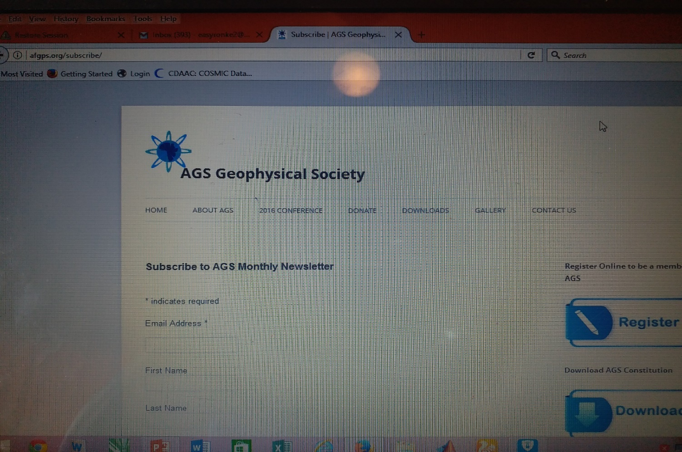
Advertise your News in AGS NEWSLETTER

Slide 19
Thank you for your attention

