Slide 1
Equatorial Spread F Occurrence and Vertical Drift Velocity of the F2 Layer Around The Time Occurrence
@ International Colloquium On Equatorial and Low Latitude Ionosphere
September 9th – 13th, 2019.
Agunbiade, G^{1,}, Adeniyi, J.O², Oladipo, O.A.¹, Olawepo, A.O.¹, Adimula, I.A.¹, & Ikubanni, O.²
¹Department of Physics, University of Ilorin, Ilorin, Kwara State.
²Department of Physical Sciences, Landmark University, Omu-Aran, Kwara State
Email: oneobalola@gmail.com

Slide 2
OUTLINE
INTRODUCTION
METHODOLOGY
RESULTS AND DISCUSSIONS
CONCLUSION

Slide 3
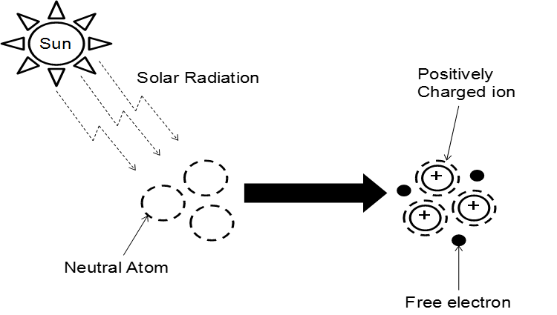
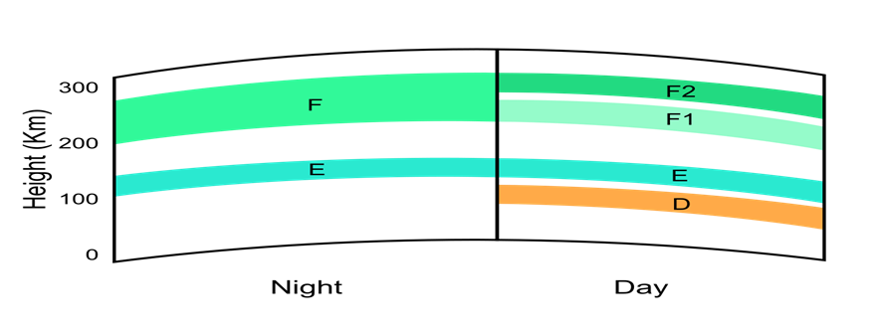
THE IONOSPHERE
.
Formation of the ionosphere by solar Radiation Layer of the ionosphere
The Ionosphere lies between the thermosphere and the exosphere
It is distinguished from lower atmosphere because it is ionized by solar radiation.
The interaction of Extreme Ultraviolet radiation (EUV) from the sun with neutral atmosphere produces ions and electrons.
It is the free electrons that cause the reflection and absorption of radio waves.
Atmospheric layer
The Earth is surrounded by a blanket of air called the Atmosphere
The Atmosphere consists of five layers
1.Troposphere: approximately 11km high.
2. Stratosphere: 50km
3. Mesosphere: between 50km and 80km
4. Thermosphere between 80km and 110km
IONOSPHERE
5. Exosphere: Above a height of about 500km.
D-region about 60 to 90 km
E-region (about 90 to 140 km
F₁-region (about 140 to 180 km
F₂-region (peak about 300 to 400 km

Slide 4
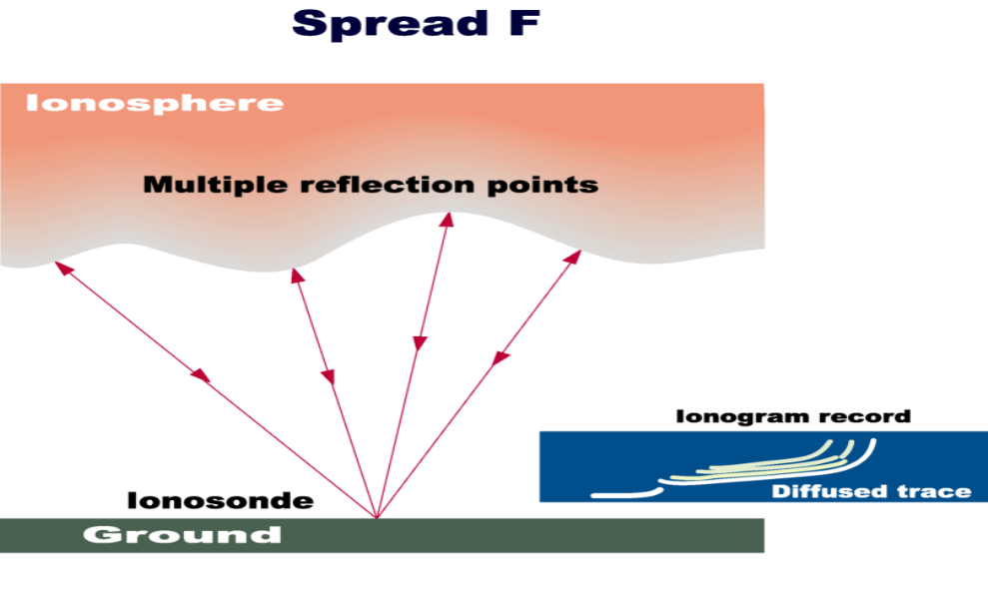
THE CAUSE OF SPREAD F
What is spread F?
Neutral Winds
Ionospheric Dynamo
E-Region and F-Region Dynamos
EXB drift
Pre reversal enhancement
Taylor (R-T) instability
The principal causes for the height rise after sunset are :
(a) The rapid post sunset enhancement of zonal electric field lead to a large vertical plasma drift (ExB), thereby lifting the F- layer to higher altitudes resulting in a condition conducive for the generation of ESF.
(b) decay of bottom side ionization because of chemical recombination in the absence of production by solar ionizing radiations after sunset and
(c) Presence of equator ward meridional neutral wind that conveys the ionization along the field lines.
The plasma is lifted up by vertical electrodynamic force, called ExB drift. Once transported to higher heights, the plasma diffuses downward across the geomagnetic field lines into both hemispheres due to gravitational and pressure gradient forces. The overall process is called fountain effect.

Slide 5
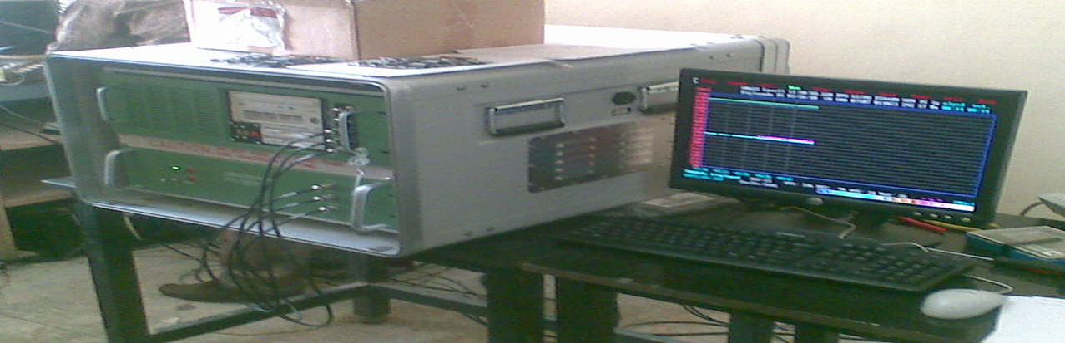
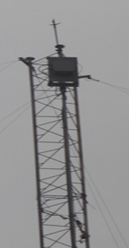
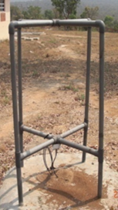
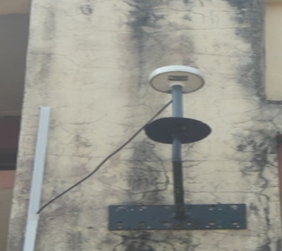
EXAMPLE AND DESCRIPTION OF THE EQUIPMENT USED
(A) The Digisonde portable sounder (DPS) (B) Transmitting antenna (C) Receiving antenna (D) Global Positioning System - (Source: Digisonde, Physics Dept., University of Ilorin)
A Digisonde is a modern digital device being used to determine ionospheric characteristics above the vicinity of the instrument. A Digisonde is comprised of a radio wave transmitter, receiver, and associated transmit and receive antennas. A Digisonde generally operates within the 1 to 20 MHz band with a physically large transmit antenna and four smaller, spaced receive antennas deployed in an equilateral triangle (the 4th antenna being placed at the triangle's centroid). Computer processing of the received radio waves is employed to develop ionograms which are used to determine the characteristics of the various ionospheric layers.
Figure A
Figure B
Figure C
Figure D

Slide 6
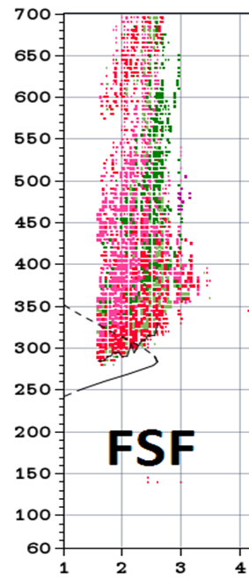
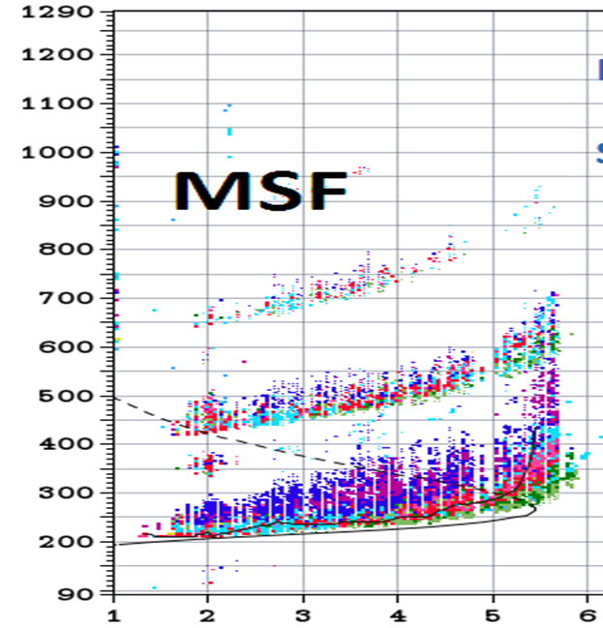
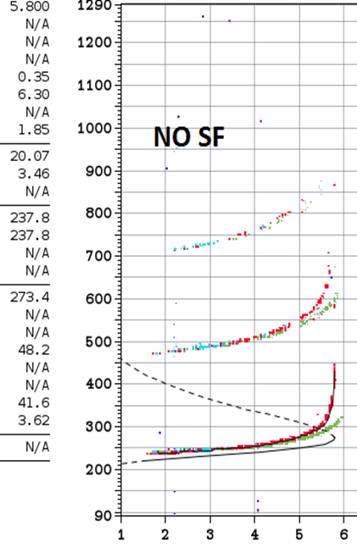
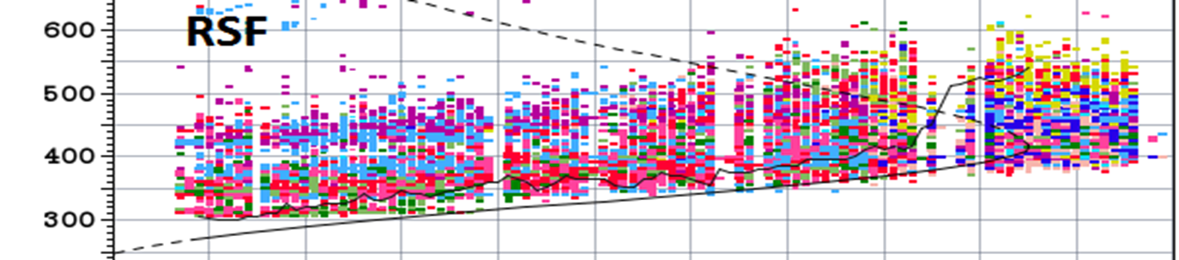
TYPES OF SPREAD F
Notes:
Show more complete ionograms.

Slide 7
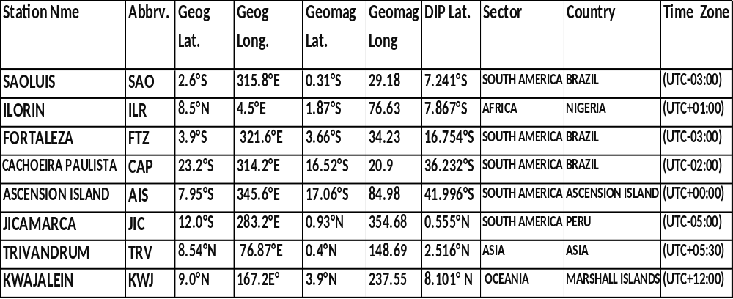
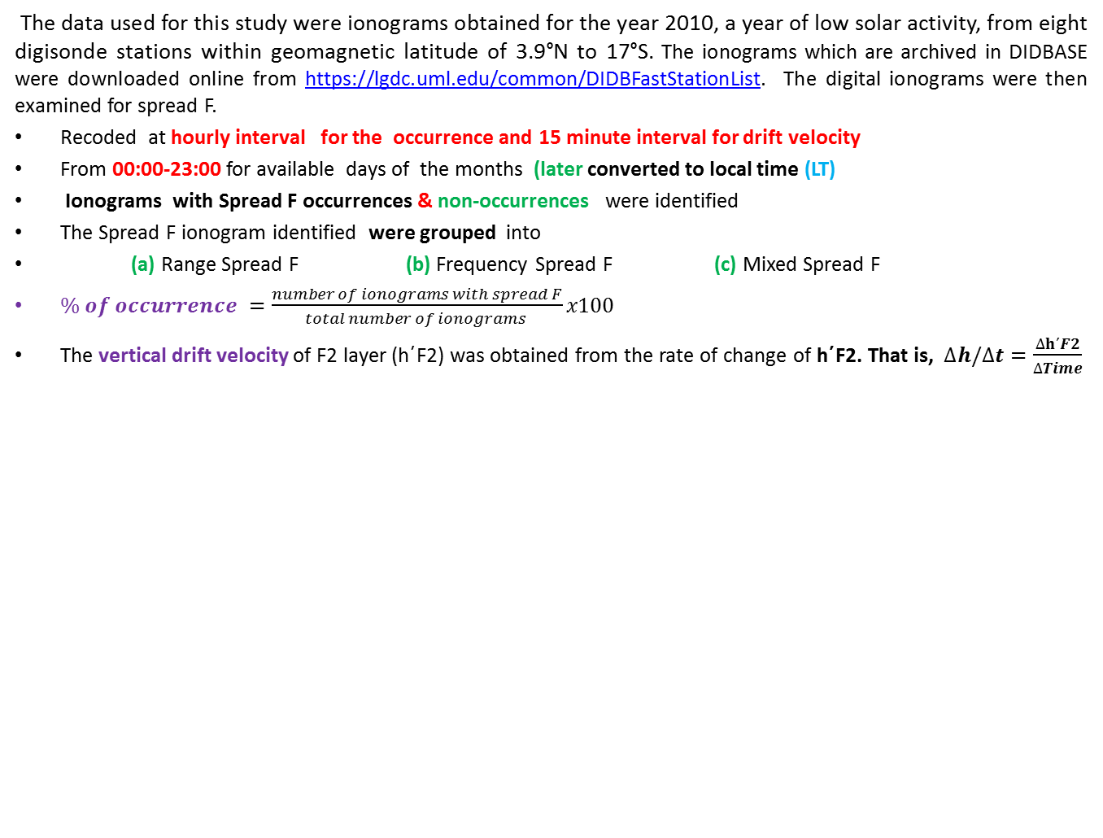
DATA AND METHOD
The data used for this study were ionograms obtained for the year 2010, a year of low solar activity, from eight digisonde stations within geomagnetic latitude of 3.9°N to 17°S. The ionograms which are archived in DIDBASE were downloaded online from https://lgdc.uml.edu/common/DIDBFastStationList. The digital ionograms were then examined for spread F.
Recoded at hourly interval for the occurrence and 15 minute interval for drift velocity
From 00:00-23:00 for available days of the months (later converted to local time (LT)
Ionograms with Spread F occurrences & non-occurrences were identified
The Spread F ionogram identified were grouped into
(a) Range Spread F (b) Frequency Spread F (c) Mixed Spread F
$\% of occurrence =\frac{number of ionograms with spread F}{total number of ionograms }x100$
The vertical drift velocity of F2 layer (h΄F2) was obtained from the rate of change of h΄F2. That is, $∆h/∆t=\frac{∆h΄F2}{∆Time}$
Notes:
Put the table on a separate page.

Slide 8
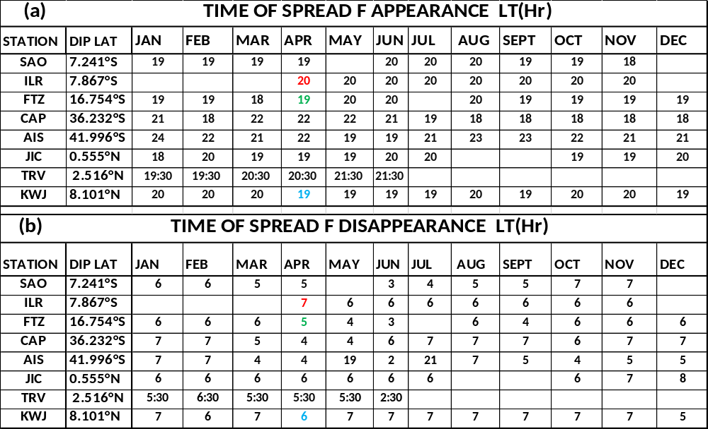
SPREAD F TIME OF APPEARANCE AND DISAPPEARANCE
Appears between 1800LT and 2200 LT Disappears usually after 0300LT and 0700 LT

Slide 9
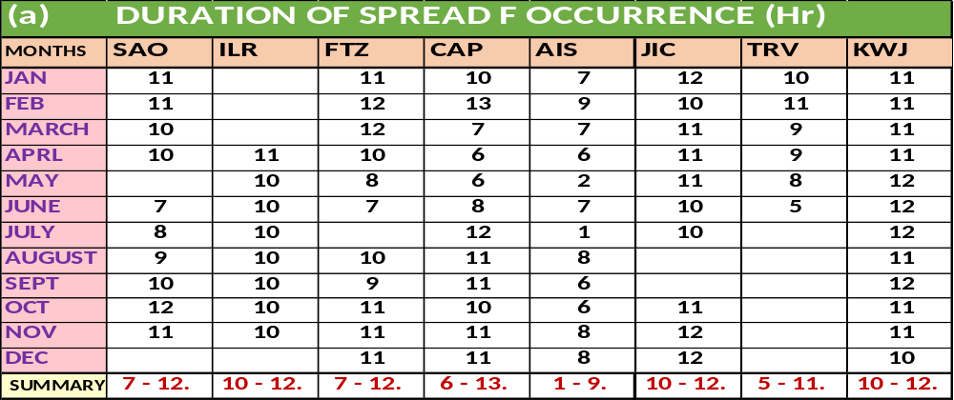
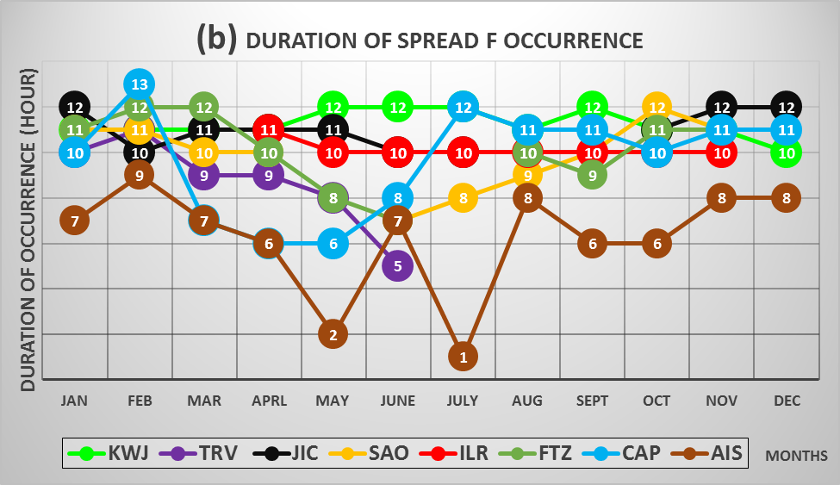
Duration of Equatorial Spread F occurrence
Duration is about 1 -12 hours

Slide 10
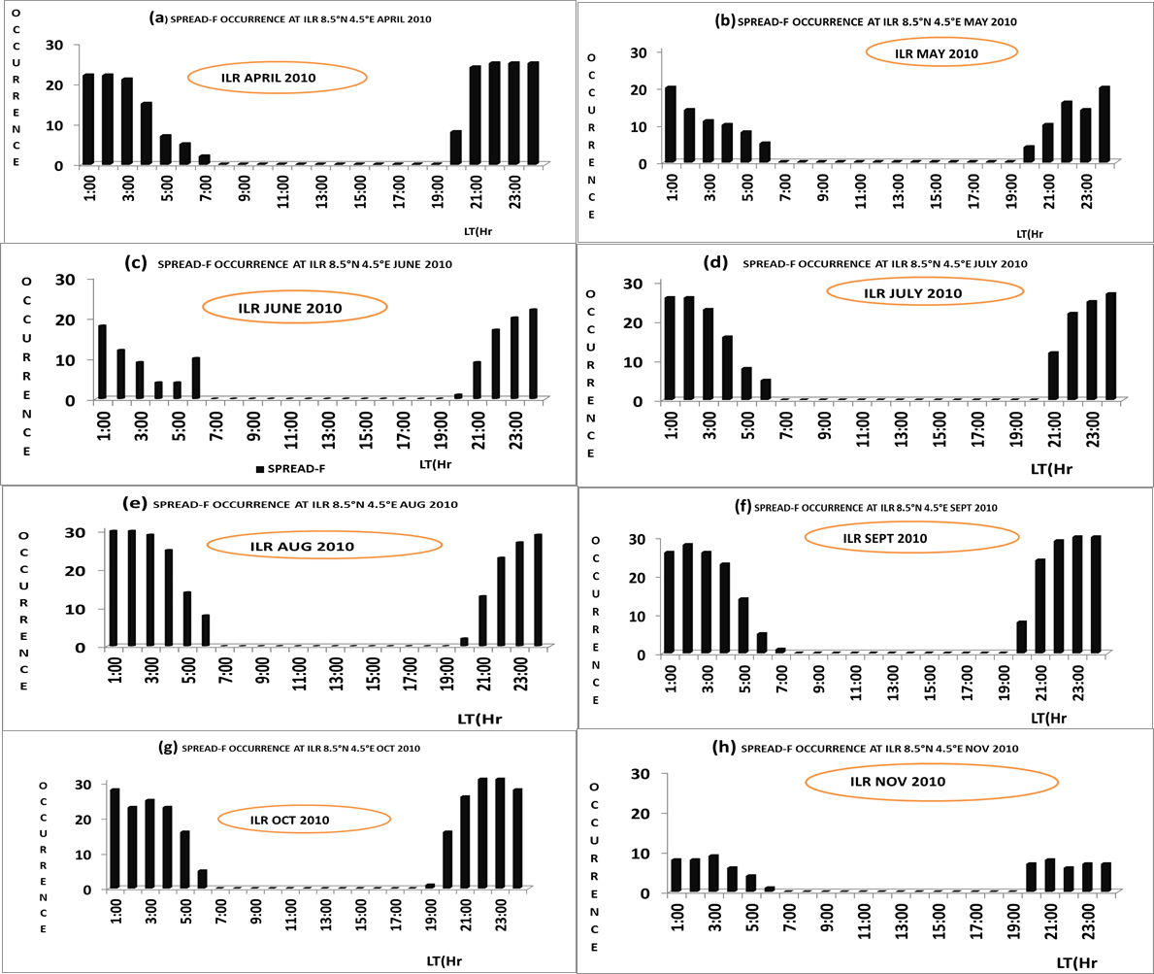
Spread F occurrence sample (ILR)

Slide 11
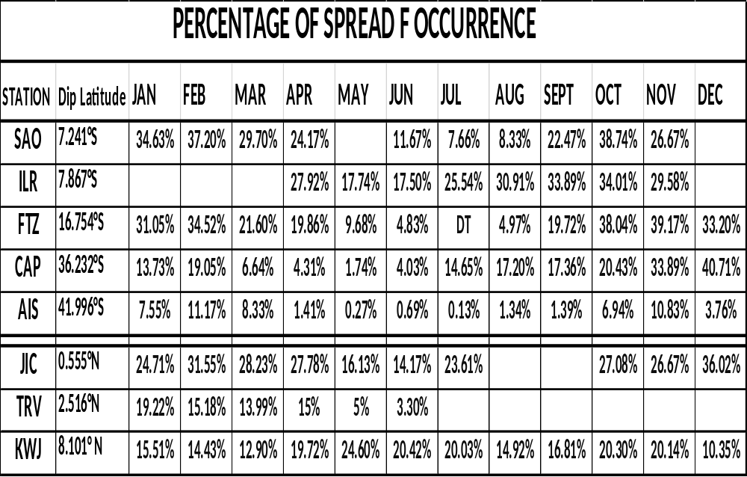
Latitudinal Variation on Equatorial Spread F occurrence
Occurrence ranged between 0.13% and 40% and occurrence increases with decease in latitude

Slide 12
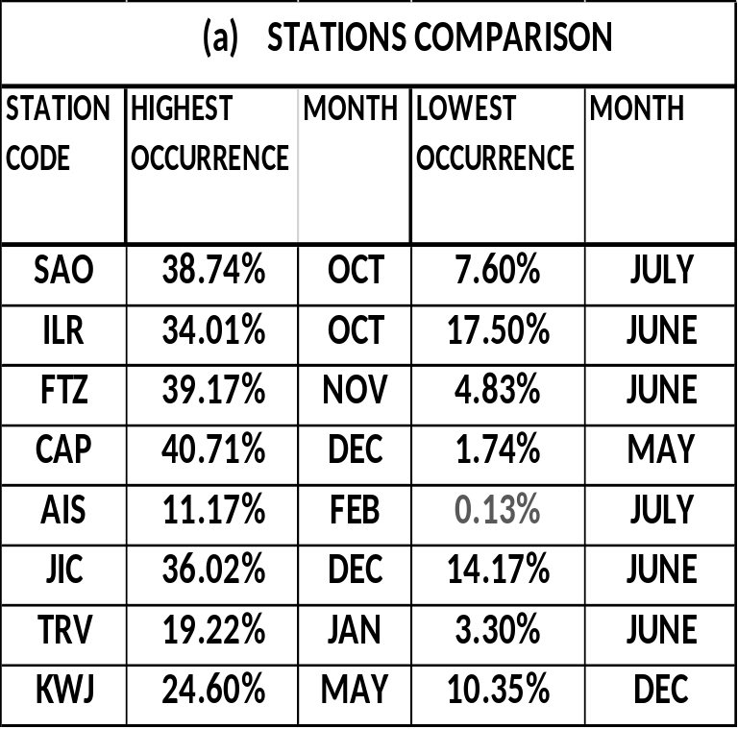
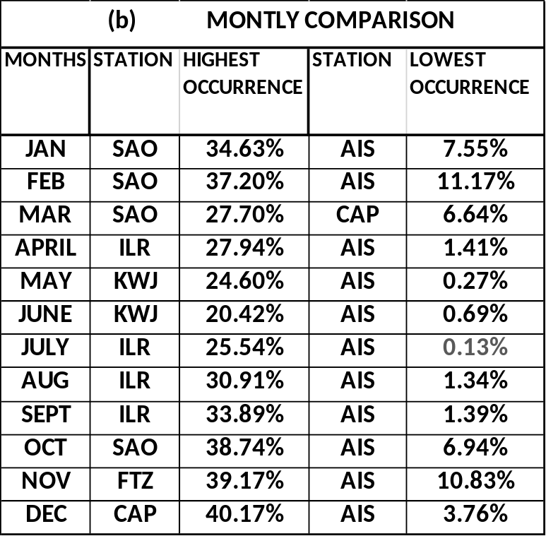
SUMMARY OF THE OVERALL PERCENTAGE OF OCCURRENCE
(Table a )Low occurrence during the June solstice . (Table b) High occurrence in the stations close to the magnetic equator while low occurrence in the stations far away from magnetic equator

Slide 13
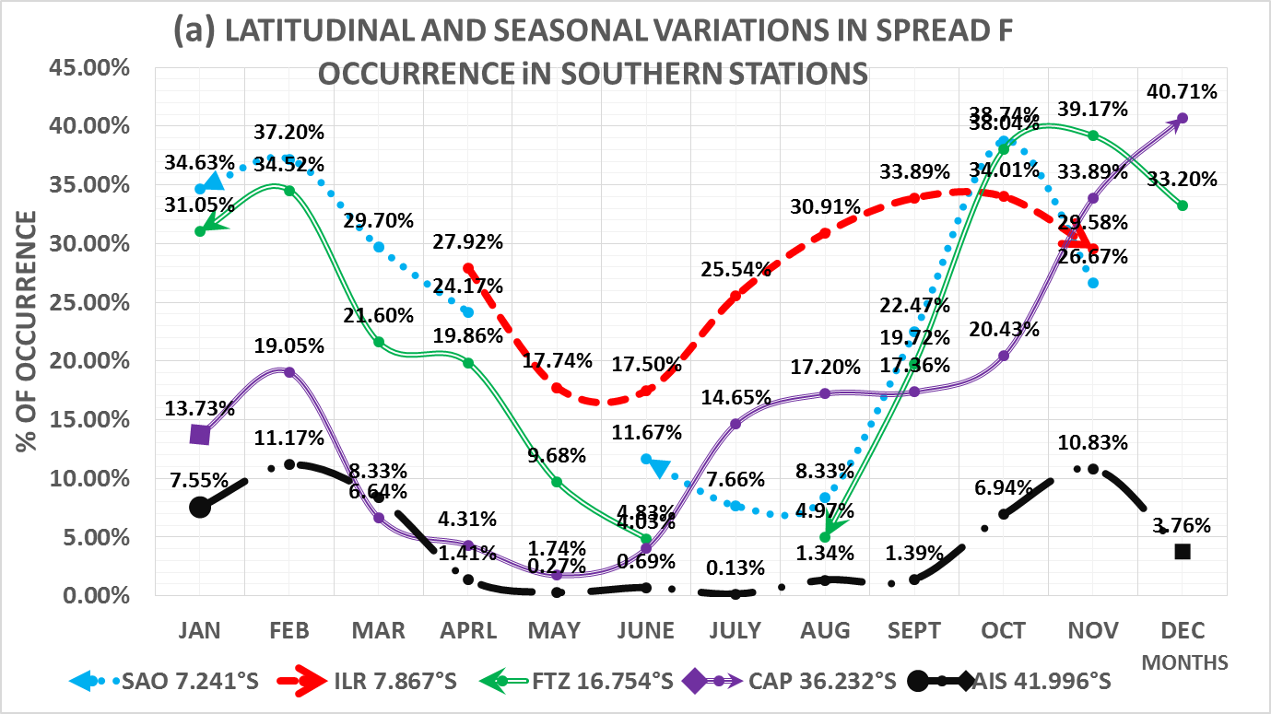
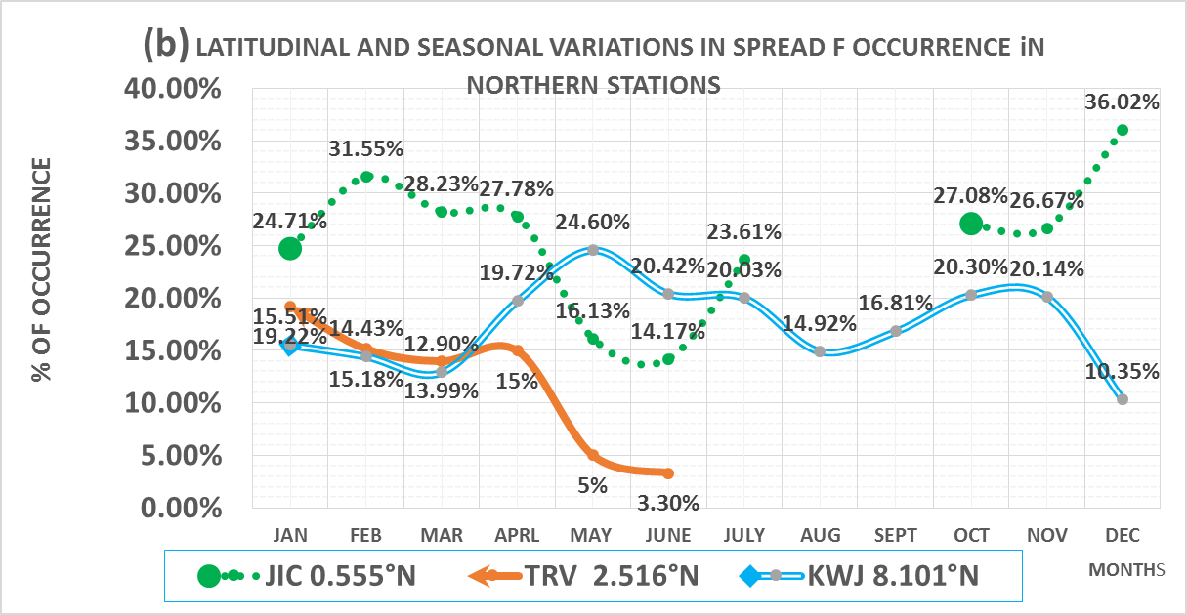
Seasonal Variation on Equatorial Spread F occurrence
Occurrence during the solstices is less than during the equinoxes.

Slide 14
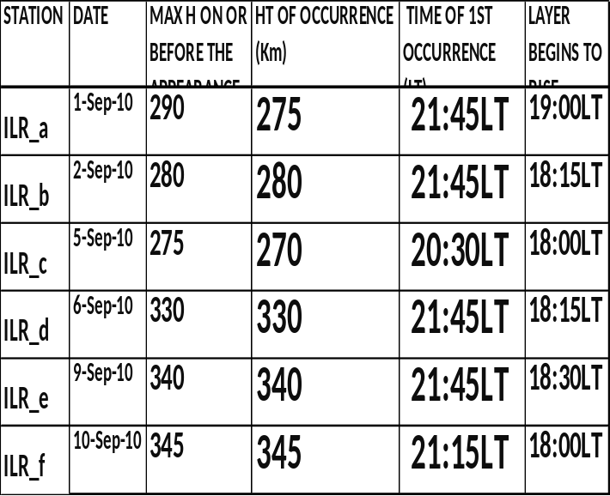
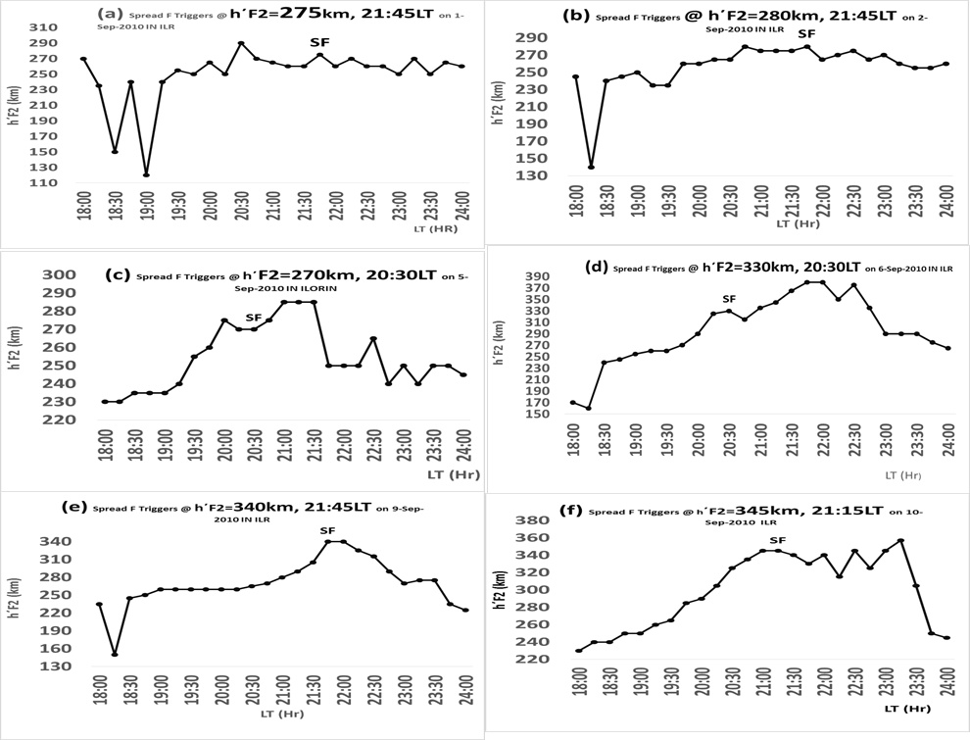
  Variation of h΄F2 with Local Time in ILR SEPT 2010
Continuous and noticeable increase in virtual height triggered SF
Low initial virtual height during the occurrence period requires good/high speed or high drift velocity (e.g. figure a) to push it to height of occurrence
virtual height during time of occurrence is a factor
If sufficient height for occurrence has already attained b4 the occurrence period and there is no continuous reduction below HT of occurrence, it can trigger
Increase in virtual height begins at 1800LT-1900LT and triggered between 2030LT & 2145LT
Height of occurrence is between 260KM AND 345KM
Notes:
Only the plots on one page. Put the table on another slide.

Slide 15
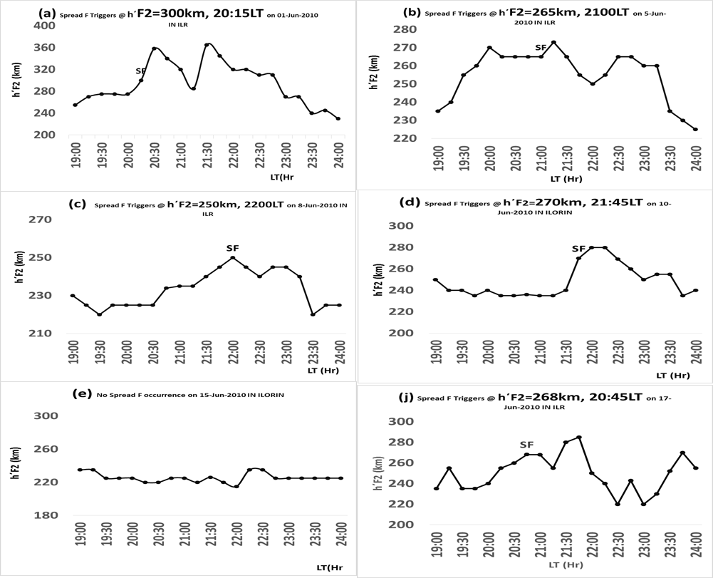
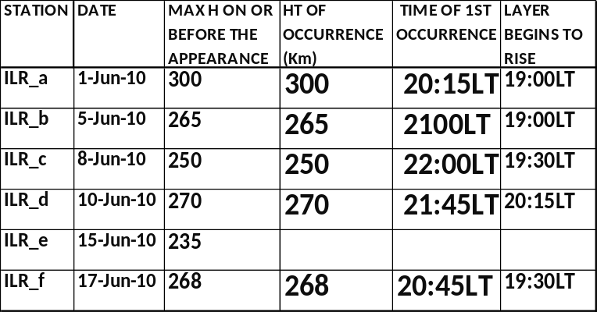
  Variation of h΄F2 with Local Time in ILR June 2010
Continuous and noticeable increase in virtual height triggered SF
Initial virtual height during the occurrence period
Virtual height during time of occurrence
If sufficient height for occurrence has already attained b4 the occurrence period and there is no continuous reduction below HT of occurrence, it can trigger
Increase in virtual height begins at 1900LT-2015LT and triggered between 2015LT & 2245LT
Height of occurrence is between 250KM AND 300KM
Low initial virtual height during occurrence hours require good/high speed to push it to min height of occurrence
Continuous decrease in virtual height cannot triggered SF

Slide 16
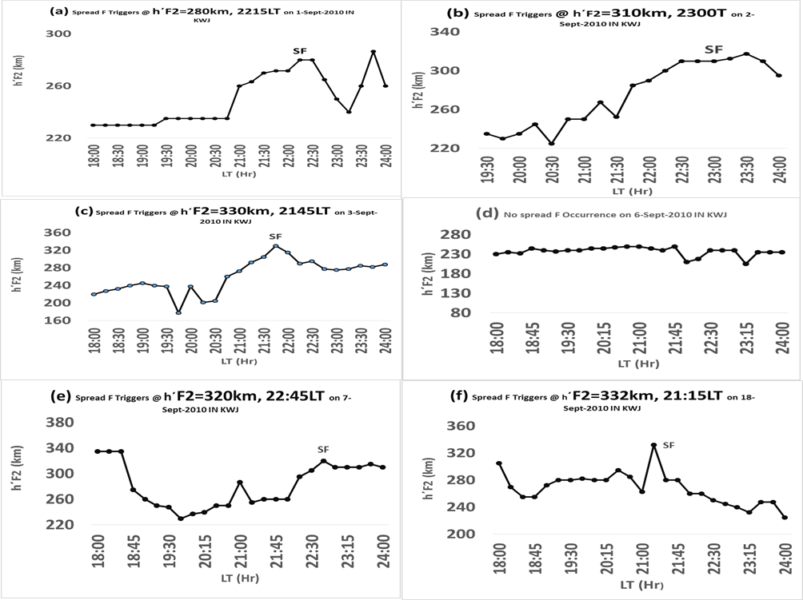
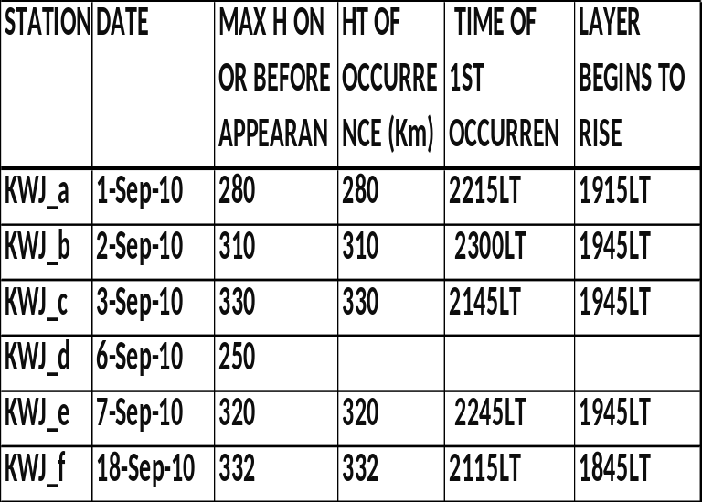
Variation of h΄F2 with Local Time in KWJ SEPT., 2010
Continuous and noticeable increase in virtual height will triggered SF
Initial virtual height during the occurrence period
Virtual height during time of occurrence
Increase in virtual height begins at 1800LT-1945LT and triggered between 1945LT & 2300LT
Height of occurrence is between 270KM AND 350KM
Low initial virtual height during occurrence hours require good/high speed to push it to min height of occurrence
It does not occurs on 6-Sep-10 because it does not meet the height of occurrence
Notes:
The plot are too small, we can’t read the features.

Slide 17
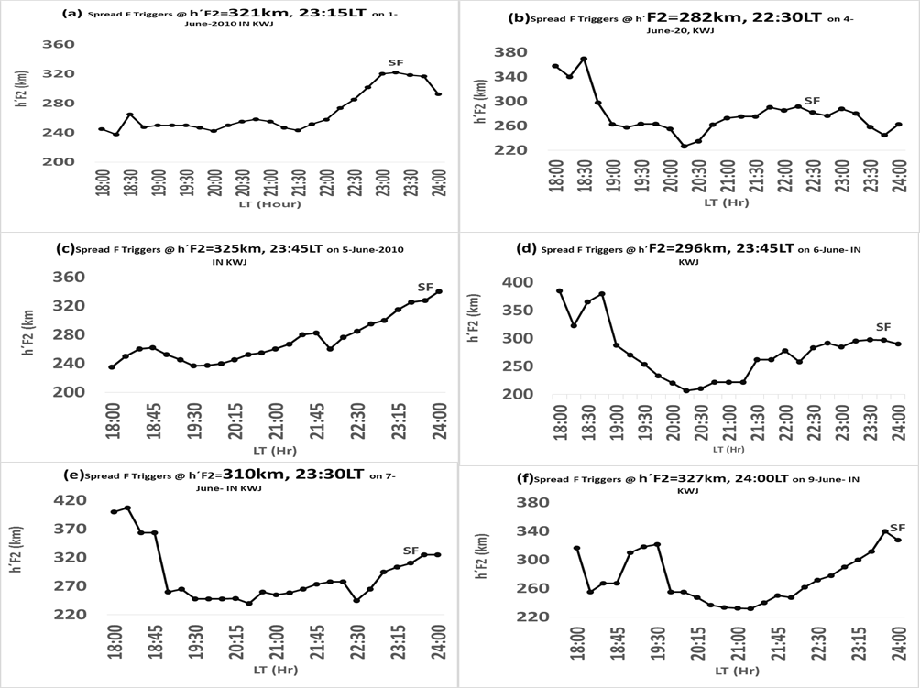
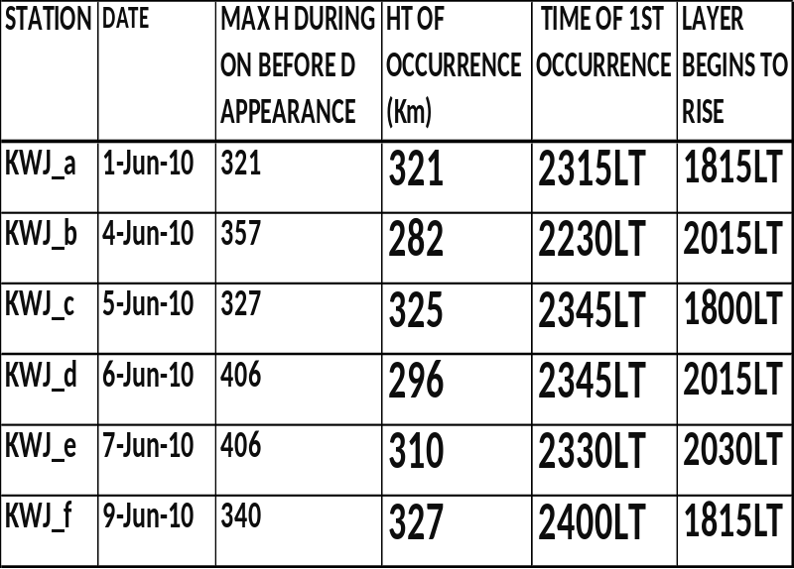
  Variation of h΄F2 with Local Time in KWJ JUNE, 2010
Continuous and noticeable increase in virtual height triggered SF
Initial virtual height during the occurrence period
Virtual height during time of occurrence
Increase in virtual height begins at 1800LT-2030LT and triggered between 2030LT & 2400LT
Height of occurrence is between 270KM AND 327KM
Low initial virtual height during occurrence hours require good/high speed to push it to min height of occurrence

Slide 18
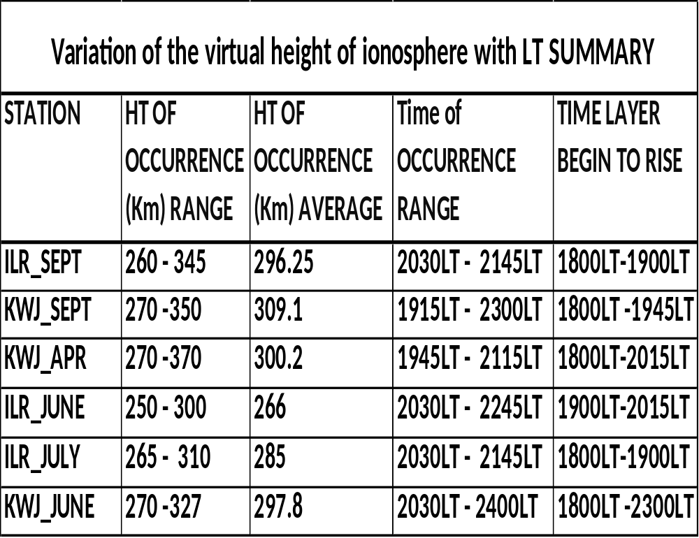

Slide 19
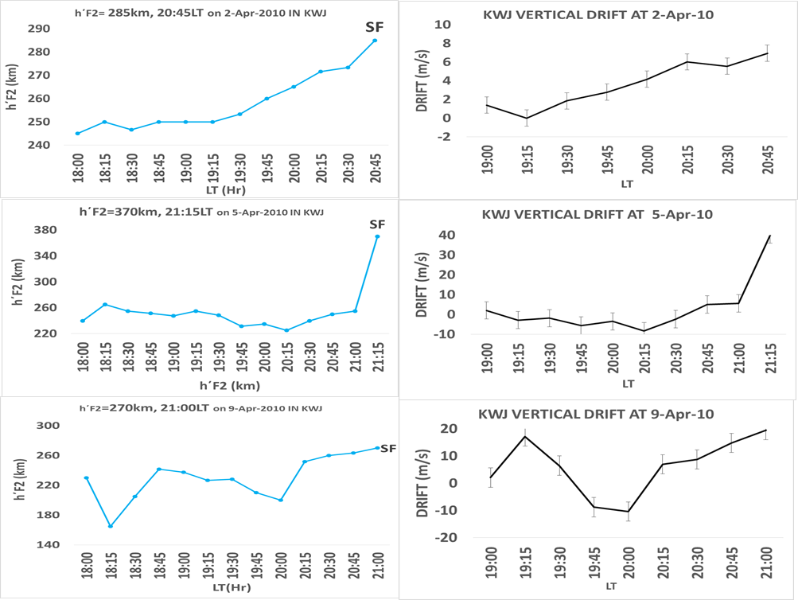
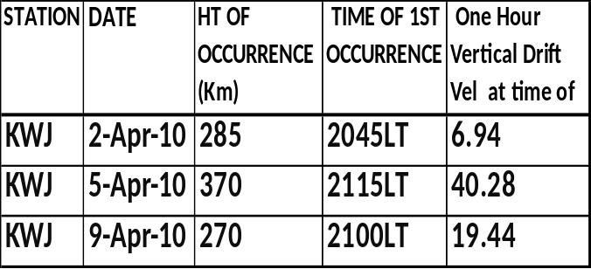
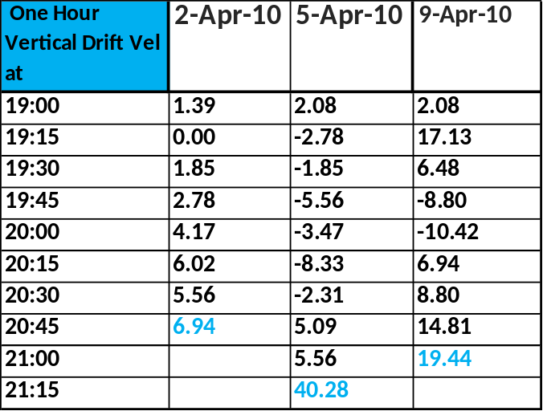
  VERTICAL DRIFT VELOCITY
Variation of h΄F2 with LT (Left panel) Vertical drift velocity (Right panel)

Slide 20
CONCLUSION
Occurrence frequency varied between 0.13% and 40.71%.
Spread F occurs within 1900LT and 0600LT and is triggered when the virtual height of F layer is within 250km and 370km.
Spread F occurred when there is continuous and a noticeable rise in virtual height and the height of the F2 layer is at least 250km. The average drift velocity around the time of occurrence is within 3 m/s to 40 m/s during the equinoxes period and 3 m/s to 18 m/s during the solstices period; and
Occurrence frequency increases with the decrease in latitude.
The study concluded that spread F is a nighttime phenomenon and that the occurrence frequency varies with time, season and latitude.

Slide 21
THANKS AND GOD BLESS YOU for Listening
Notes:
Do you think you will have all the time to present all these 54 slides? You are joking. Your slides should not be more than 15 maximum. You will have only 20 minutes to present. So redo your slides, picking only the important results.

