Slide 1
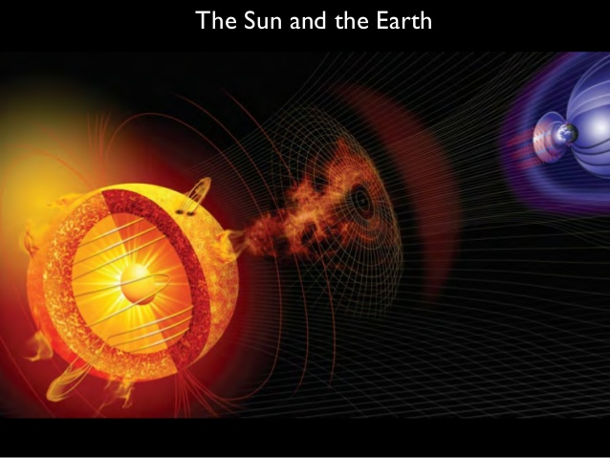
RESPONSE OF EQUATORIAL IONOSPHERE TO SPACE WEATHER
EVENTS
¹Akinyemi, G.A, ²Rabiu, A.B., and ¹Kolawole, L.B
¹Department of Physical Sciences, Redeemer’s University, Ede, Osun State.
²Centre for Atmospheric Research, National Space Research and Development Agency, Kogi State University Campus, Anyigba.

Slide 2
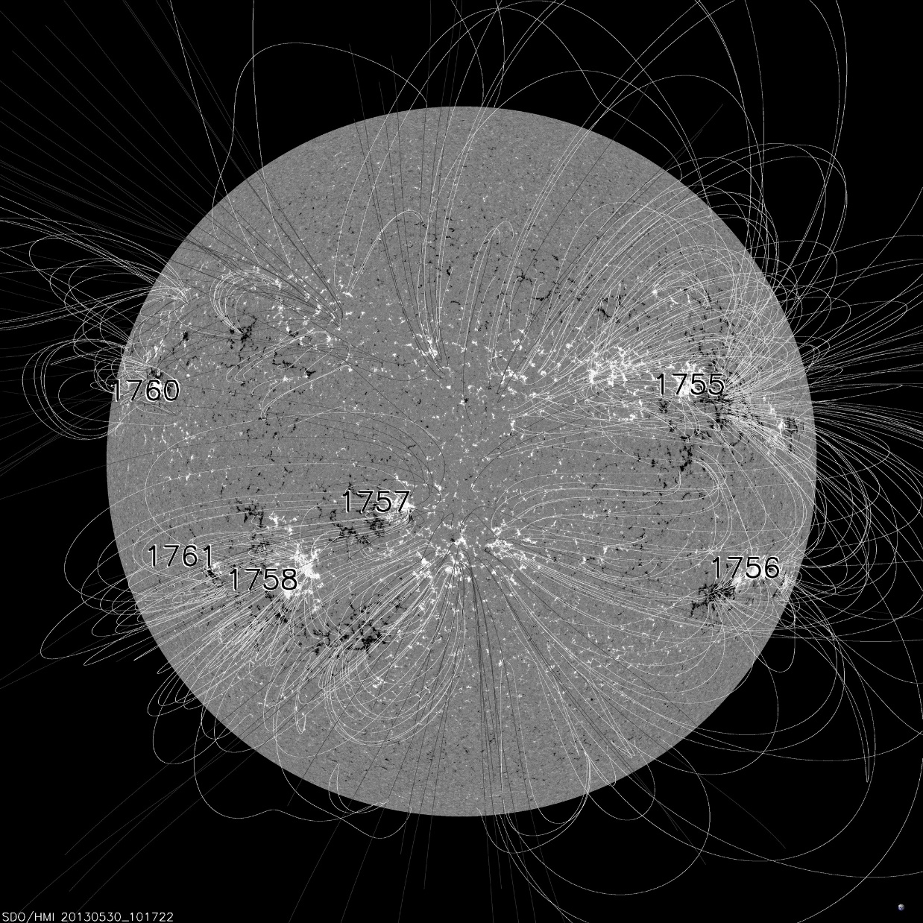
GENERAL INTRODUCTION
SUN
SUN
SOLAR WIND
MAGNETOSPHERE
EARTH
IONOSPHERE
NASA
OPEN AND CLOSED FIELDS ON THE SUN
The Sun regularly bathes us and the rest of our solar system with energy
In the forms of light and charged particles and magnetic fields --- Solar wind
Two types of solar Wind: SSW, originates from
areas of closed Magnetic F lines. FSW originates from
areas of open magnetic F lines.

Slide 3
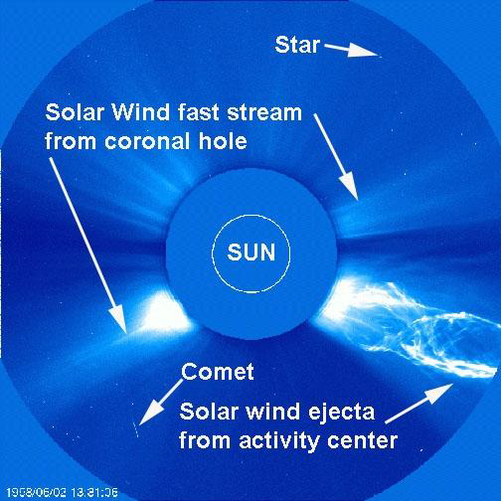
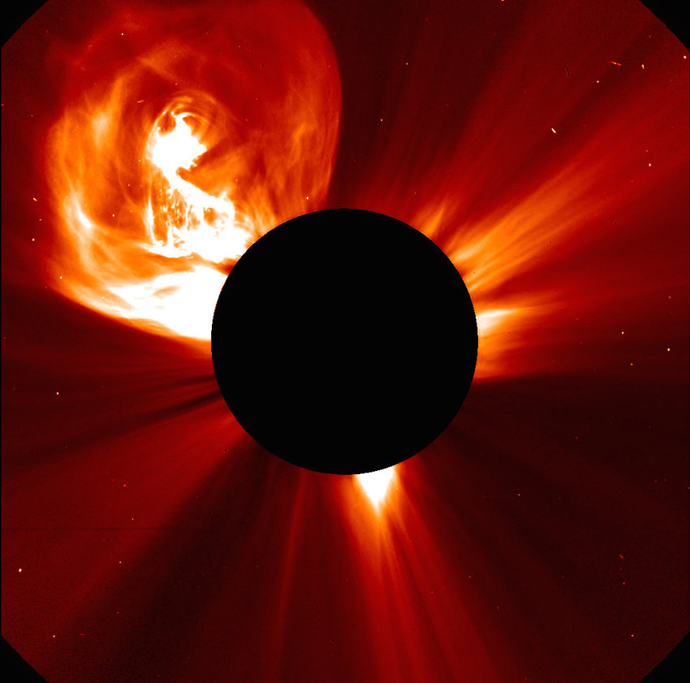
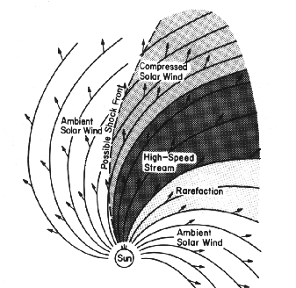
SOLAR WIND STRUCTURES (CMEs and CIRs)
CMEs are huge bubbles of plasma wrapped in a magnetic field, ejecting from the sun. If Bz turns south this magnetic bubble can penetrate into our magnetosphere and inject high energy particles to cause storms.
Co-rotating interaction regions (CIRs) are formed when FSW overtakes the SSW and exert pressure on it.
11/09/2019

Slide 4
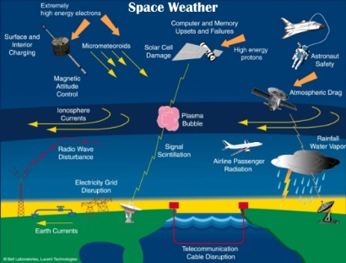
Conditions existing in the Sun, and in the solar wind, magnetosphere, ionosphere and thermosphere that can affect/influence the performance and reliability of space-borne and ground-based technological systems and can endanger human life or health . Adverse conditions in the space environment can cause disruption of satellite operations, communication, navigation and electric power distribution grids, leading to a variety of socioeconomic losses
Notes:
The space weather comprises plasma bubble………

Slide 5
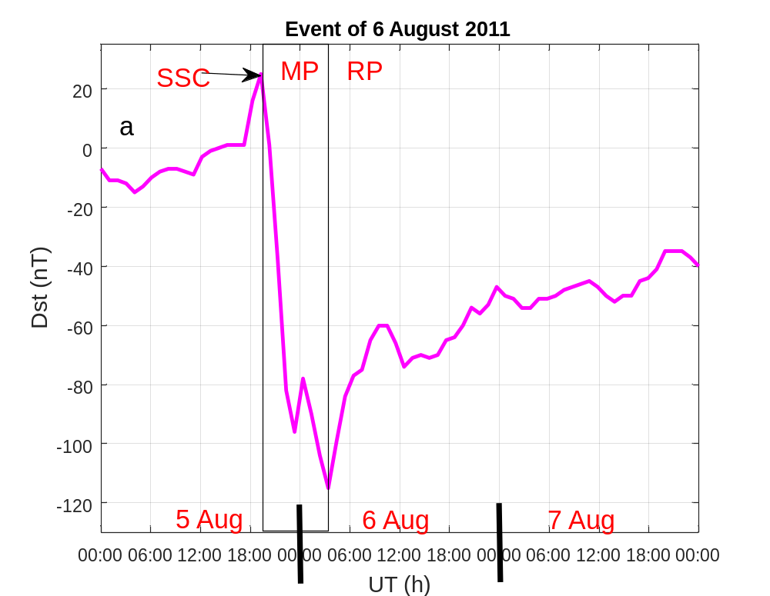
GEOMAGNETIC STORMS
An interval of time when a sufficiently intense
and long lasting interplanetary convection
EF leads, through a substantial energization
In the magnetosphere-ionosphere system, to
an intensified ring current sufficiently strong
to exceed some threshold of the quantifying
Storm time Dst. Index - A measures of the ring
Current forming around the earth during geo
Storms (Gonzalez et al., 1994).
(Dst -50 nT = IMF-Bz -5 nT).
Dst -30 nT < weak < Dst -50 nT,
Dst -50 nT < moderate < Dst -100 nT,
Dst -100 nT < strong < Dst -200 nT,
Dst -200 nT < severe < Dst -350 nT,
great < Dst -350 nT,
Storms are generally categorized as +ve or –v
depending on
weather the dominant deviation is on the increase
or decrease.

Slide 6
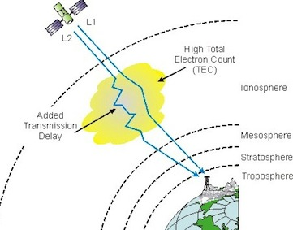
^{TOTAL ELECTRON CONTENT (TEC)}
The ionospheric parameter that has an overbearing influence GPS-based communication and navigation systems. Number of electrons in the column of 1 meter square cross section that extends from a GPS transmitter to a receiver.
Ionosphere Delay

Slide 7
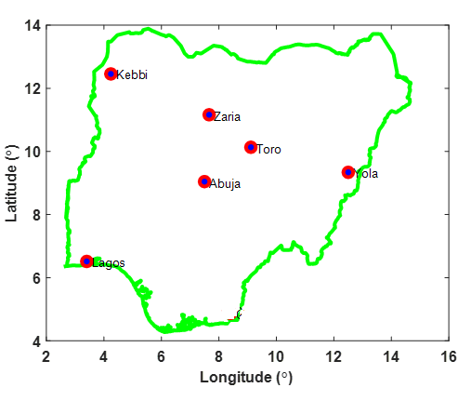
Data Source
TEC data: ground-based GPS receiver stations of Nigerian Global Navigation Satellite Systems network of stations ( NIGNET) (www.nignet.net).
Operated by OSGoF.
solar-geomagnetic indices data (htpp://omniweb.gsfc.nasa.gov)
Period: August 2011
ID | LOCATION | Geo. Lat (ºN) | Geo. Lon (ºE) | Mag.lat (ºN) | Mag.lon (ºE)
abuz | Kaduna | 11.15 | 7.65 | -0.13 | 79.75
bkfp | Kebbi | 12.47 | 4.23 | 0.72 | 76.62
cggt | Toro | 10.12 | 9.12 | -1.04 | 81.10
futy | Yola | 9.35 | 12.50 | -1.33 | 84.31
osgf | Abuja | 6.92 | 11.18 | -3.04 | 82.94
ulag | Lagos | 6.52 | 3.40 | -3.03 | 75.45

Slide 8
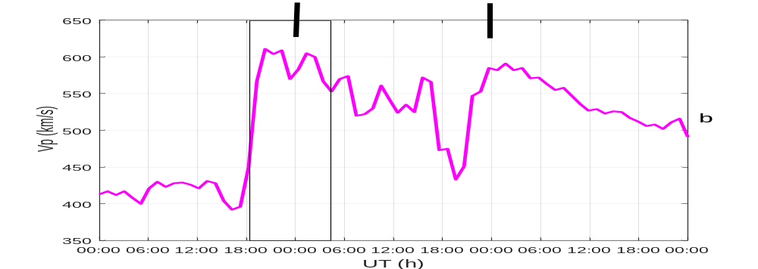

Slide 9
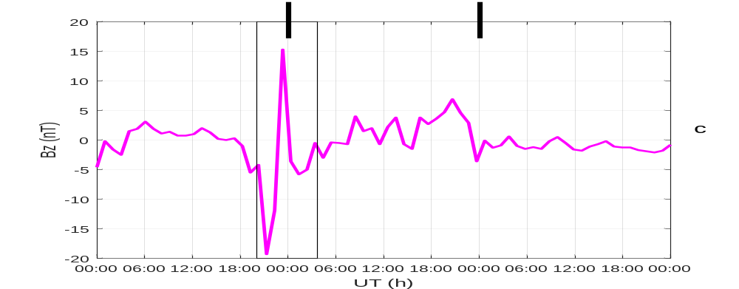
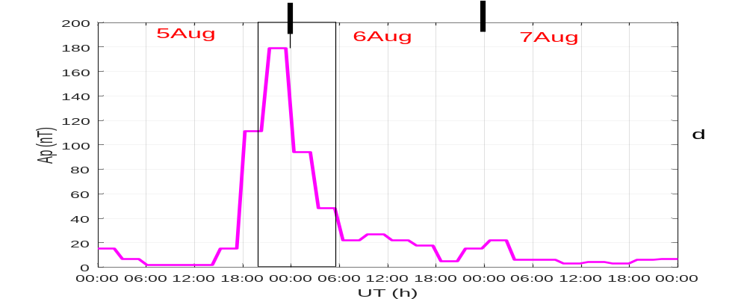

Slide 10
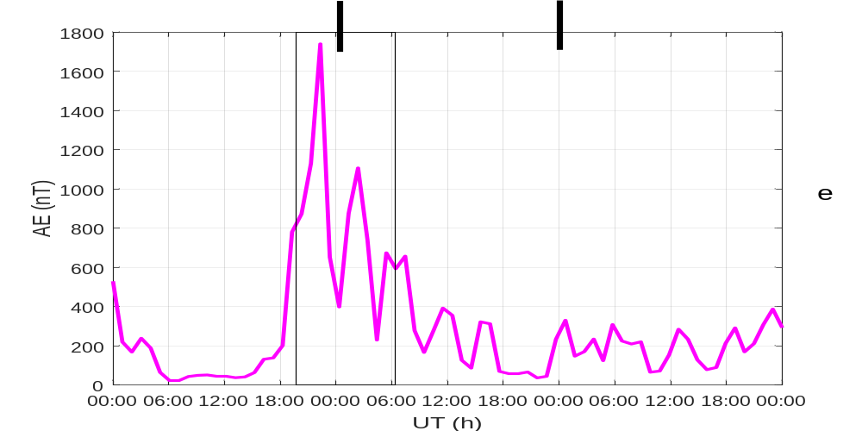

Slide 11
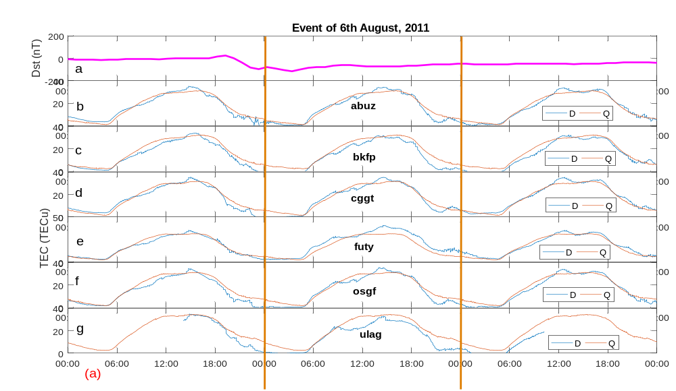

Slide 12
RESULTS
LOCATION | Geo. Lat (ºN) | Geo. Lon (ºE) | Ave QDs | 5 Aug | 6 Aug | 7 Aug | % variation
abuz | 11.15 | 7.65 | 30.86 | 34.01 | 33.95 | 33.24 | 10.01 (+ Se)
bkfp | 12.47 | 4.23 | 32.09 | 33.75 | 30.85 | 31.24 | -3.86 (-Se)
cggt | 10.12 | 9.12 | 31.55 | 33.60 | 34.82 | 34.57 | 10.36 (+ Se)
futy | 9.35 | 12.50 | 31.25 | 32.94 | 39.51 | 34.07 | 26.43 (+ Se)
osgf | 6.92 | 11.18 | 28.26 | 32.64 | 34.75 | 33.46 | 22.97 (+ Se)
ulag | 6.52 | 3.40 | 34.15 | 33.94 | 31.6 | 18.63 | -7.46 (-Se)

Slide 13
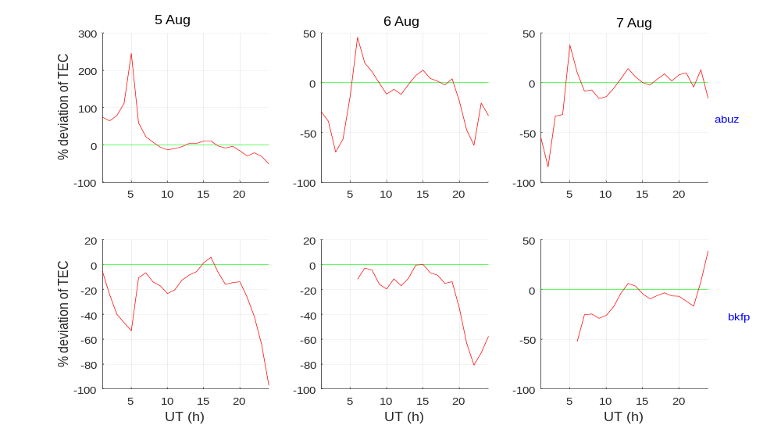

Slide 14
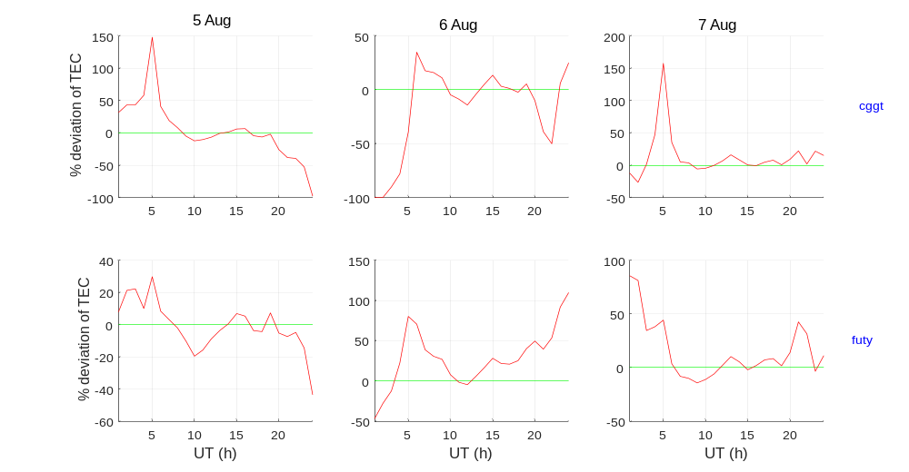

Slide 15
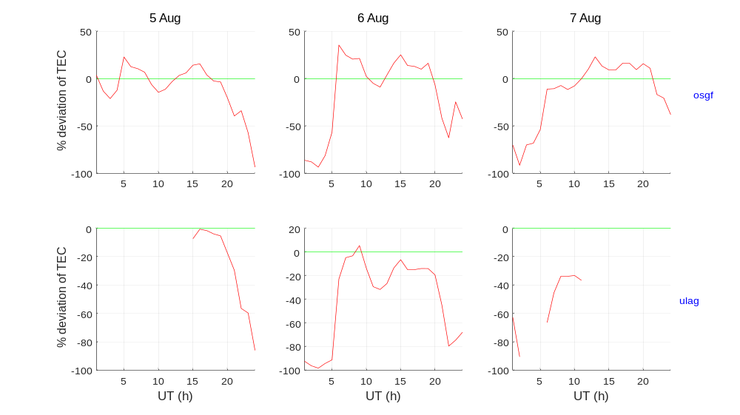

Slide 16
DISCUSSIONS
Response of the ionosphere a geo storm is influenced by two opposing effects; (1) Meridional neutral winds which causes an increase of TEC and (2) local temperature rise which causes a decrease of TEC. If the wind effects dominate the local temperature effects, TEC will tend to increase. If the reverse is the case, TEC will tend to decrease and if both effects are equal there will neither be increase or decrease of TEC (Huang et al., 1974).

Slide 17
THANKS
FOR
LISTENING

