Slide 1
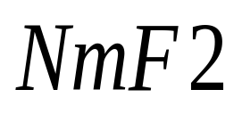
Solar wind-geomagnetic activity effect on over an African equatorial anomaly station
Kazeem A. B.
Department of Physics,
Federal University of Technology,
Akure, Nigeria
Rabiu A. B.
Centre for Atmospheric Research,
National Space Research & Development Agency,
Anyigba, Nigeria

Slide 2
Outline of Presentation
Introduction
Aim
Methodology
Results
Conclusion

Slide 3
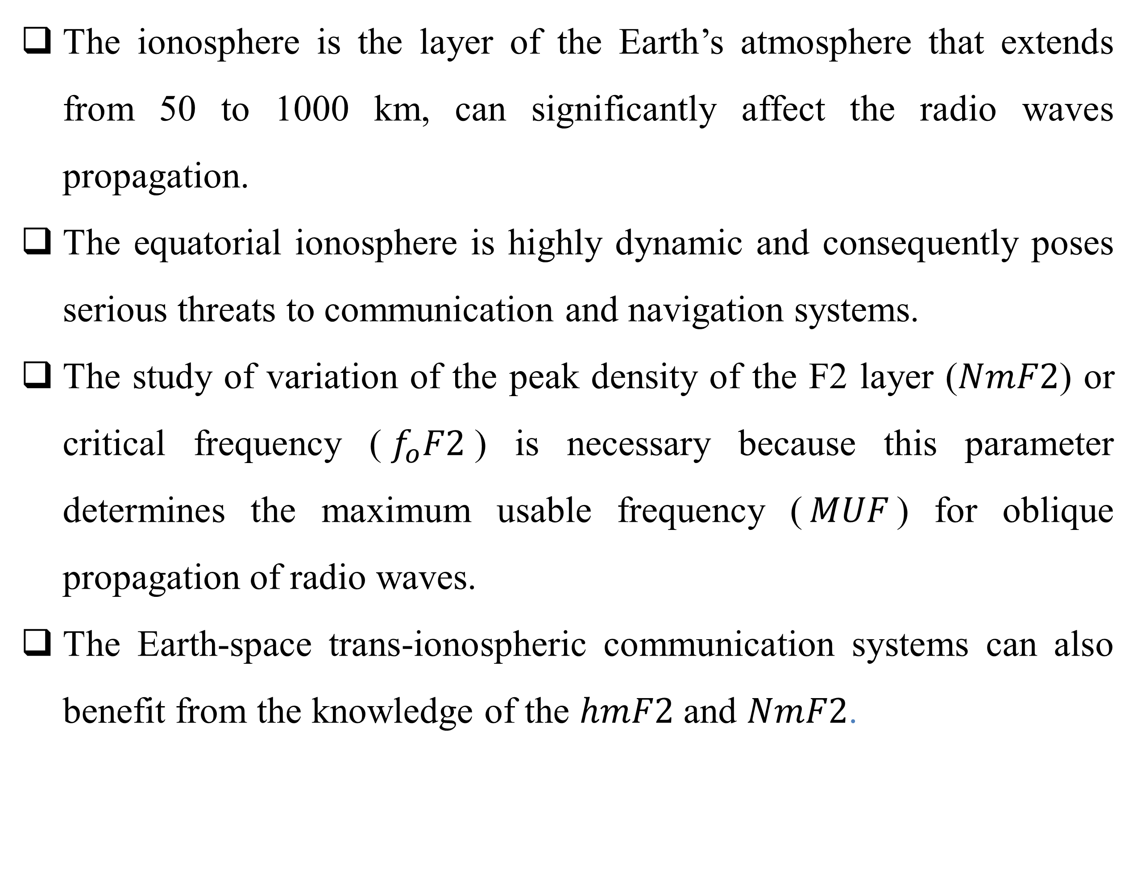
Introduction
The ionosphere is the layer of the Earth’s atmosphere that extends from 50 to 1000 km, can significantly affect the radio waves propagation.
The equatorial ionosphere is highly dynamic and consequently poses serious threats to communication and navigation systems.
The study of variation of the peak density of the F2 layer ($NmF2$) or critical frequency ($f_{o}F2$) is necessary because this parameter determines the maximum usable frequency ($MUF$) for oblique propagation of radio waves.
The Earth-space trans-ionospheric communication systems can also benefit from the knowledge of the $hmF2$ and $NmF2$.

Slide 4
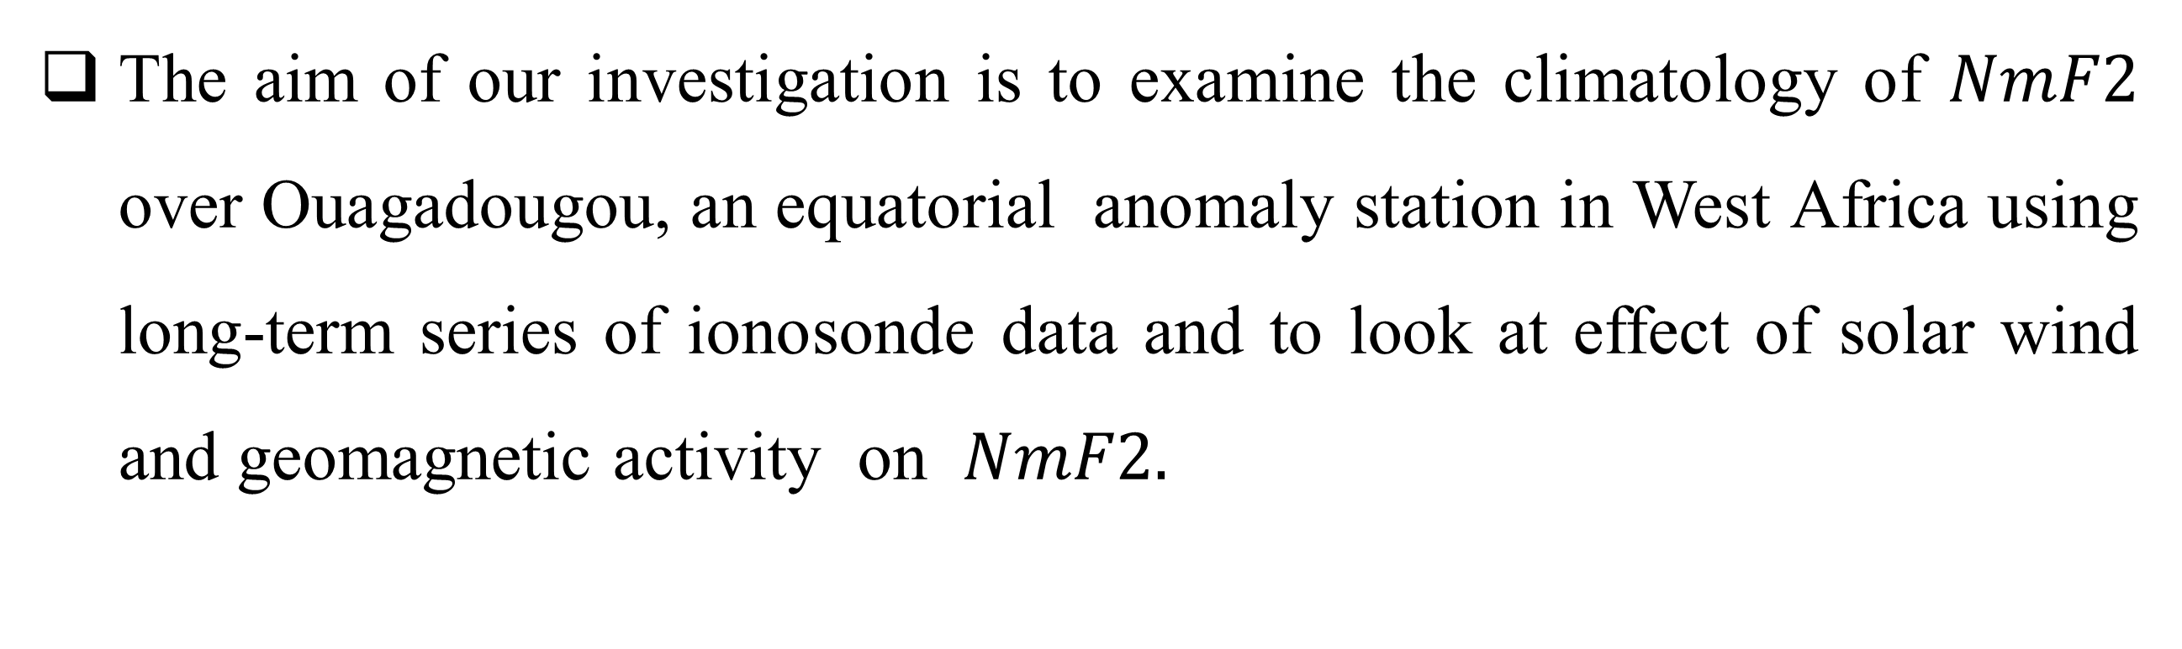
Aim
The aim of our investigation is to examine the climatology of $NmF2$ over Ouagadougou, an equatorial anomaly station in West Africa using long-term series of ionosonde data and to look at effect of solar wind and geomagnetic activity on $NmF2.$

Slide 5
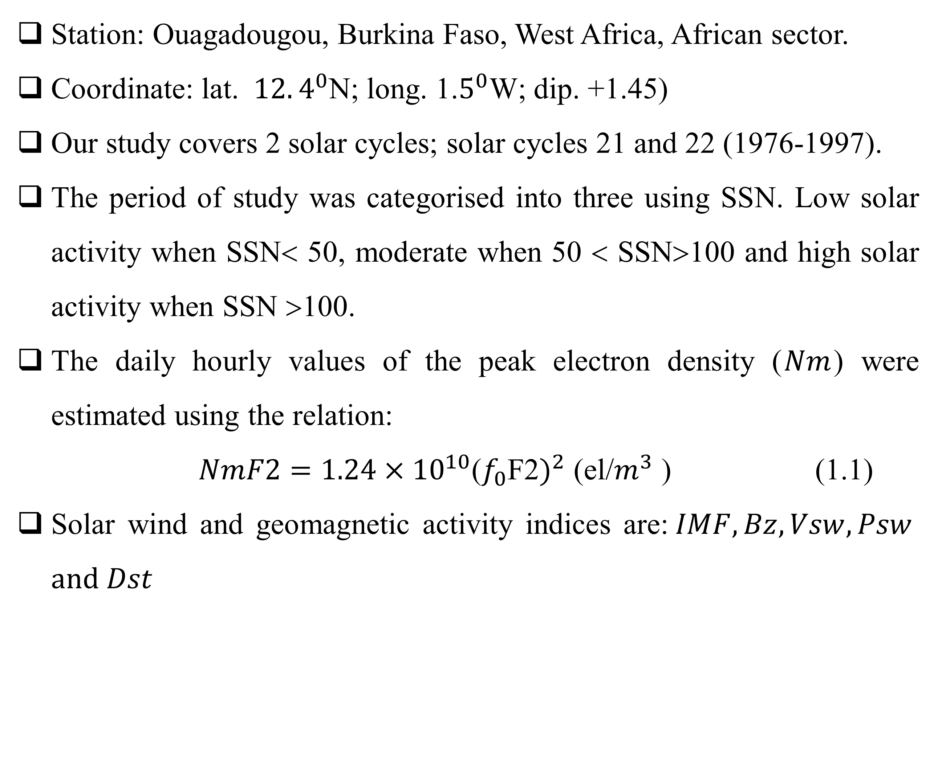
Methodology
Station: Ouagadougou, Burkina Faso, West Africa, African sector.
Coordinate: lat. $12.4^{0}$N; long. 1.$5^{0}$W; dip. +1.45)
Our study covers 2 solar cycles; solar cycles 21 and 22 (1976-1997).
The period of study was categorised into three using SSN. Low solar activity when SSN< 50, moderate when 50 < SSN>100 and high solar activity when SSN >100.
The daily hourly values of the peak electron density ($Nm$) were estimated using the relation:
$NmF2=1.24×{10}^{10}$($f_{0}$F2$)^{2}$ (el/$m^{3}$ ) (1.1)
Solar wind and geomagnetic activity indices are:$IMF, Bz, Vsw, Psw$ $and Dst$

Slide 6
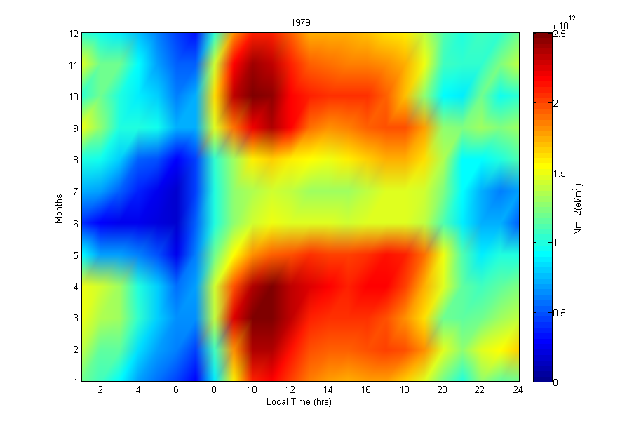
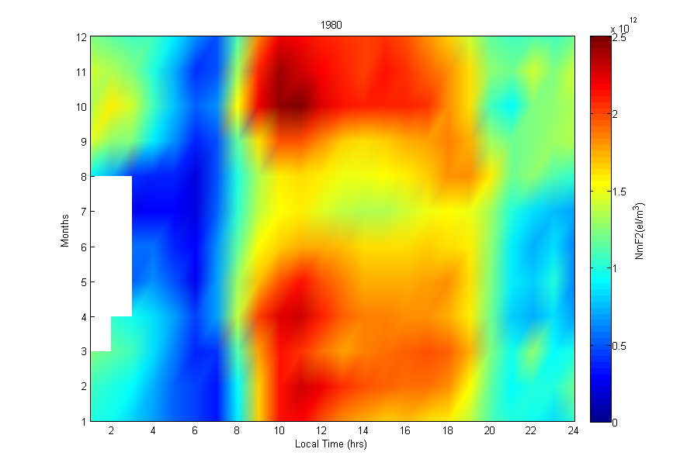
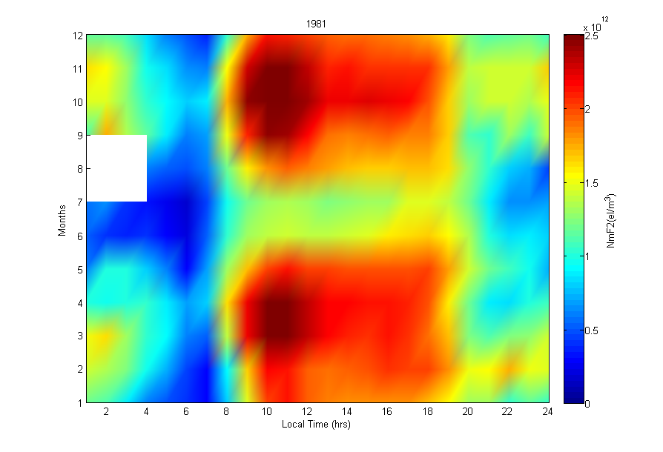
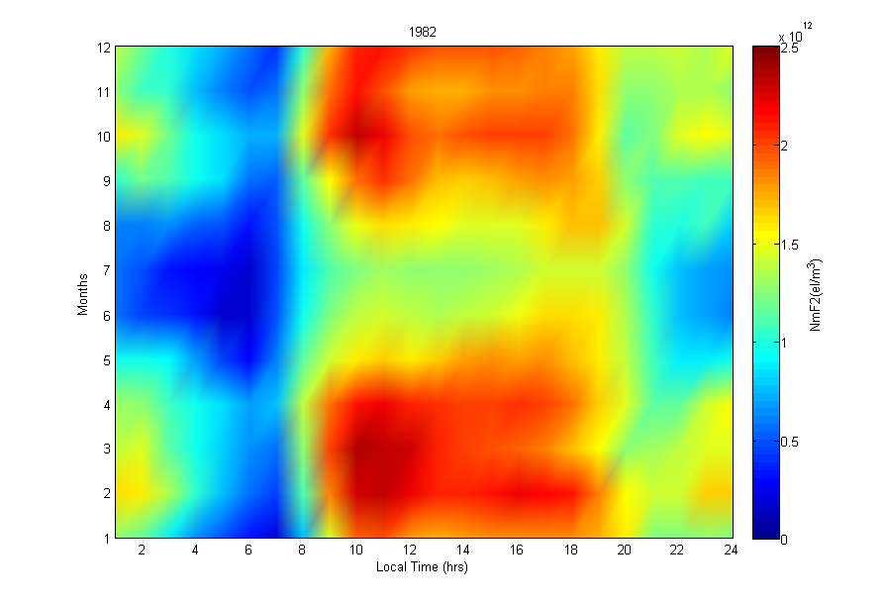
Results
Fig. 1a: Diurnal variation of over Ouagadougou, for years of high solar activity: left upper panel (1979); right upper panel (1980); left middle panel (1981); right middle panel (1982).

Slide 7
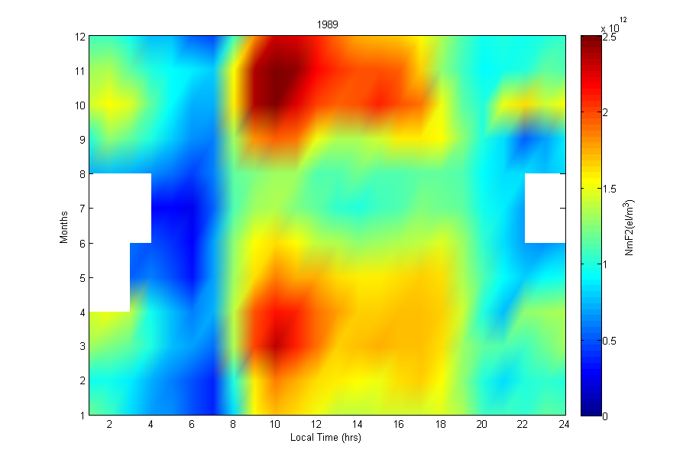
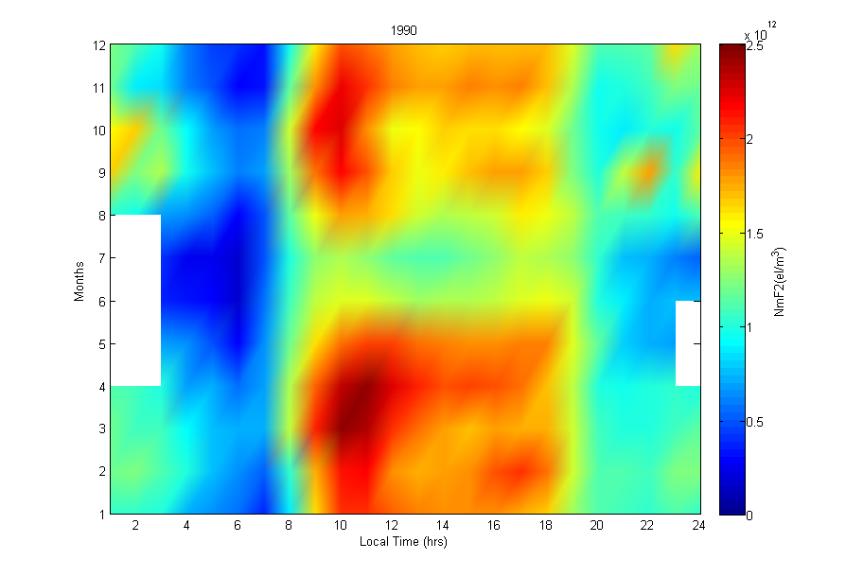
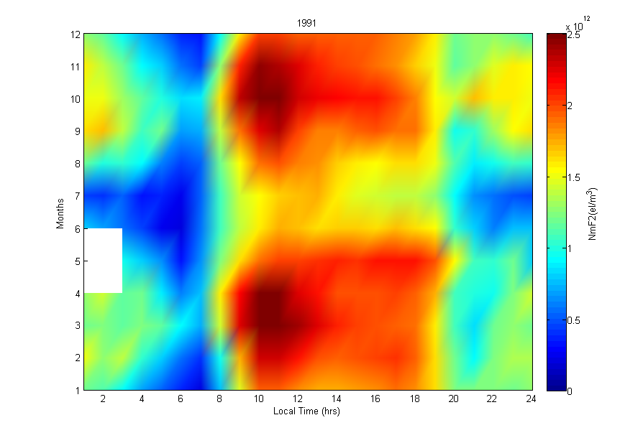
Fig. 1b: Diurnal variation of $NmF2$ over Ouagadougou, for years of high solar activity: left upper panel (1989); right upper panel (1990); left lower panel (1991).

Slide 8
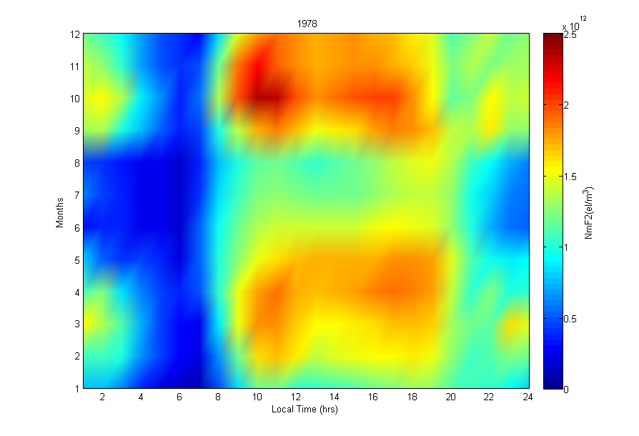
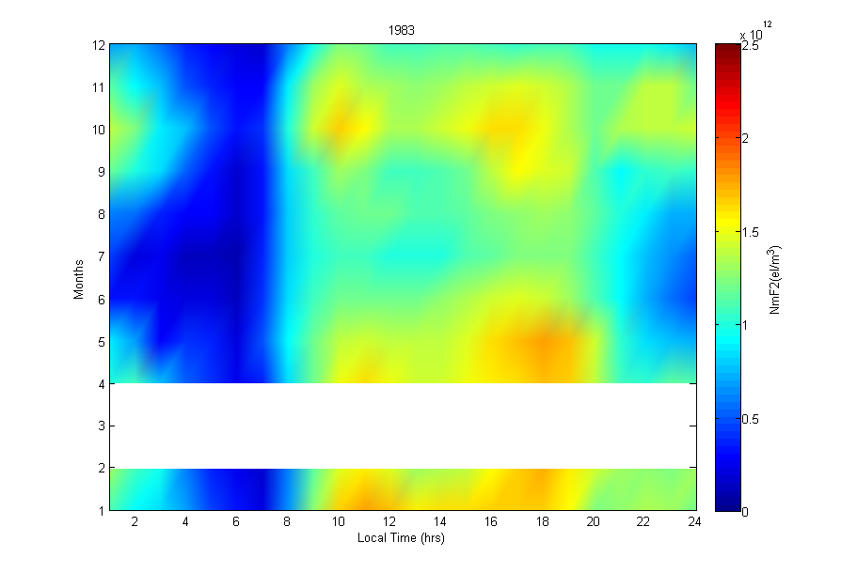
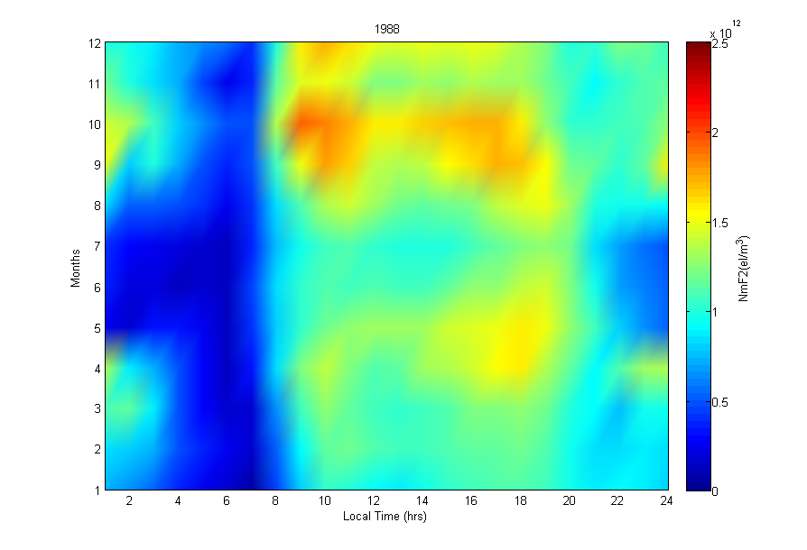
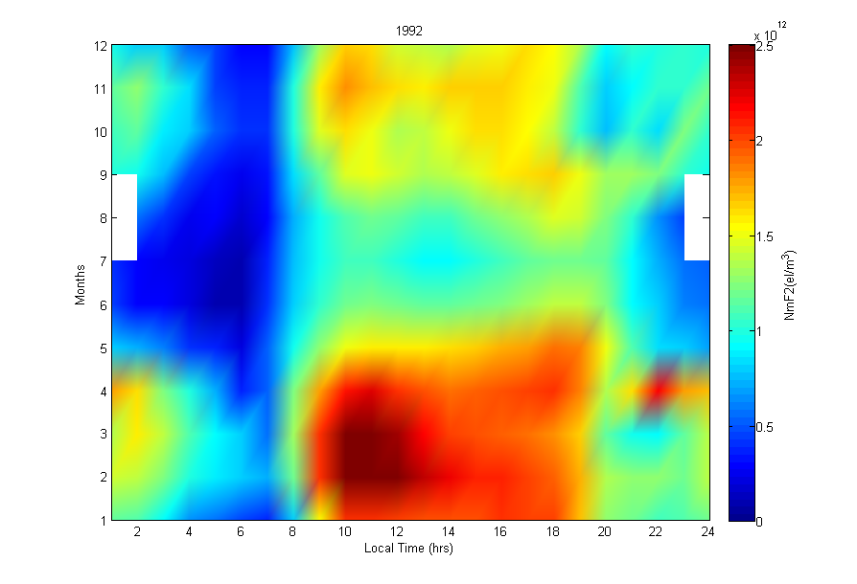
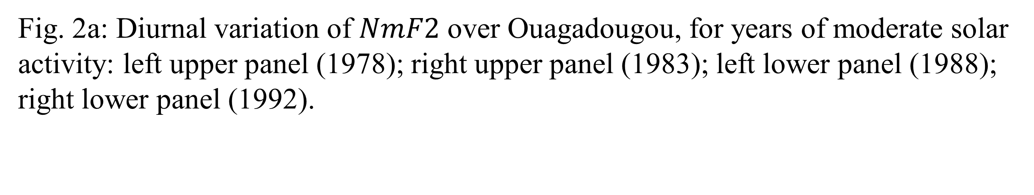
Fig. 2a: Diurnal variation of $NmF2$ over Ouagadougou, for years of moderate solar activity: left upper panel (1978); right upper panel (1983); left lower panel (1988); right lower panel (1992).

Slide 9
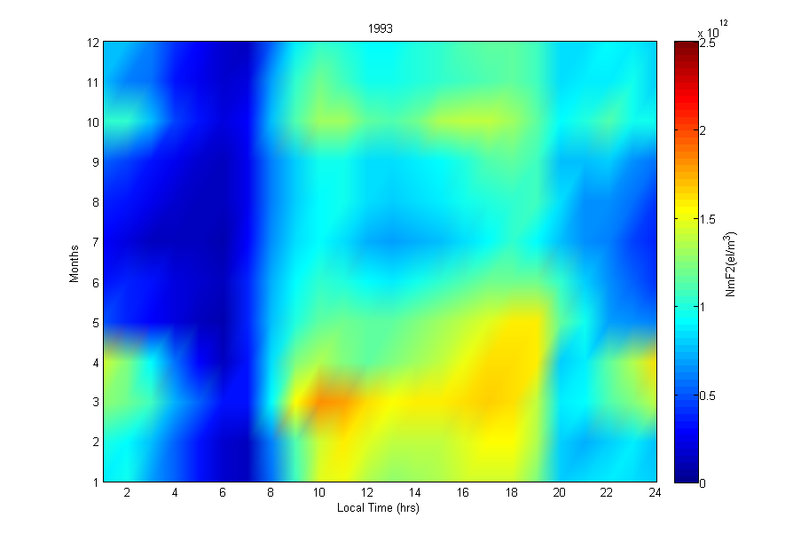
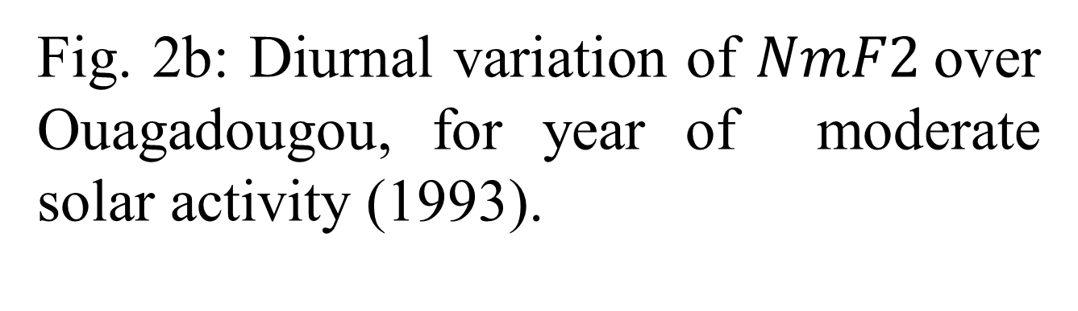
Results Contd.
Fig. 2b: Diurnal variation of $NmF2$over Ouagadougou, for year of moderate solar activity (1993).

Slide 10
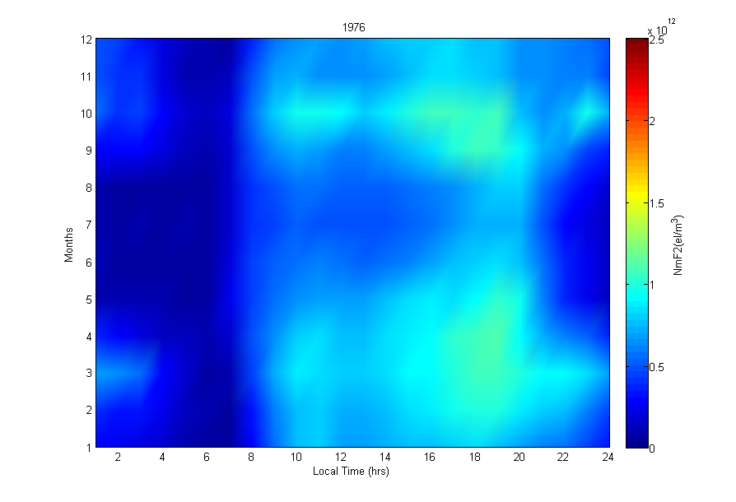
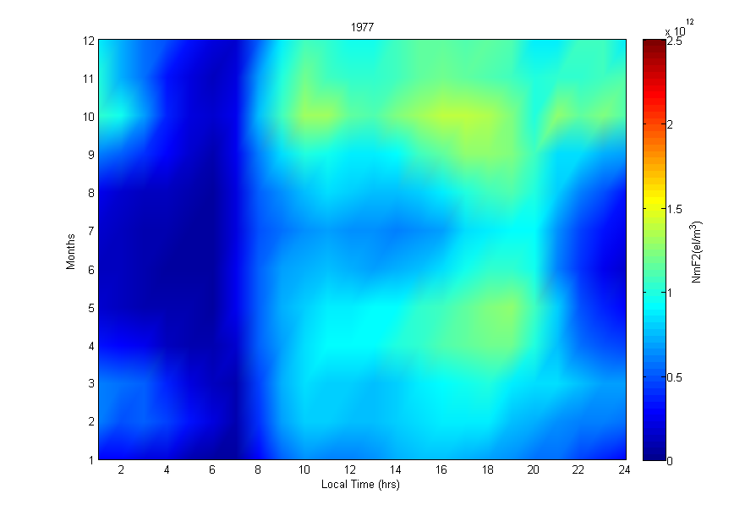
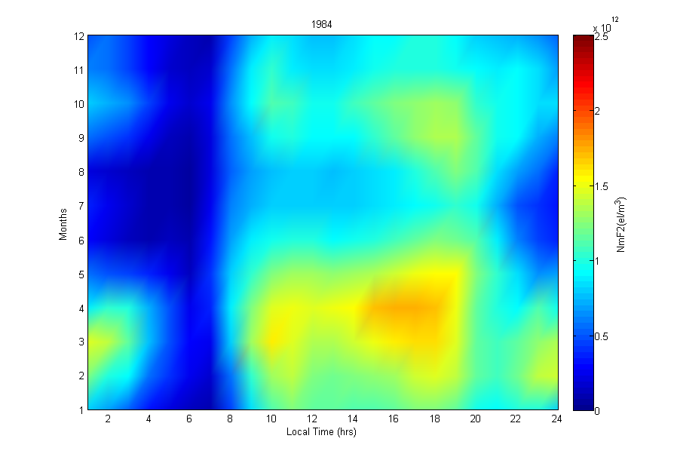
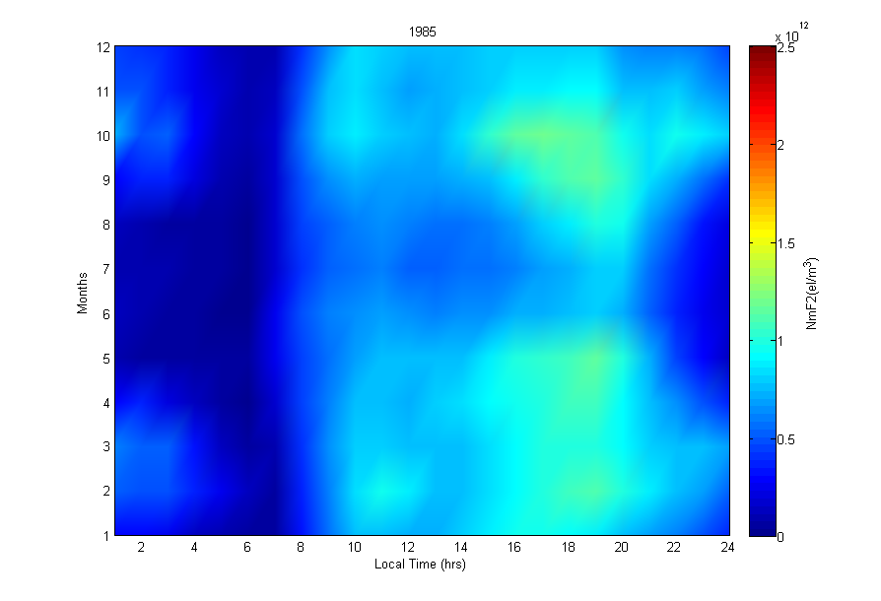
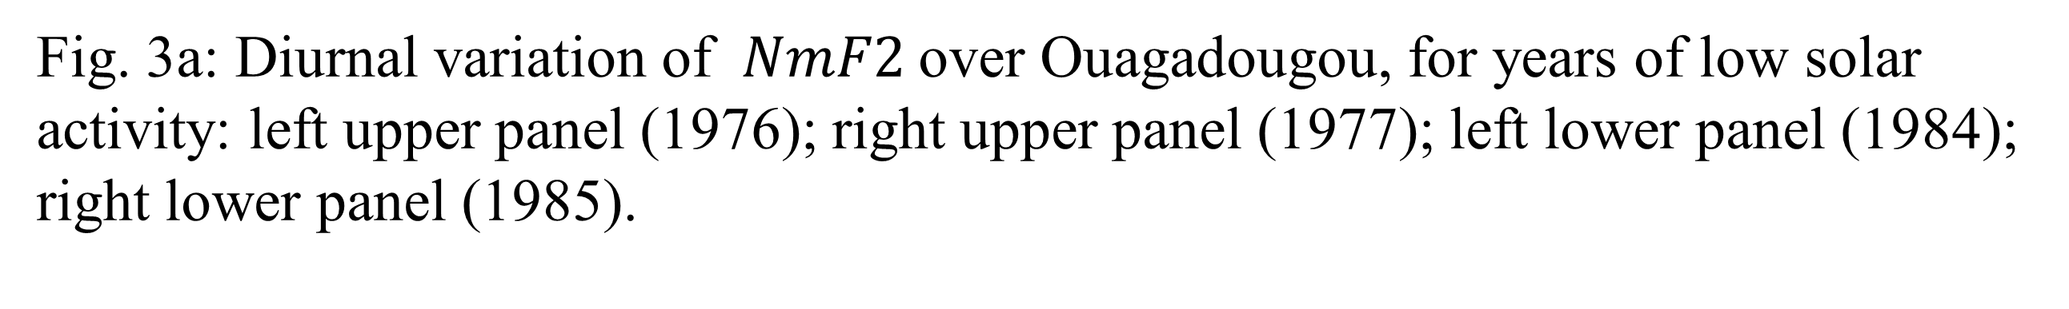
Fig. 3a: Diurnal variation of $NmF2$over Ouagadougou, for years of low solar activity: left upper panel (1976); right upper panel (1977); left lower panel (1984); right lower panel (1985).

Slide 11
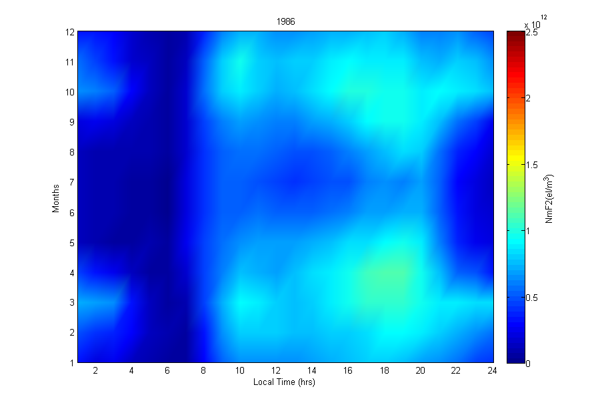
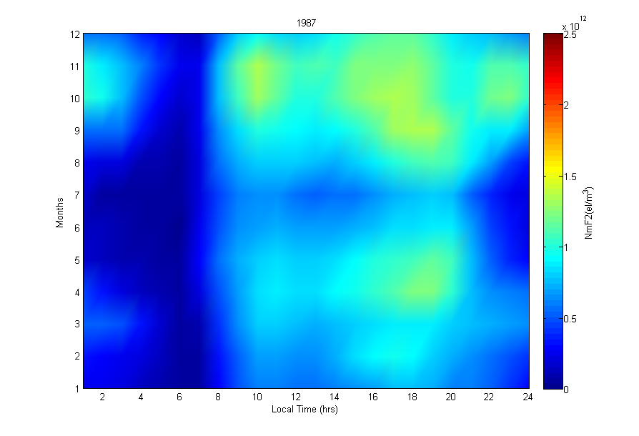
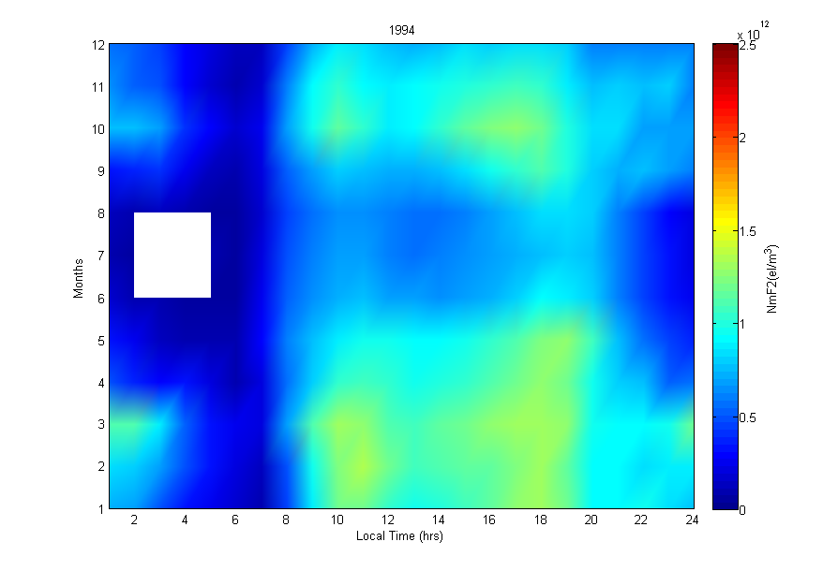
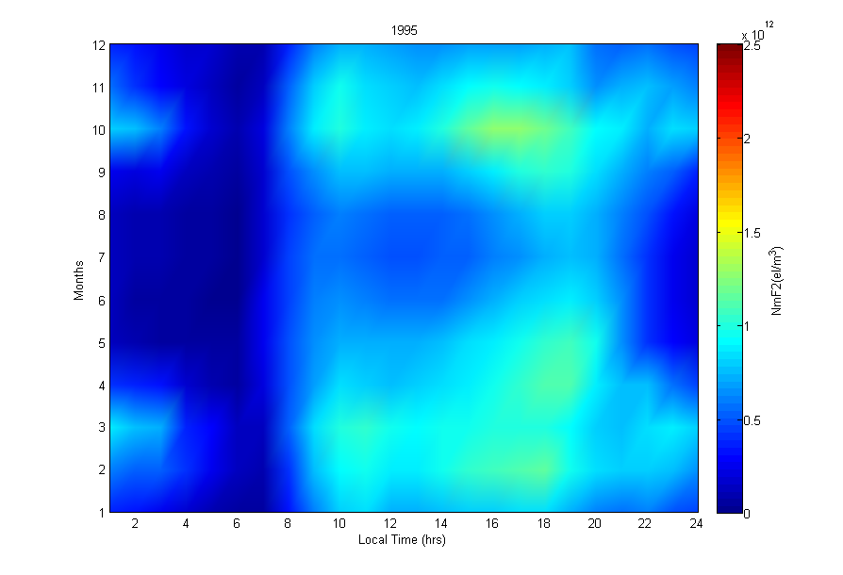
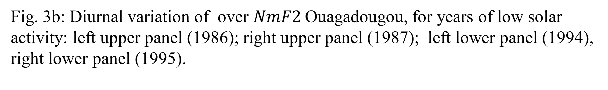
Fig. 3b: Diurnal variation of over $NmF2$Ouagadougou, for years of low solar activity: left upper panel (1986); right upper panel (1987); left lower panel (1994), right lower panel (1995).

Slide 12
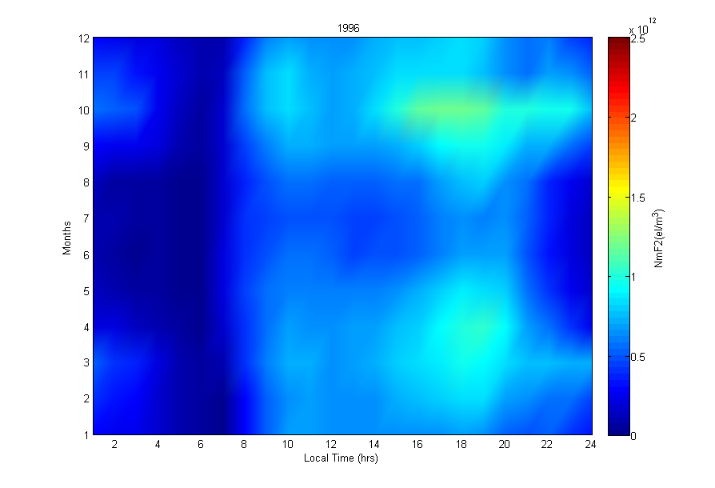
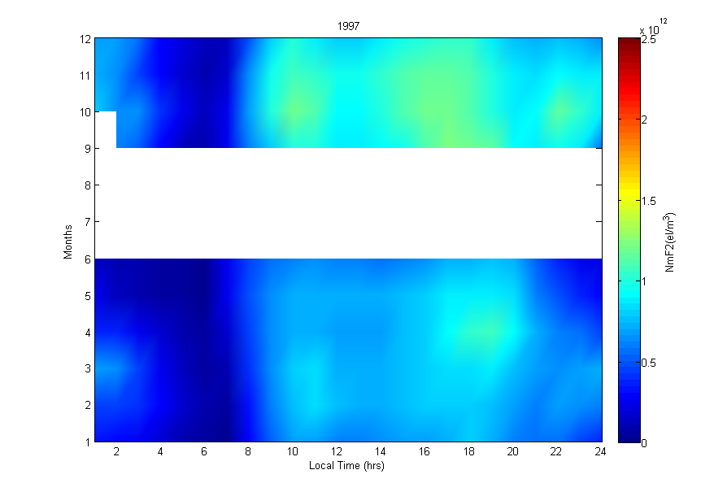
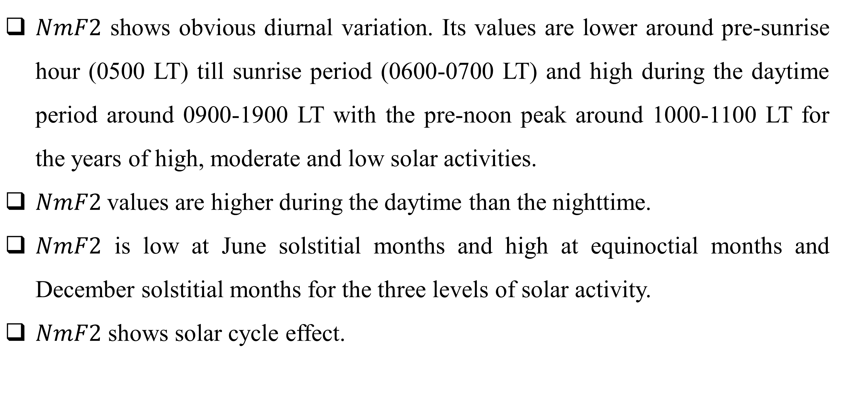
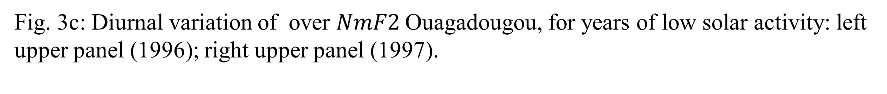
Fig. 3c: Diurnal variation of over $NmF2$Ouagadougou, for years of low solar activity: left upper panel (1996); right upper panel (1997).
$NmF2$ shows obvious diurnal variation. Its values are lower around pre-sunrise hour (0500 LT) till sunrise period (0600-0700 LT) and high during the daytime period around 0900-1900 LT with the pre-noon peak around 1000-1100 LT for the years of high, moderate and low solar activities.
$NmF2$values are higher during the daytime than the nighttime.
$NmF2$ is low at June solstitial months and high at equinoctial months and December solstitial months for the three levels of solar activity.
$NmF2$ shows solar cycle effect.

Slide 13
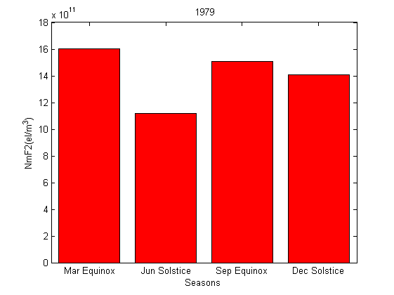
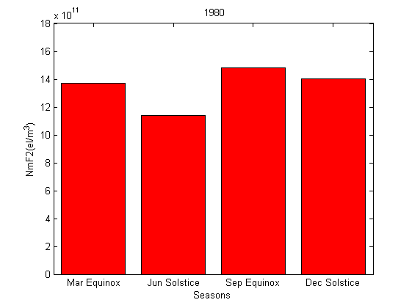
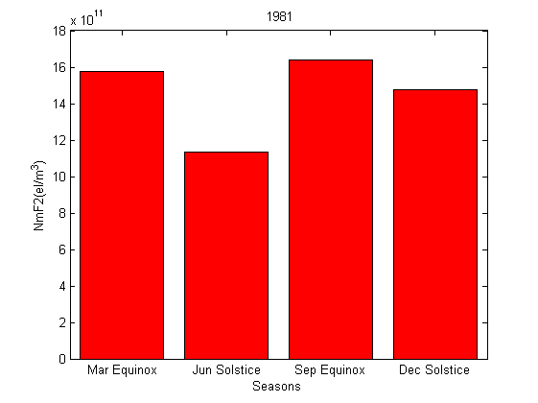
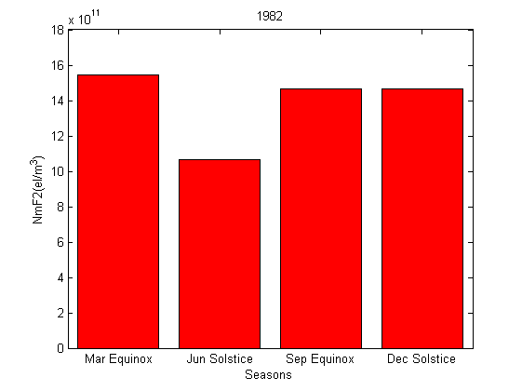
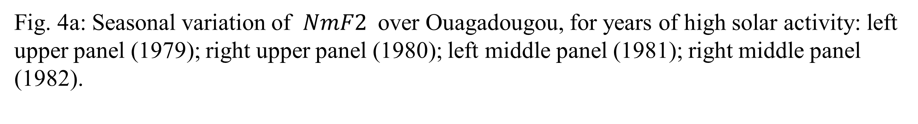
Results Contd.
Fig. 4a: Seasonal variation of $NmF2$ over Ouagadougou, for years of high solar activity: left upper panel (1979); right upper panel (1980); left middle panel (1981); right middle panel (1982).

Slide 14
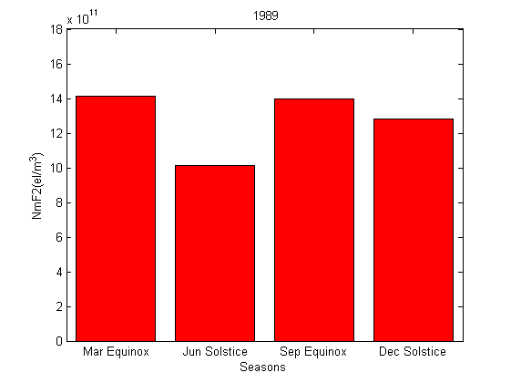

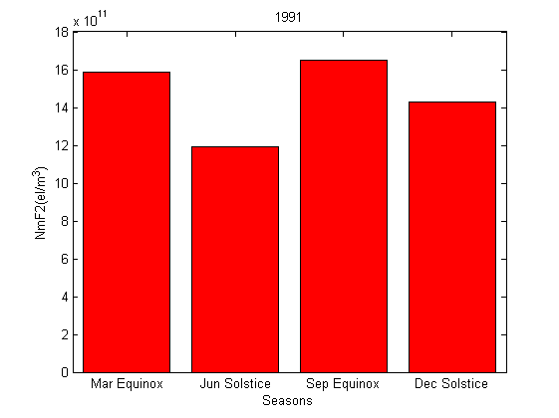
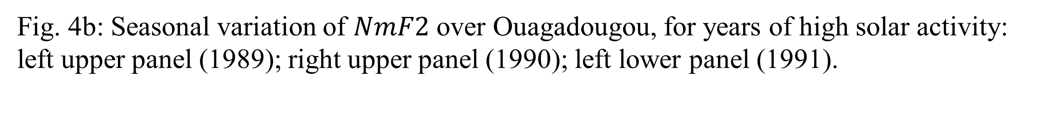
Fig. 4b: Seasonal variation of $NmF2$ over Ouagadougou, for years of high solar activity: left upper panel (1989); right upper panel (1990); left lower panel (1991).

Slide 15
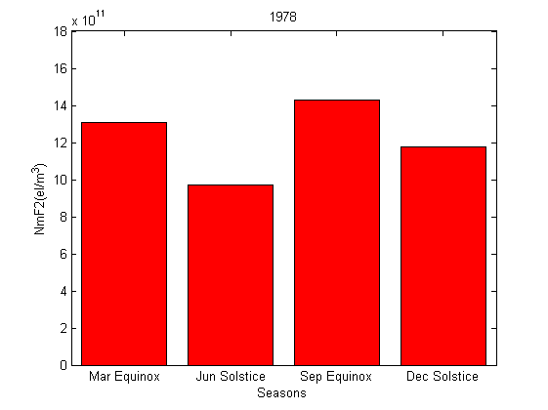
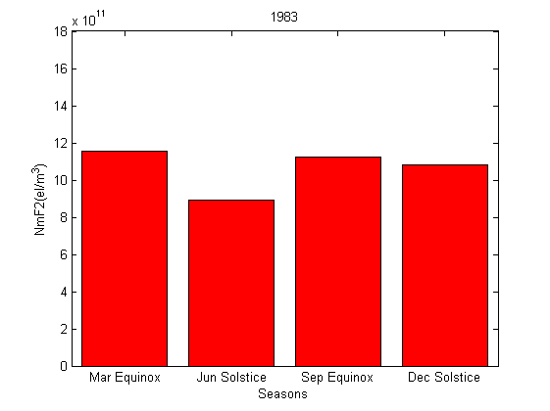
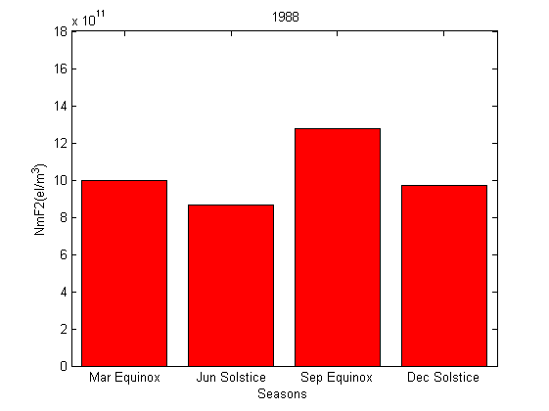
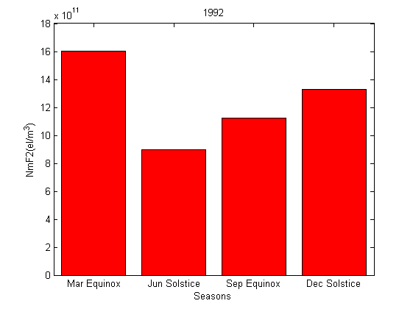
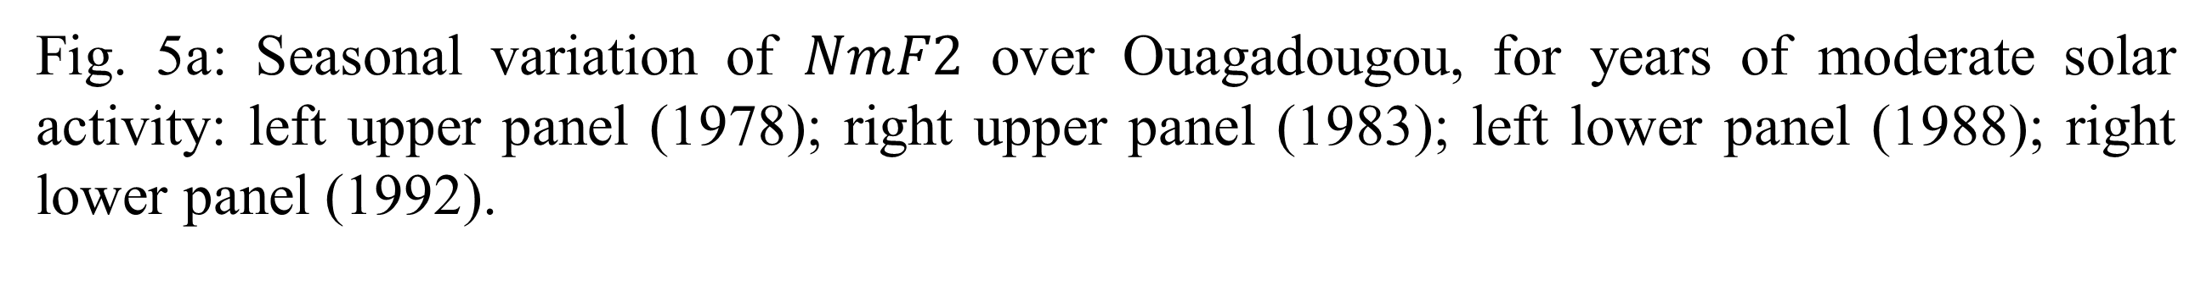
Fig. 5a: Seasonal variation of $NmF2$ over Ouagadougou, for years of moderate solar activity: left upper panel (1978); right upper panel (1983); left lower panel (1988); right lower panel (1992).

Slide 16
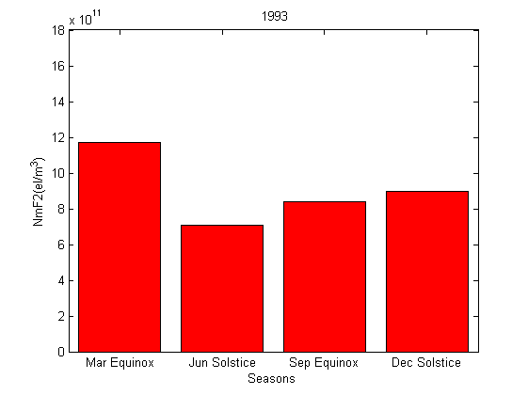
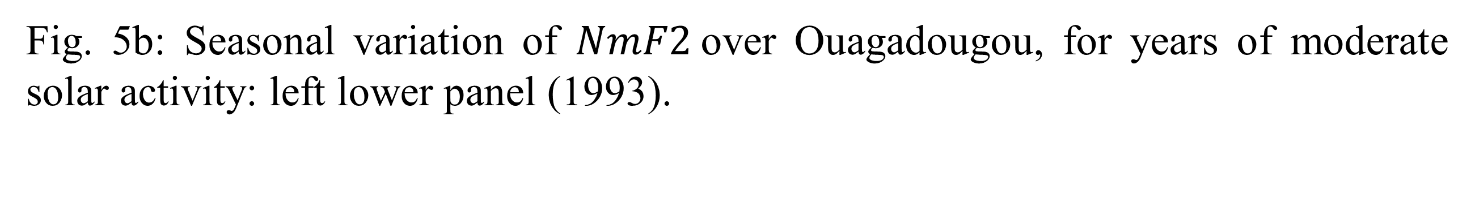
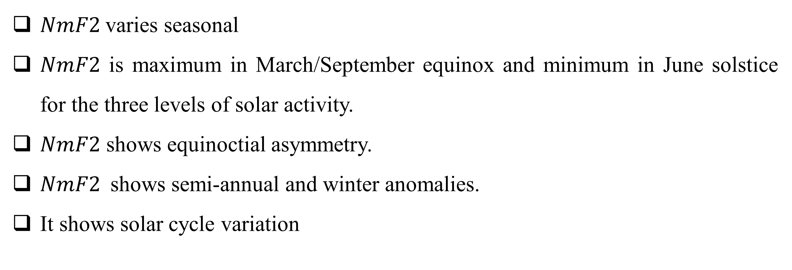
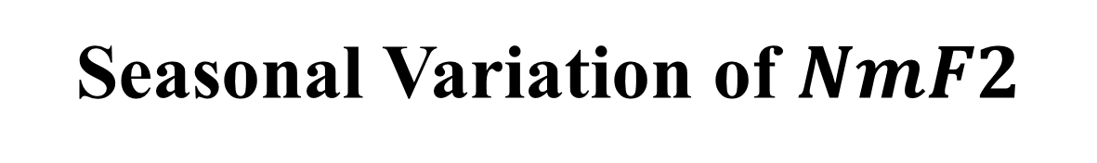
Fig. 5b: Seasonal variation of $NmF2$over Ouagadougou, for years of moderate solar activity: left lower panel (1993).
Seasonal Variation of $NmF2$
$NmF2$varies seasonal
$NmF2$ is maximum in March/September equinox and minimum in June solstice for the three levels of solar activity.
$NmF2$ shows equinoctial asymmetry.
$NmF2$shows semi-annual and winter anomalies.
It shows solar cycle variation

Slide 17
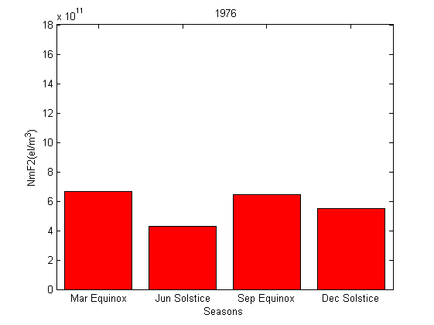




Result Contd.
Fig. 6a: Seasonal variation of $NmF2$over Ouagadougou, for years of low solar activity: left upper panel (1976); right upper panel (1977); left lower panel (1984); right lower panel (1985).

Slide 18





Fig. 6b: Seasonal variation of $NmF2$ over Ouagadougou, for years of low solar activity: left upper panel (1986); right upper panel (1987); left lower panel (1994); right lower panel (1995).

Slide 19


Fig. 6c: Seasonal variation of over Ouagadougou, for years of low solar activity: left panel (1986); right panel (1987).

Slide 20




Variation of $NmF2$ with Solar wind and geomagnetic activity indices
(a)
(b)
(d)
(c)
Fig. 7a: The scatter plot of annual average values for: (a) NmF2 versus Dst, (b) NmF2 versus Psw, (c) NmF2 versus Bz and (d) NmF2 versus IMF for the interval of 1976-1997.

Slide 21


(e)
Fig. 7b: The scatter plot of annual average values for: (e) NmF2 versus Vsw for the interval of 1976-1997.
Table 1: Correlation coefficient (R), coefficient of determination ($R^{2})$regression coefficients-(Intercept (a) and slope (b)) between NmF2 and geomagnetic and solar wind indices
Indices | $$R$$ | $$R^{2}$$ | a | b
Dst (nT) Psw (nPa) Bz (nT) IMF (nT) Vsw (km/s) | -0.621 -0.157 0.146 0.869 -0.078 | 0.385 0.025 0.021 0.755 0.006 | 2.355×10¹¹ 1.498×10¹² 1.029×10¹² -8.387×10¹¹ 1.456×10¹² | -4.361×10¹⁰ -1.682×10¹¹ 2.492×10¹¹ 2.693×10¹¹ -9.291×10⁸

Slide 22

Conclusion
$NmF2$shows both diurnal and seasonal variations.
$NmF2$shows solar cycle effect.
Electron densities are higher at years of high solar activity, followed by years of moderate solar activity and minimum at years of low solar activity.
$NmF2$shows winter/seasonal and semi-annual anomalies.
$NmF2$shows equinoctial asymmetry.
The results of the correlation analysis also indicate that $IMF$ and $Dst$ have major effects on the $NmF2$ of the equatorial ionosphere over Ouagadougou, an equatorial anomaly region.

Slide 23
Thanks for listening

